Slide 1
Исследование осцилляций нейтрино в ускорительных и реакторных экспериментах
А.Г.Ольшевский, ОИЯИ
Сессия-конференция «Физика фундаментальных взаимодействий»
17-21 февраля 2025
Особая благодарность коллегам: Людмиле Колупаевой и Максиму Гончару за помощь
в подборе материала, в частности, поддержку базы данных осцилляционных результатов
https://git.jinr.ru/nu/osc

Slide 2
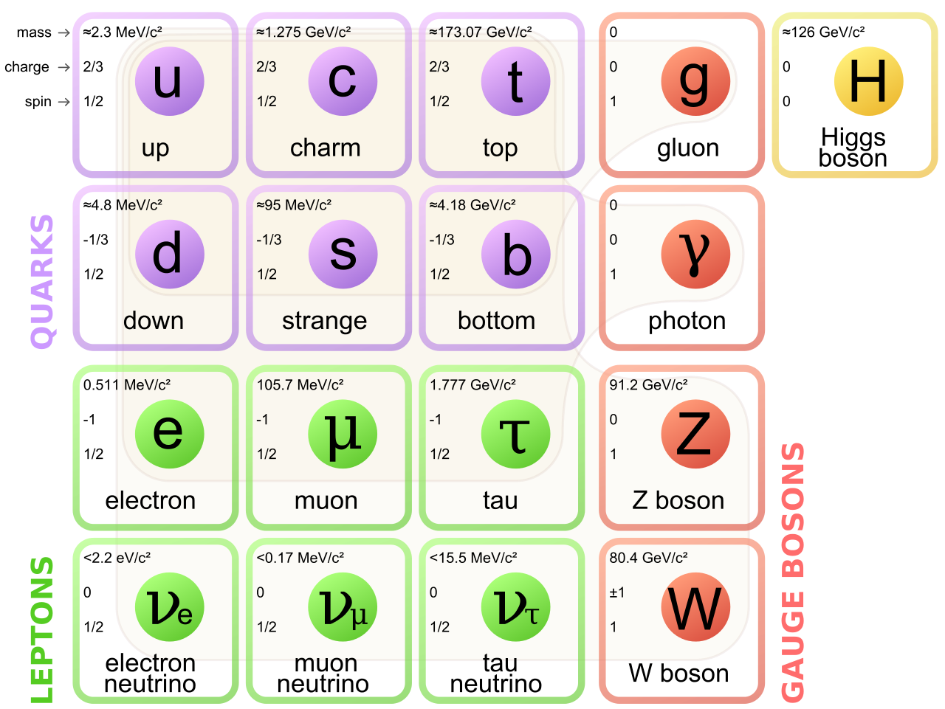
Neutrino physics
Standard Model particle.
Small but non zero mass.
Neutrino interactions conserve flavor.
Interact only via weak (and gravity) force.
Modern hot topics:
Study neutrino properties, incl. three-flavor oscillation parameters;
search for sterile neutrinos;
measurement of absolute neutrino masses,
search for neutrinoless double beta-decay (are neutrinos Dirac or Majorana particles);
detection of relic neutrinos;
detection of high energy astrophysical neutrinos and spotting their sources;
…

Slide 3
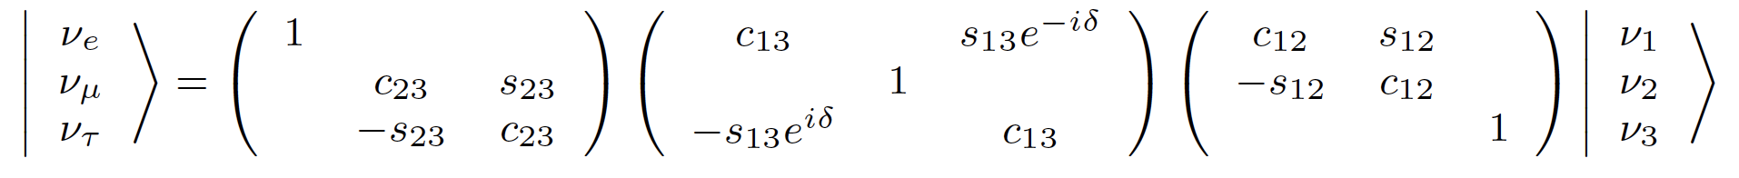
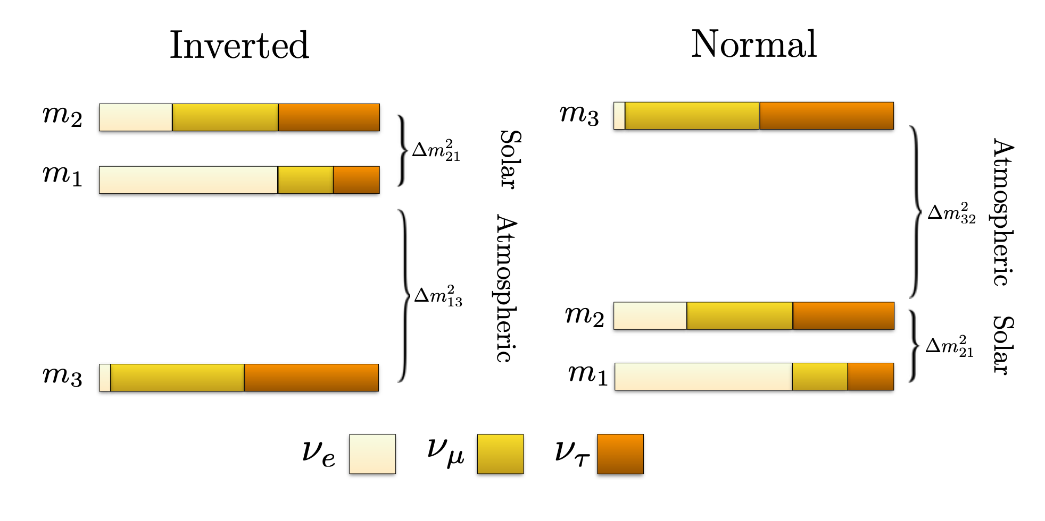








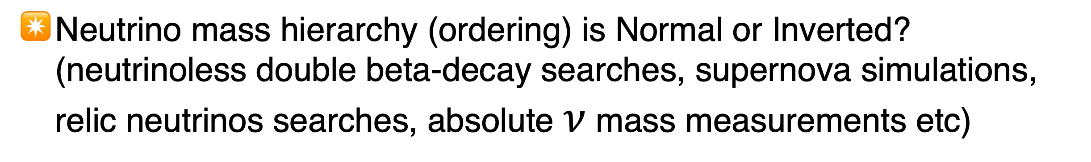
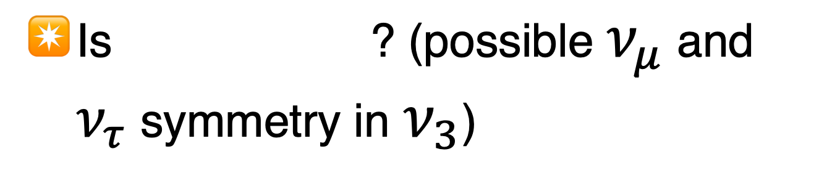
Neutrino oscillations and mixing
PMNS matrix
atmospheric
accelerator
short baseline reactor
accelerator
solar
long baseline reactor
Oscillation parameters and how
precisely do we know them:
Open questions:
Is ? (possible $ν_{μ}$ and $ν_{τ}$ symmetry in $ν_{3}$)
(4.4%)
(5.2%)
(3.8%)
Is there CP violation in lepton sector? (matter-antimatter asymmetry of the Universe (leptogenisis)
(2.2%)
(1.4%)
Neutrino mass hierarchy (ordering) is Normal or Inverted?
(neutrinoless double beta-decay searches, supernova simulations, relic neutrinos searches, absolute $ν$ mass measurements etc)
L

Slide 4
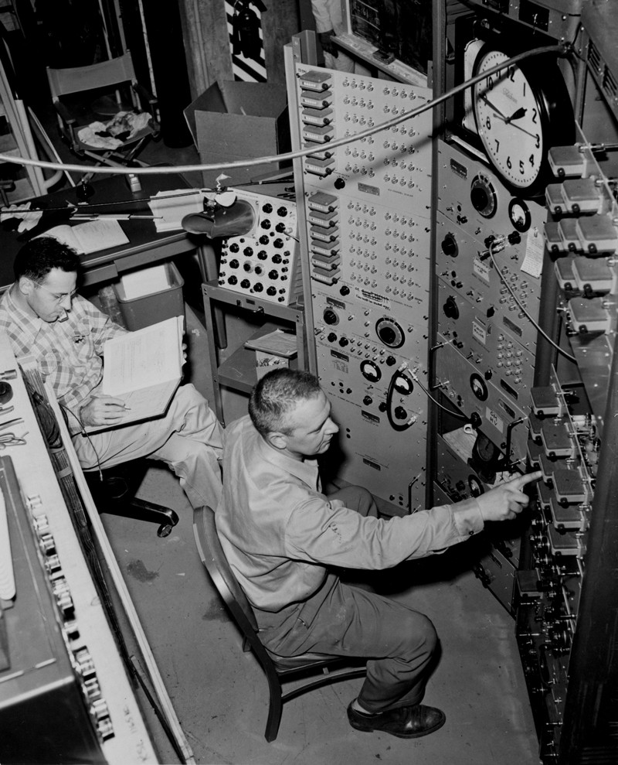


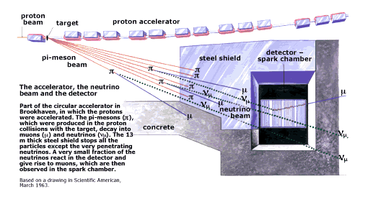
Reactor and Accelerator experiments
Both are artificial sources, very much deserved historically:
  Discovery of Neutrino
  by F.Reines and C.Cowan
  in the reactor Savannah River
  experiment in1956
  Detection of inverse beta-decay:
  Marked the beginning of experimental neutrino physics
  Discovery of the Muon Neutrino
  by L.Lederman, M.Schwartz and J.Steinberger
  at BNL accelerator in 1962 established neutrino
  flavor quantum number
  It is worth mentioning that in both cases there was
  contribution from Bruno Pontecorvo to those ideas

Slide 5
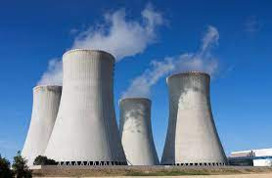
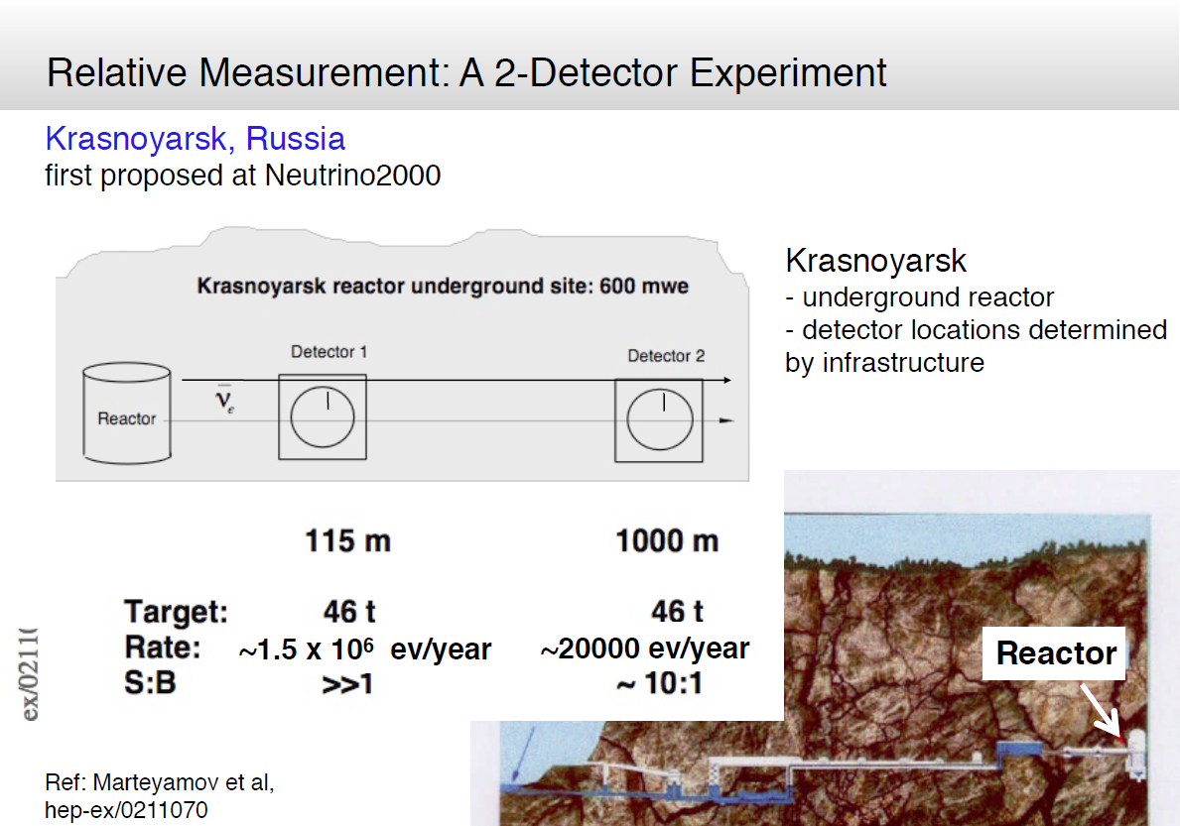
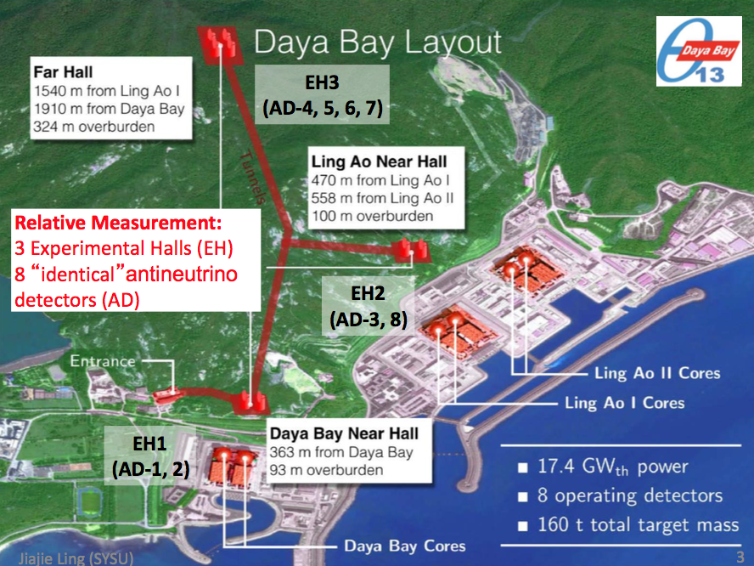
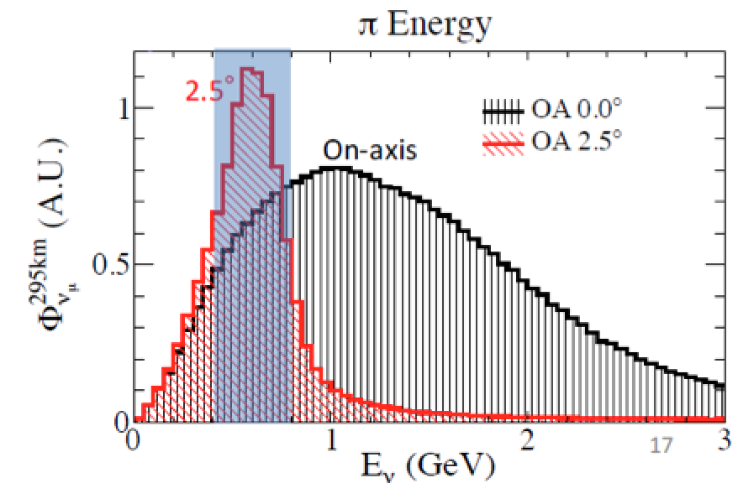
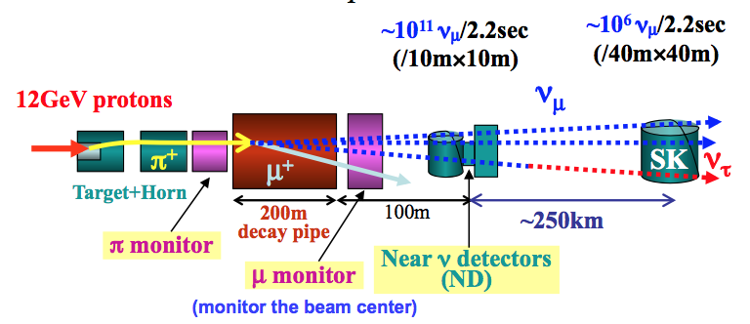
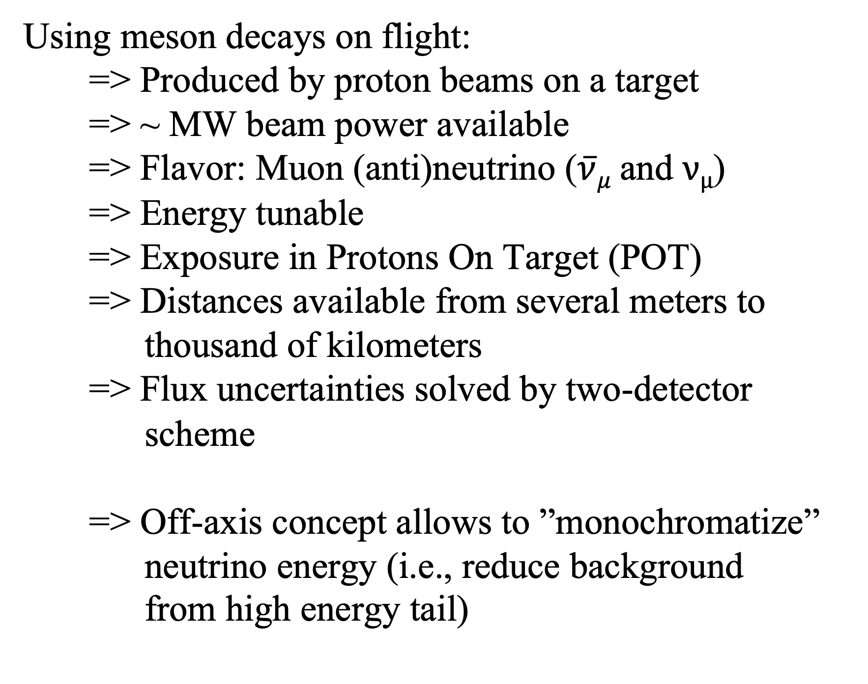
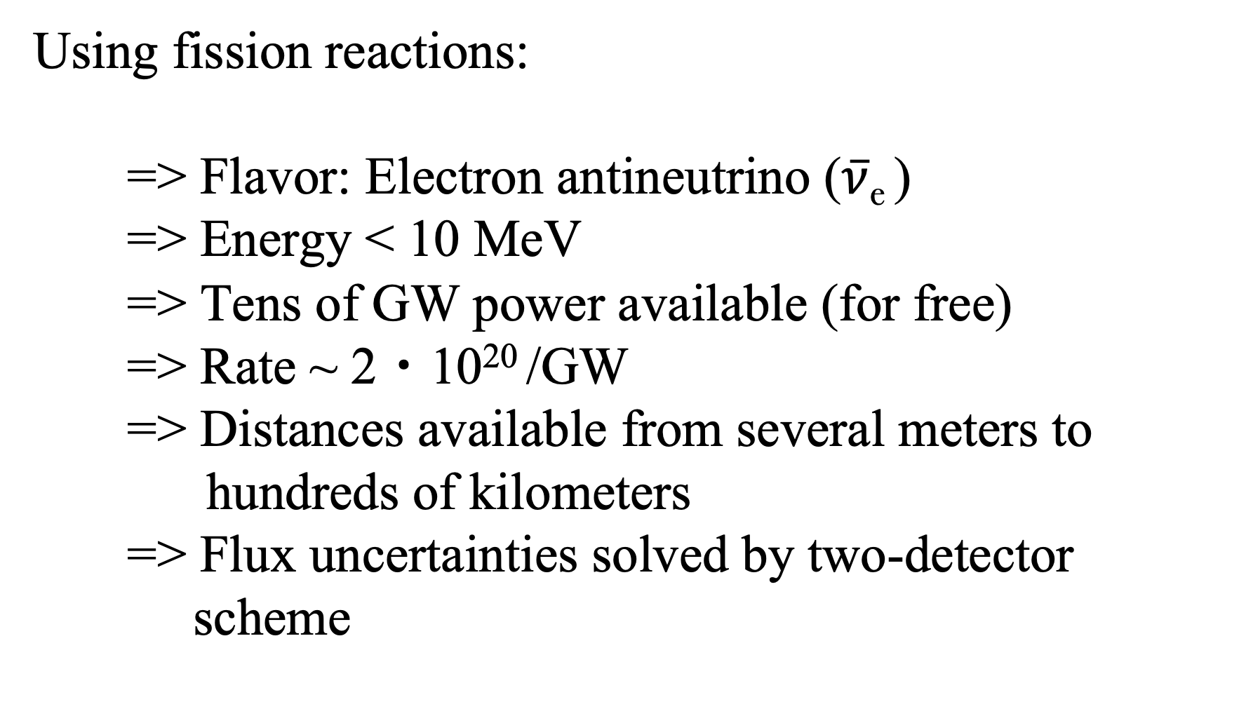
Reactor experiments
Accelerator experiments
Using meson decays on flight:
=> Produced by proton beams on a target
=> ~ MW beam power available
=> Flavor: Muon (anti)neutrino ($\overline{ν}μ \text{and} νμ\text{)}$
=> Energy tunable
=> Exposure in Protons On Target (POT)
=> Distances available from several meters to thousand of kilometers
=> Flux uncertainties solved by two-detector scheme
=> Off-axis concept allows to ”monochromatize” neutrino energy (i.e., reduce background
from high energy tail)
Using fission reactions:
=> Flavor: Electron antineutrino ($\overline{ν}$_{e} )
  => Energy < 10 MeV
=> Tens of GW power available (for free)
=> Rate ~ 2・10²⁰ /GW
=> Distances available from several meters to hundreds of kilometers
=> Flux uncertainties solved by two-detector scheme

Slide 6
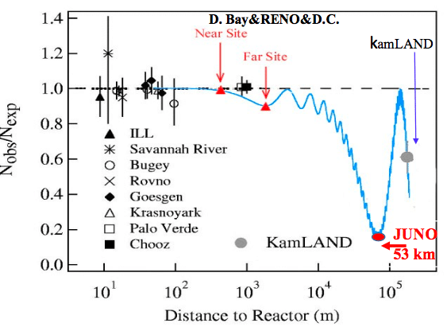

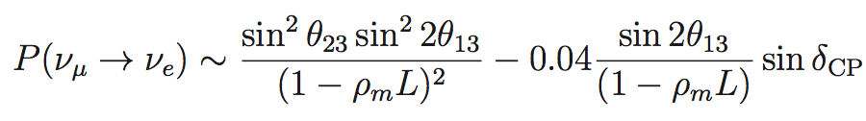
Reactor experiments
Depending on baseline can measure:
short baseline (5 - 30 m) - search for sterile neutrinos and measurement of ∆m²₄₁ and sin²2θ₁₄
medium baseline (1 - 2 km) - measurement of sin²2θ₁₃ and ∆m²₃₂
long baseline (>10 km) - measurement of ∆m²₃₂ , neutrino mass ordering, ∆m²₂₁, sin²2θ₁₂ , and sin²2θ₁₃ (with less precision than medium baseline experiments)
Reminder of the first non-zero θ₁₃ reactor measurements:
Daya Bay (March 2012, 5.2σ) Phys.Rev.Lett. 108 (2012) 171803
RENO (April 2012, 4.9σ) Phys.Rev.Lett. 108 (2012) 191802
Double Chooz far detector (Nov. 2011, 94.6% C.L.) Phys.Rev.Lett. 108 (2012) 131801
Also hints from T2K and global fits for non-zero θ_{13.}
This allowed measuring leptonic δ_{CP} via oscillations:
Precise measurement of sin²2θ₁₃ and ∆m²₃₂ plays utmost important role:
Disappearance experiments to measure ν ̄_{e} survival probabilities:
No ambiguity, independent of matter effect (at this baseline) and δ_{CP}
Place two detectors for a relative measurement, <1% systematics, big statistics

Slide 7
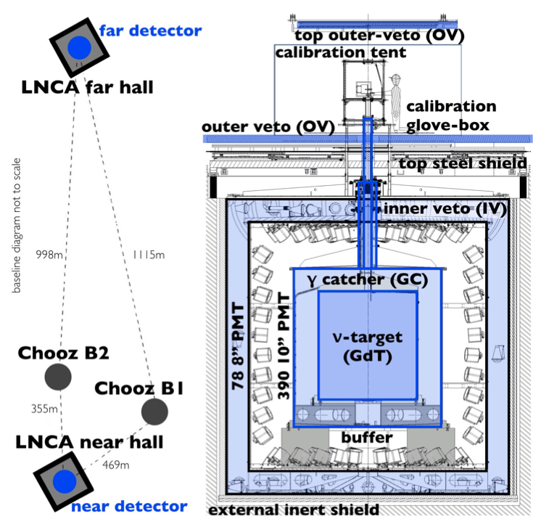
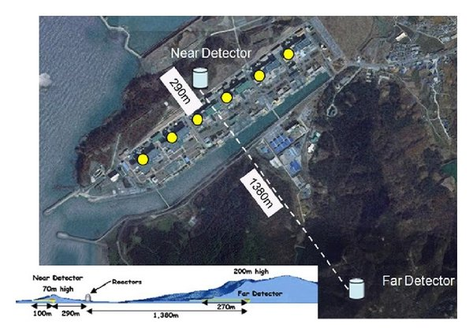
Reactor experiments measuring θ₁₃ :
Double Chooz
Reno
Daya Bay
Double Chooz Apr. 2011 to Dec. 2017, ∼1350 days
RENO Aug. 2011 to Mar. 2023, ∼3800 days
Daya Bay, Dec. 2011 to Dec. 2020, 3158 days
All captures (nGd + nH + nC), full dataset
Neutrino 2020 results (new analysis in progress):
sin²2θ₁₃ = 0.102 ± 0.004(stat.) ± 0.011(syst.)
(precision 11.8%)
nGd, full dataset
Neutrino 2024
sin²2θ₁₃ = 0.0920 ± 0.0044(stat.) ± 0.0041(syst.) (precision 6.5%)
nH, ∼2800 days
New results at Neutrino 2024:
sin²2θ₁₃ = 0.082 ± 0.007(stat.) ± 0.011(syst) (precision 15.9%)
nGd, full dataset
PhysRevLett. 130 161802
sin²2θ₁₃ = 0.0851 ± 0.0024
(precision 2.8%)
nH, ∼1958 days
sin²2θ₁₃ = 0.0759 ± 0.005
(precision 5.3%)

Slide 8

Reactor experiments measuring θ₁₃ and $∆$m²₃₂:

Slide 9
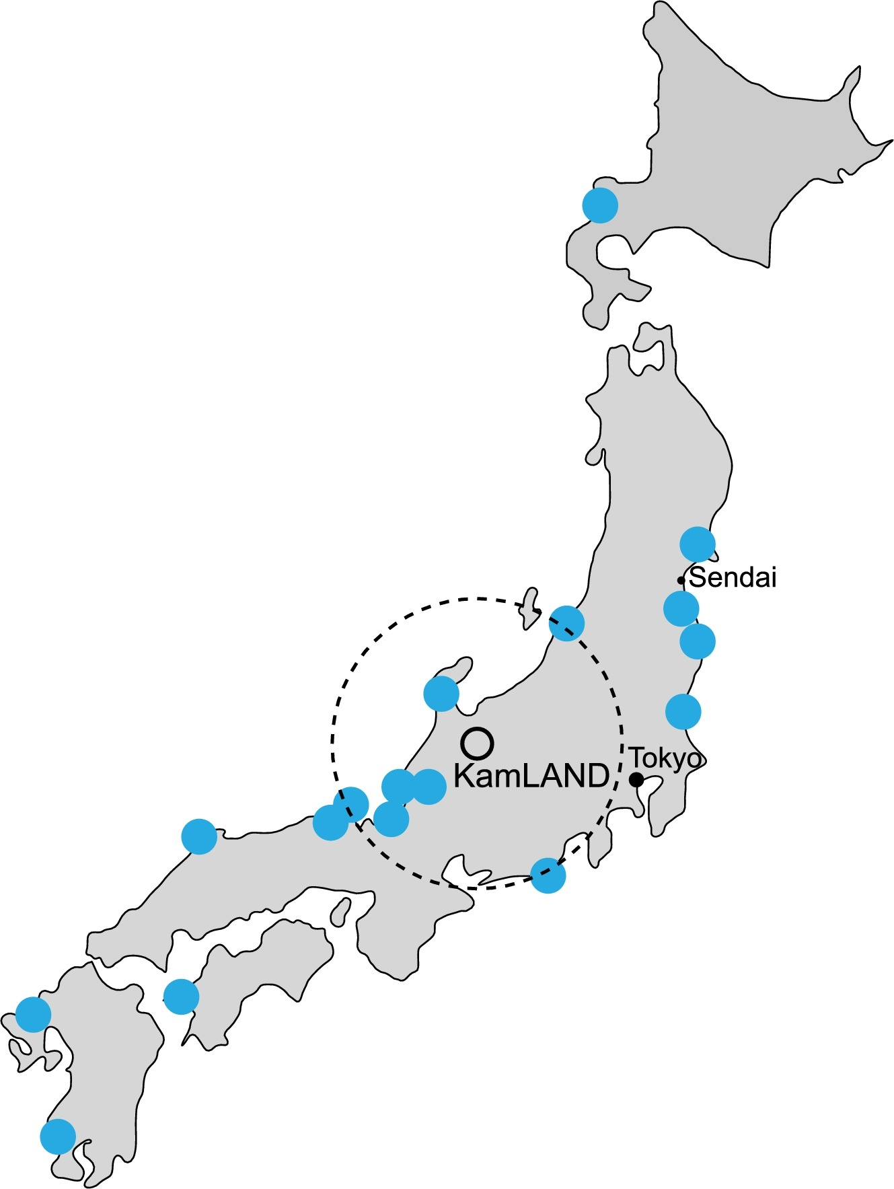
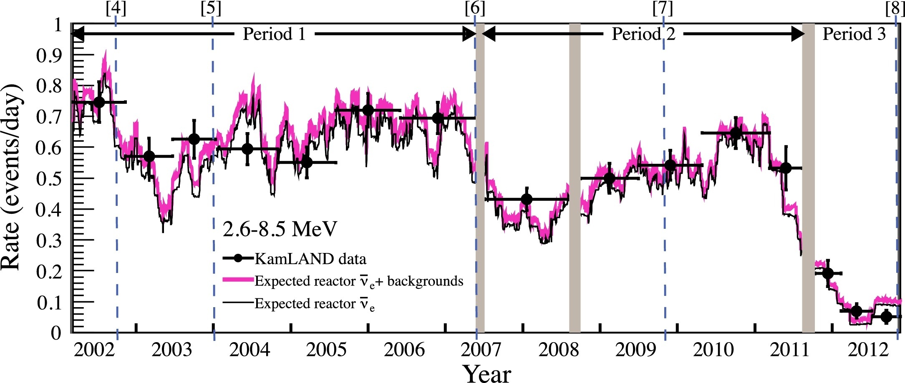
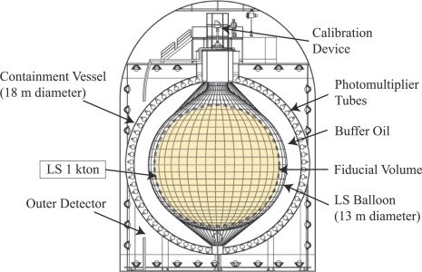
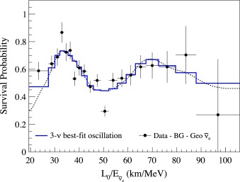
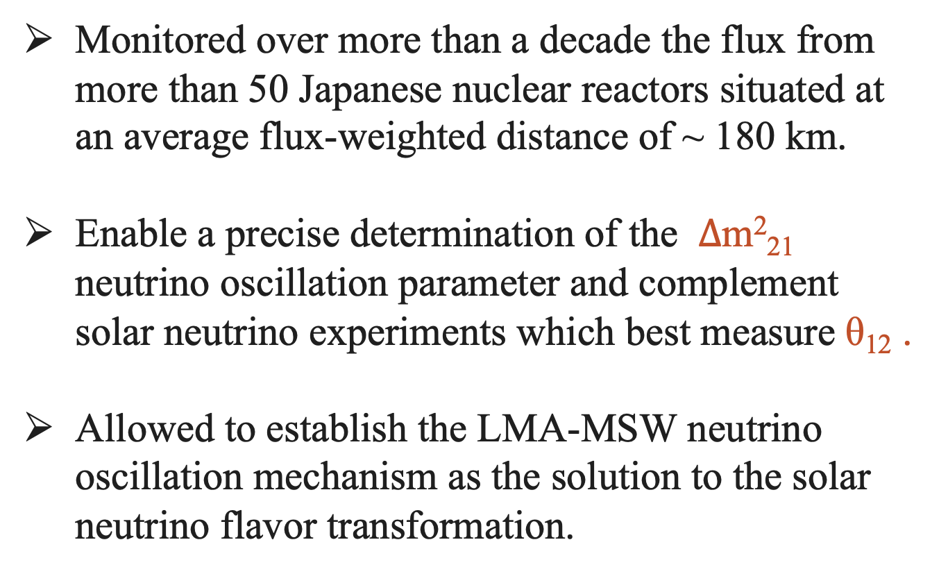
KAMLAND experiment
1 kton LS detector in the mine with ~2700 m water-equivalent
Monitored over more than a decade the flux from more than 50 Japanese nuclear reactors situated at an average flux-weighted distance of ~ 180 km.
Enable a precise determination of the $∆$m²₂₁ neutrino oscillation parameter and complement solar neutrino experiments which best measure θ₁₂ .
Allowed to establish the LMA-MSW neutrino oscillation mechanism as the solution to the solar neutrino flavor transformation.

Slide 10
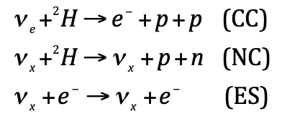
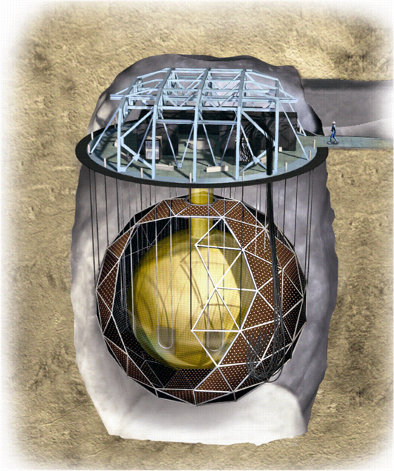
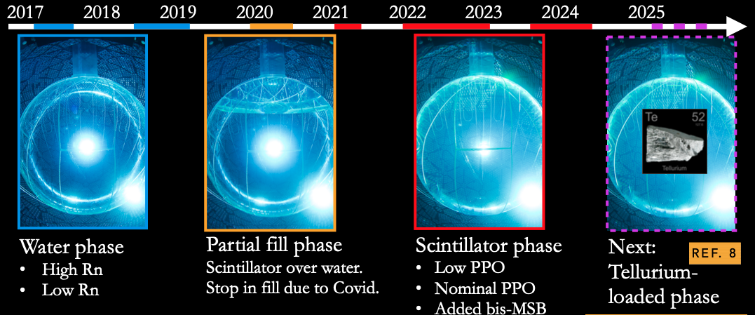
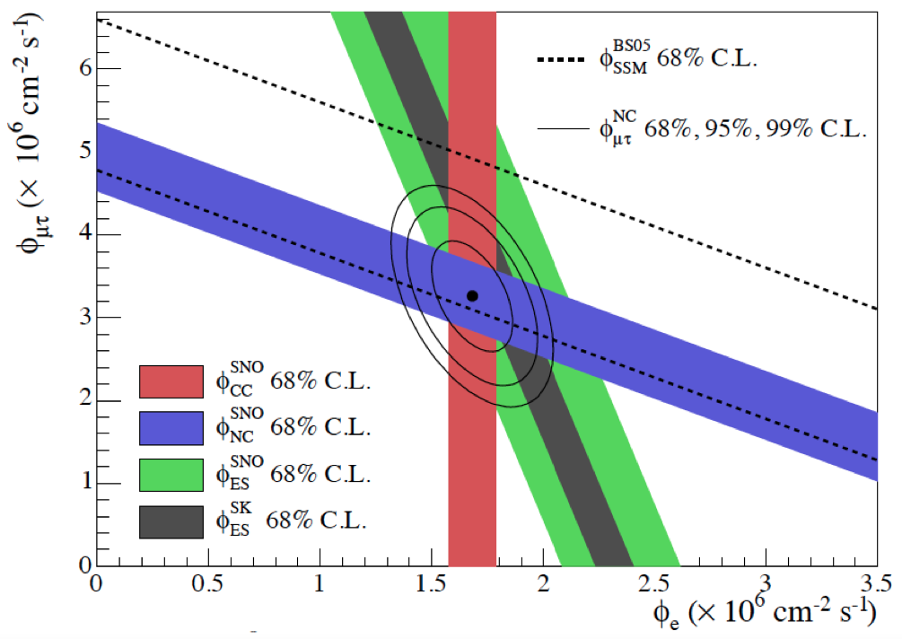
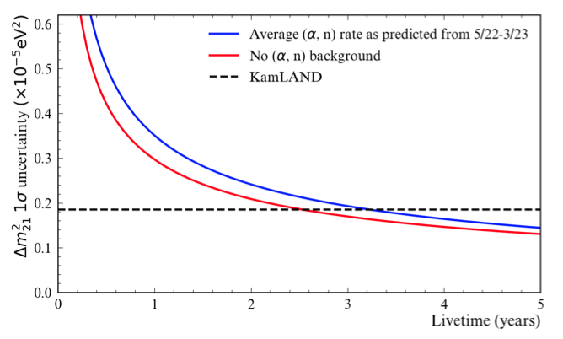
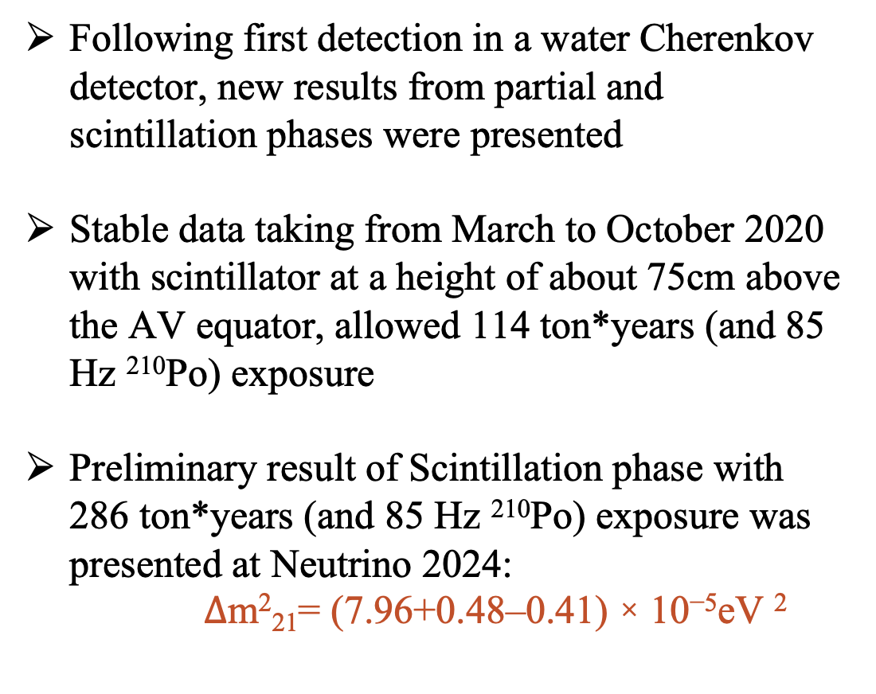
SNO+ Experiment
1 kton D₂O Cherenkov detector at ~6000 mwe
LS loading and ν ̄_{e} flux detection from 3 CANDU reactors at distances
of 240, 340, 350 km (60%) and ~ 100 cores in the USA (40%)
Following first detection in a water Cherenkov detector, new results from partial and scintillation phases were presented
Stable data taking from March to October 2020 with scintillator at a height of about 75cm above the AV equator, allowed 114 ton*years (and 85 Hz ²¹⁰Po) exposure
Preliminary result of Scintillation phase with 286 ton*years (and 85 Hz ²¹⁰Po) exposure was presented at Neutrino 2024:
$∆$m²₂₁= (7.96+0.48–0.41) × 10⁻⁵eV ²

Slide 11
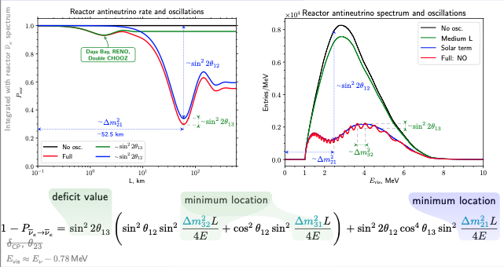
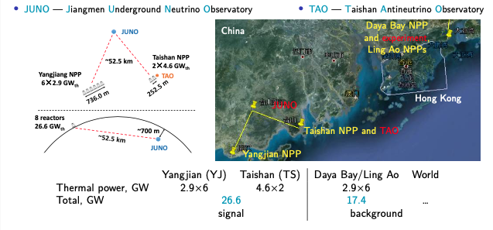
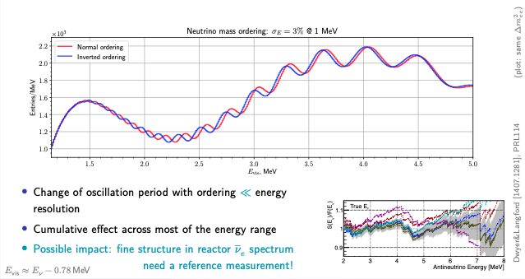
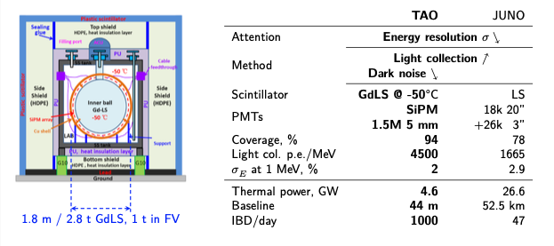
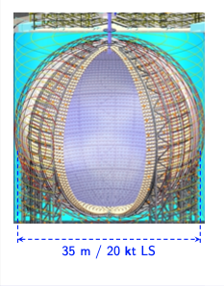
NMO measurement at reactors
JUNO/TAO
High statistics (power)
Optimized baseline
Unique energy resolution
Significant overburden
Radiopure materials
Reactor spectrum measurement

Slide 12
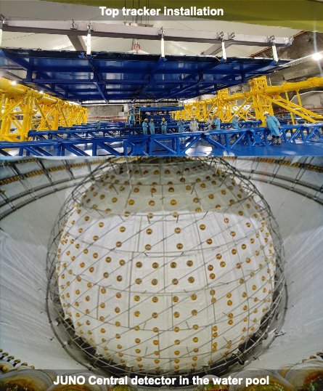
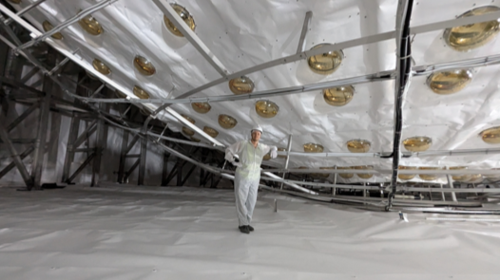
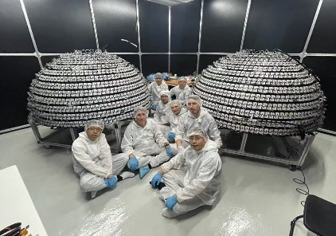
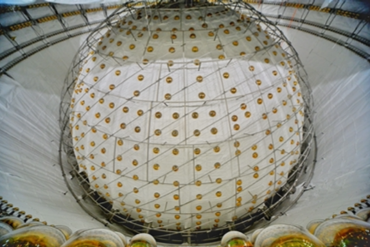
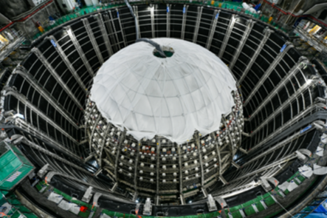
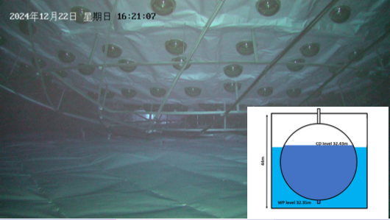
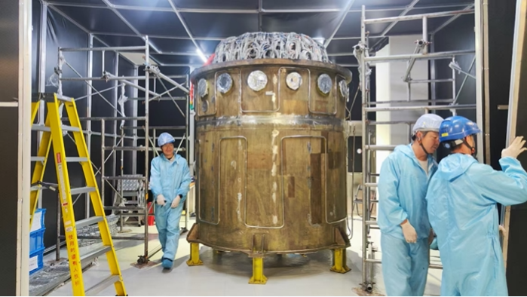

JUNO status
TAO status
• JUNO filling goes full speed and will finish by Sep 2025
• Part of the detector already in operation
• First physics results in early 2026

Slide 13
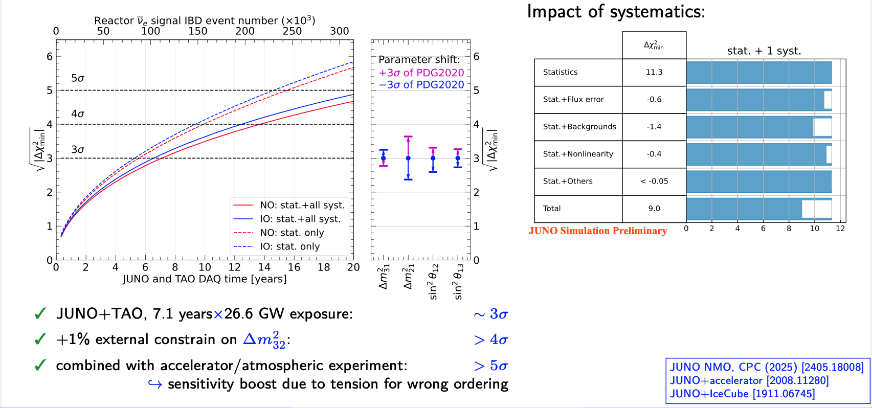
Sensitivity to Neutrino Mass Ordering

Slide 14
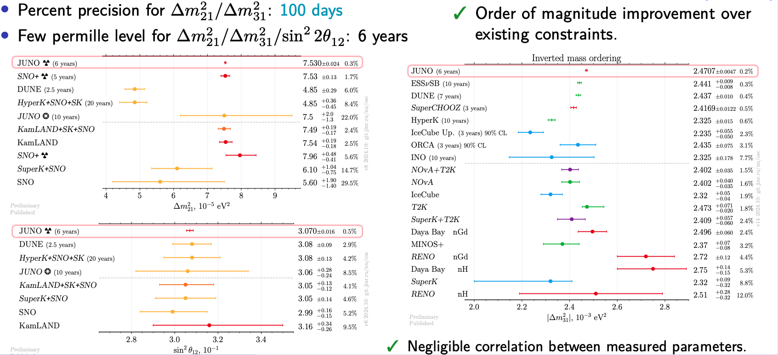
JUNO and neutrino oscillation parameters
+ many other subjects: sterile, supernova, light dark matter, solar, geo, atmospheric, etc.

Slide 15
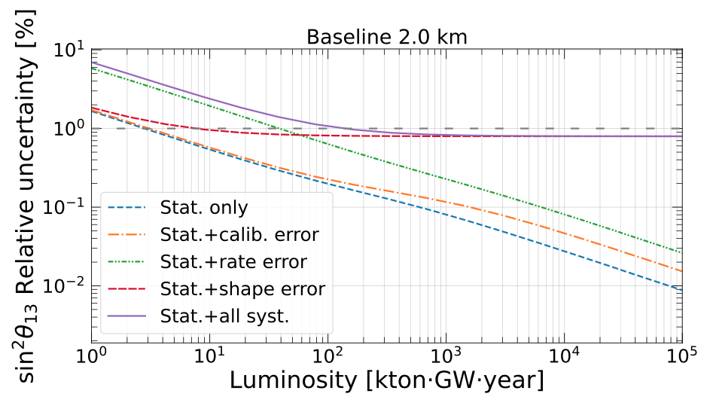
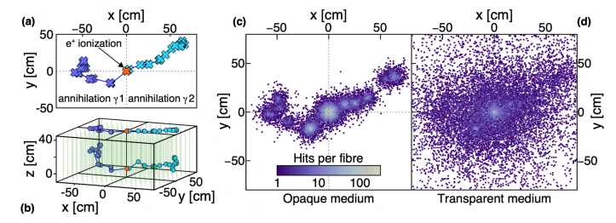
Future reactor experiments and their sensitivities
Motivation: sub-percent precision on θ₁₃ can be helpful in unitarity test of PMNS, which in turn is important for
various research fields, including particle physics, astrophysics, and cosmology.
Two interesting proposals exist:
            the statistics, the baseline, and the control of the spectral shape uncertainty were studied numerically in JHEP03(2023)072 and it was shown that a single detector with an exposure of about 150ktons·GW·year (~4kton·4years·9.2GW(Taishan)) at optimal 2.0 km baseline can provide sub-percent measurement of θ₁₃
            SuperCHOOZ experiment proposal at Chooz-B reactors with 8.4GW thermal power is expected to provide 0.5% precision on sin²2θ₁₃
            Near (5 tons, baseline ~30 m, overburden ~5 m, rate ~30 M/year) and
            Far (10 ktons, baseline ~1km , overburden ~300 mwe, ~20 M/year)
            both will be using LiquidO detector technique: opaque scintillator and a
            lattice of 1 cm pitch optical fibers readout by SiPM with high quantum
            efficiency (50%) and good time resolution (100ps)

Slide 16
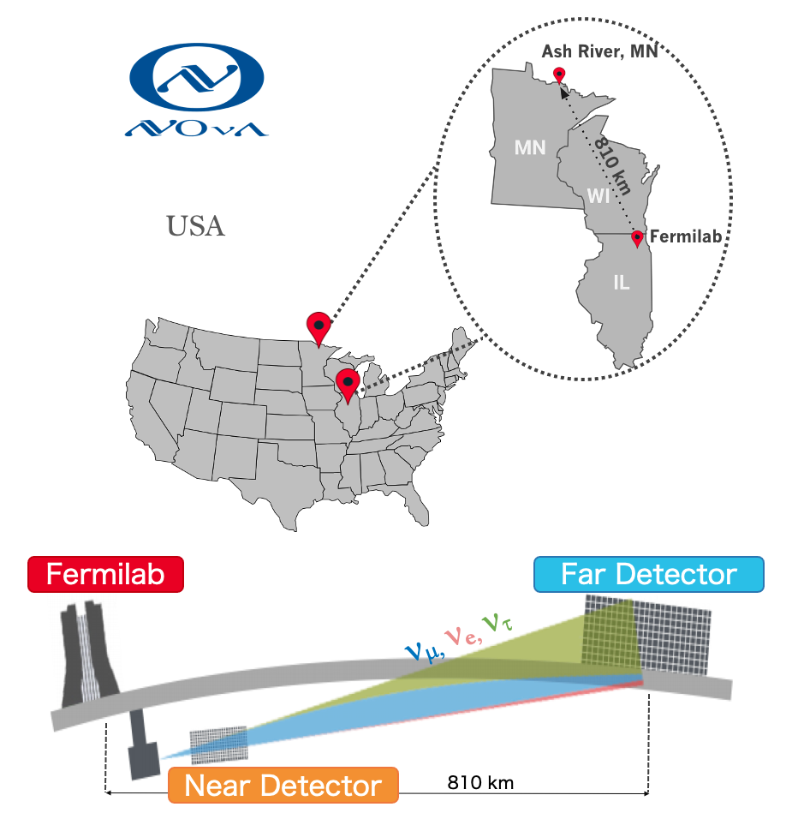
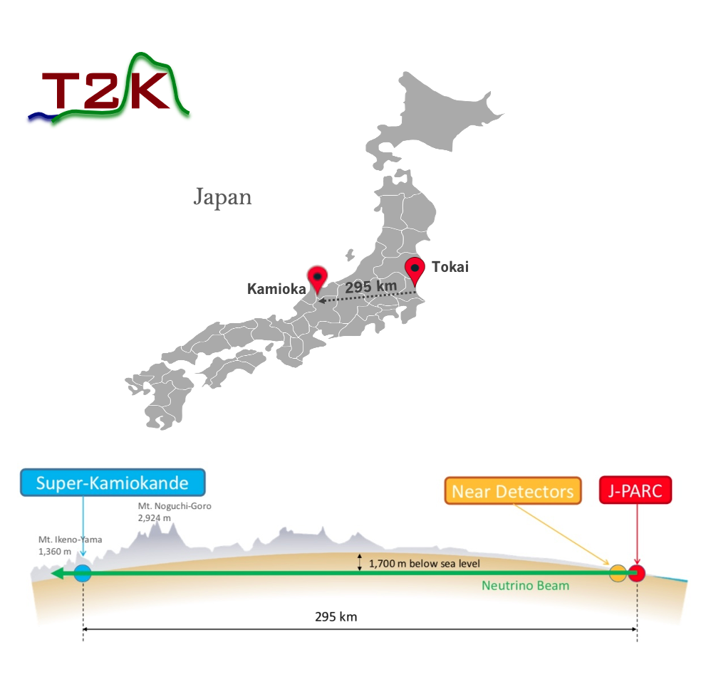
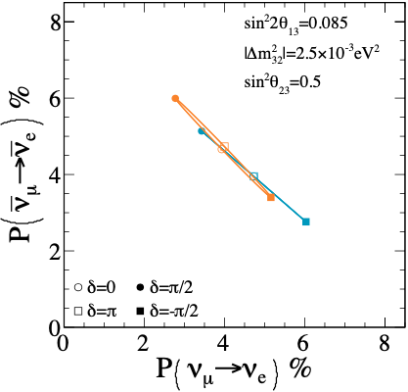
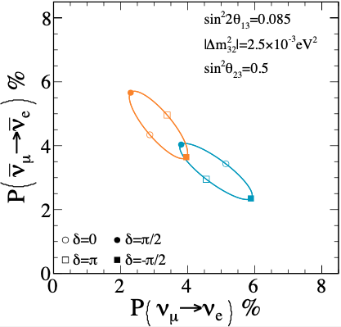
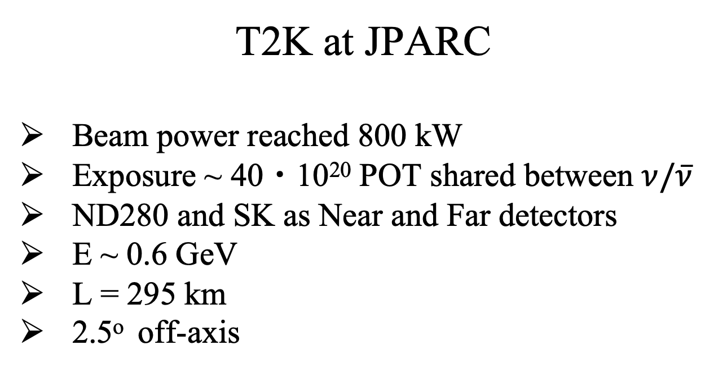

Accelerator long baseline experiments
  Allows control of beam characteristics to emphasize sensitivity
  Focused and intense beam with timing information to reduce backgrounds
  Exposure measured in Protons On Target (POT) and beam power of ~ MW
  Can choose energy to work with and switch between neutrinos and antineutrinos
  Distances available from several meters to thousand of kilometers
  Flux uncertainties solved by two-detector scheme
  Additional physics at near detectors
NOvA at Fermilab
Typically run at ~900 kW (record 1018 kW)
Exposure ~ 40・10²⁰ POT shared between $ν/\overline{ν}$
Technologically identical Near and Far detectors
E ~ 2 GeV
L = 810 km
14 mrad off-axis
T2K at JPARC
Beam power reached 800 kW
Exposure ~ 40・10²⁰ POT shared between $ν/\overline{ν}$
ND280 and SK as Near and Far detectors
E ~ 0.6 GeV
L = 295 km
2.5º off-axis
T2K
NOvA

Slide 17

Phys. Rev D 106, 032004 (2022) (Frequentist)
and arXiv:2311.07835 (Bayesian)

Slide 18

Eur. Phys. J. C (2023) 83:782 (2023)

Slide 19



Slide 20

NOvA + T2K
Based on latest published analyses
Full-fledged joint fit produced by both collaborations:
  unique effort for neutrino physics
  use complementary features of both experiments
Full implementation of:
  energy reconstruction and detector response
  detailed likelihood from each experiment
  consistent statistical inference across the full dimensionality
In-depth review of:
  models, systematic uncertainties and possible correlations
  different analysis approaches driven by contrasting detector designs
  As a by-product: cross-check and review of each other analyses
  Results:
  More precise measurement of oscillation parameters compared to individual results
  Stronger constraint on $∆m_{32}^{2}$ (for the first time was better than 2.0%)
  Disfavor CP conservation in Inverted neutrino mass ordering at >3$σ$
  Firm foundation for future NOvA+T2K analyses
Common publication is prepared

Slide 21



NOvA results
Recent 2024 results
T2K results
Recent 2024 results
NOvA’s first large update since 2020
  Doubled neutrino-mode dataset with 10 years of neutrino & antineutrino data (26.61×10²⁰ POT neutrino + 12.5×10²⁰ POT antineutrino)
  World’s largest accelerator $ν$ sample
  Various remarkable updates to the analysis procedures (larger analysis phase space, improved simulation and systematics)
  As a result:
  Most precise single-experiment measurement of $Δm_{32}^{2}$ (1.5%).
  Results are consistent with previous analysis.
  Data favors region where matter, CP violation effects are degenerate.
  Reactor constraint on $Δm_{32}^{2}$ enhances Normal Ordering preference.
Improved SK detector systematics evaluation
  Neutrino-mode dataset (+10%), first data after Gd loading to SK (0.01%) (21.4×10²⁰ POT neutrino + 16.4×10²⁰ POT antineutrino)
  Same ND280 analysis and neutrino interaction model
  Improved SK detector systematics evaluation
As a result:
  Small improvements in the precision of results, which are consistent with previous analysis.
  δ_{CP} = −2.08+1.33-0.61, CP conservation is excluded with 90% CL
  IO slightly disfavored (1.69σ)
  Weak preference of upper octant for θ₂₃ , compatible with maximal mixing
  |∆m²₃₂ | = 2.521+0.037-0.050 × 10⁻²eV² (1.7%)

Slide 22







Slide 23



Future accelerator experiments:
ESSnuSB
Proposed addition to the ESS project (neutron facility)
Extremely high power (5 MW) 2 GeV proton beam
Neutrino beam energy in the range 200-600 MeV
ND/FD setup tuned to measure CPV precisely

Slide 24






Future accelerator experiments:
THEIA
P2O
Additional detector at the location of DUNE
Complements DUNE measurement by different technique
Simultaneous WC and LS detector combines advantages:
Large mass, direction reconstruction, low cost & high light yield, low threshold
R&D on Water based Liquid Scintillator detector and fast high-efficiency photon detection
Neutrino beam from U-70 to ORCA (8Mton)
Very long baseline = 2595 km , Enu = 5 GeV
Beam power: 15 kW -> 90 kW -> 450 kW
90 kW*year = 0.8 10²⁰ POT
Tagging provides Enu and modest energy resolution detector provides identification

Slide 25






Combining experiments results
SuperK + T2K
JUNO + Accelerator + Atmospheric
The same detector, similar infrastructure for analysis
Not so straight forward anyway
Slight preference for normal ordering:
Bayes factor B(NO/IO) = 8.98
p-value for IO = 0.08 (1.2𝜎 deviation, using one-sided test)
Between 1.9𝜎 and 2.0𝜎 exclusion of CP symmetry
Joint fit prefers values close to -$π$/2 for both MO cases with $π$/2 outside 3σ.

Slide 26


Another approach: global fits
Exist already for decades
First global analysis was published in 1994
Main players in the field today are NuFIT, Bari and Valencia groups that produce results on:
three-flavour oscillation parameters
3+1, 3+2 oscillation parameters
NSI parameters
Newcomers: Gambit, GNA (JINR).
Very long way ahead.
General approach
Have to use lots of approximations to make basic predictions that are used to apply oscillations
Impossible to repeat gigantic work on experiment simulation performed by collaborations
Details of simulations (and others) are not shared outside collaboration
There is no ‘‘universal’’ output that can be used for global fit
Some experiments are making public maps, but that’s not enough for joint fit
Interexperiment correlations of systematics excluded, but of course, they matter
With current experiments this approach works and most likely in the next decade it will be still valid
Given sensitivity of future experiments, hints on MO will be obtained by global fits by 2030 and this seems to be the best practical way to perform the world measurement
Neutrino experiments have just started to make joint fits
These days joint fits are very comprehensive and include also cosmology m_{i}, 0$νββ$, $β$- decay m$β$

Slide 27



Present and Future Accuracy on Oscillation Parameters:
$$sin2θ12 , ∆m221$$

Slide 28



Present and Future Accuracy on Oscillation Parameters:
$sin2θ23 , |∆m232$|

Slide 29



Present and Future Accuracy on Oscillation Parameters:
$sin22θ13 , |∆m231$|

Slide 30


Present Accuracy on Oscillation Parameters:
$NMO , δCP$

Slide 31

Summary
Neutrino physics, in general, is an exciting and rapidly developing field with a good chance for fundamental discoveries in the era of precision measurements that has just begun.
Accelerator and reactor neutrino experiments have played and continue to play a fundamentally important role in neutrino physics and oscillation studies.
At present, most of the parameters in the 3-flavor oscillation picture have been established with good accuracy, while poorly determined (NMO, $δ$_{CP} and $θ$₂₃) are planned to be measured in the near future in the JUNO, NOvA/DUNE, and T2K/T2HK experiments, as well as in others, including atmospheric and solar neutrino experiments.
Joint analyses and combining results from different experiments will play an important role in achieving accuracy. This work will require serious efforts of collaborations and joint working groups and, besides the main result of increasing the accuracy of measurements, will be a good mutual verification of individual results.
The first experience of full-fledged joint analysis obtained in the NOvA/T2K group, combined SuperK/T2K results and proposals for combining JUNO with other experiments, as well as interpreting results using “global” analysis (NUFIT, GAMBIT, GNA and others), are complementary approaches and will require further development.

Slide 32

Заключение
Физика нейтрино, увлекательная и быстро развивающаяся область, имеет хорошие шансы на фундаментальные открытия в начавшейся недавно эре прецизионных измерений.
Ускорительные и реакторные нейтринные эксперименты сыграли и продолжают играть принципиально важную роль в физике нейтрино и изучении осцилляций.
В настоящий момент большинство параметров в картине 3-флейворных осцилляций установлены с хорошей точностью, а плохо пока определенные (NMO, $δ$_{CP} $и θ$₂₃) планируется измерить в ближайшее время в экспериментах JUNO, NOvA/DUNE и T2K/T2HK, а также в других, в том числе, с атмосферными и солнечными нейтрино.
Важная роль в достижении точности отводится совместным анализам и объединению результатов различных экспериментов. Эта работа требует серьезных усилий, как самих коллабораций, так и совместных рабочих групп и, кроме основного результата по увеличению точности измерений, будет хорошей взаимной проверкой индивидуальных результатов.
Первый опыт полноценного совместного анализа, полученный в группе NOvA/T2K, комбинированные результаты SuperK/T2K и предложения по объединению JUNO с другими экспериментами, а также интерпретация результатов с помощью «глобального» анализа (NUFIT, GAMBIT, GNA и другие), являются дополняющими друг друга подходами и требуют дальнейшего развития.

