Slide 1


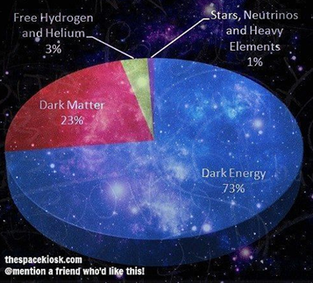
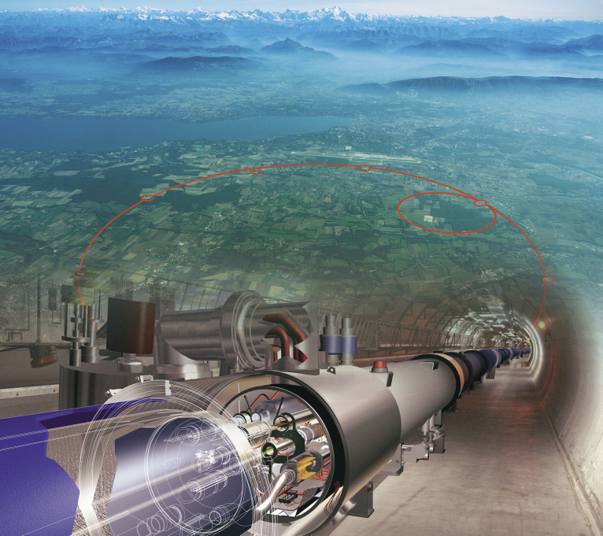
WIMP как кандидаты в темную материю и поиск на LHC - где осталось окно возможностей?
Сессия-конференция секции ядерной физики ОФН РАН, посвящённая 70-летию со дня рождения В.А. Рубакова
19 февраля 2025, Москва
M.В. Савина
ЛТФ ОИЯИ, Дубна
Maria.Savina@cern.ch

Slide 2
DM searches at the LHC – are you serious about this?
Definitely YES !!
1.Additional search tool to DD,
significant contributions in different models in the
moderate mass region, where there is a severe loss of DD
sensitivity
2. A unique opportunity
to feel an extended dark
sector as opposed to just
one DM particle
The long-term LHC search program on DM/DS

Slide 3
Map of the DM models probed in CMS searches
Portal approaches and simple DS vs “full” theories (or at least an extended DS)
CMS EXO-23-005

Slide 4


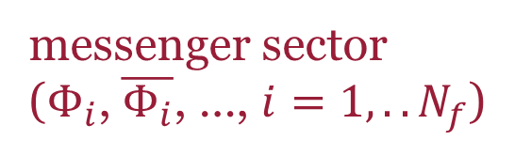
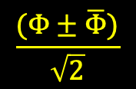
GMSB, low scale SSB: a basis
messenger sector
($Φ_{i}$, $\overline{Φ_{i}}$, …, $i=1,..N_{f}$)
SM+SP, SUSY
$$X, \left\langle X\right\rangle =M+θ^{2}F$$
one(two)loop suppressed
interactions with MS ,
soft SP masses, no flavor
violation enhancement
from soft terms,
LSP – gravitino!
Masses are depend on
F, M, N
chiral scalar superfield(s),
fund. rep. 5+anti-5 (also 10+anti-10)
of SU(5) or
16+anti-16 of SO(10) for the GUT
group
tree level interaction goldstino-MS
$$\frac{(Φ±\overline{Φ})}{\sqrt{2}}$$
physical scalar states :
$${M2}_{Φ\tilde{Φ} }\sim {\left(λM\right)}^{2}±\left(λF\right)$$
(limits:
F ~ M² or F << M² )
M – SUSY mass scale, F – SSB energy scale !!

Slide 5

GMSB SUSY, soft mass terms and universal spectrum
1-loop for gauginos, 2-loops for squarks
$$t=ln{M^{2}}/{Q^{2}}$$
F<<M²
All soft masses are proportional to NF/M

Slide 6

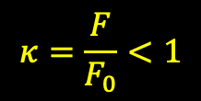
GMSB, gravitino as DM in the MSSM sector
Gravitino mass
“warm” DM - OK
$$κ=\frac{F}{F_{0}}<1$$
$$m_{3/2}≥keV$$
no direct search – not OK
Gravitino effective action
1/F suppressed !

Slide 7


GMSB, HS/MS stable states as DM candidates
S. Dimopoulos, G. F. Guidice, and A. Pomarol , arXiv:hep-ph/9607225
HS neutral scalar (singlets under SM group, loop level only, accidental global symmetry prevents hidden scalar interaction with MSSM sector, stable state – no DD of DM)
MS neutral scalar
cold unobservable DM (highly
suppressed HS-MSSM interactions)
superheavy DM
$$M_{Φ\tilde{Φ} }\sim {\left(λM\right)}^{2}±\left(λF\right)$$
F << M²
or
M² – F ~1
$$x_{f}=\frac{m_{φ}}{T_{f}}$$
conditions for the stable lightest neutral scalar
overestimated DM density !!
(but – the LMSS can
decay into gravitino)
cold observable DM

Slide 8
GMSB at the LHC, CMS RUN 2, prompt decays
EWK production, neutralino as the NLSP, general GMSB
CMS SUS-16-046; arXiv:1711.08008 [hep-ex]
CMS-SUS-19-001; arXiv:2310.03154 [hep-ex]

Slide 9
Split/GMSB SUSY in LLP decays with displaced vertices plus MET
CMS EXO-22-020; arXiv:2402.15804 [hep-ex]

Slide 10
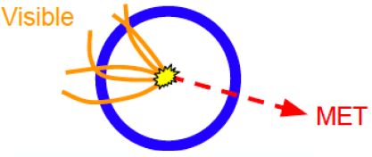
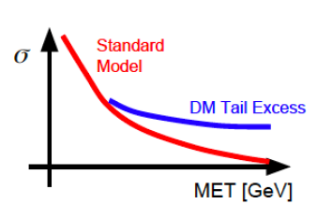

SUSY beyond MSSM: low(zero)${ p}_{T}^{mis} signatures$
“natural” mass spectrum
From prompt production to LLP:
1. Stealth SUSY
JiJi Fan, Matthew Reece, Joshua T. Ruderman
arXiv:1105.5135 [hep-ph]
arXiv:1201.4875 [hep-ph]
arXiv:1512.05781 [hep-ph]
typical experimental signature: high
$p_{T}^{mis}$
2. RPV SUSY
Csaba Csaki, Yuval Grossman, and Ben Heidenreich
arXiv:1111.1239 [hep-ph]

Slide 11
Stealth SUSY basis
SUSY is natural, low-scale SUSY breaking, hidden sector with (at least) one chiral
singlet supefield (R-odd singlino, R-even singlet). LSP – gravitino (GMSB),
NLSP decays to gravitino through a hidden sector.
HS states of order the EW scale, states approximately supersymmetric (F << M ) –
closely degenerated by masses.
Suppression of large missing E_{T} at the end of decay chain (gravitino assosiated).
arXiv:1105.5135 [hep-ph]
very soft!!!

Slide 12
Stealth SUSY simplified, prompt/LLP
JiJi Fan, Matthew Reece, Joshua T. Ruderman
arXiv:1105.5135 [hep-ph]
arXiv:1201.4875 [hep-ph]
arXiv:1512.05781 [hep-ph]
Field set: LOSP – gluino, stop, higgsino only
The lightest R-odd SUSY particle – gravitino/axino
NLSP neutralino decay width
NLSP gluino decay width
Typically LLP signatures in a wide parameter space region!! ($cτ_{0}>8 mm$ for F ~ 10 GeV)

Slide 13



Stealth SUSY, gluino pair production, gluino/stop as NLSP
$$SY\overline{Y}:$$
GMSB-like: messengers in $5, \overline{5}$ of SU(5), m_{S} ~ 100 GeV, m_{Y} ~ TeV – supersymmetric soft masses
$$\tilde{g}→\tilde{S}→\tilde{G}$$
$$\tilde{g}→\tilde{t}→\tilde{S}S\tilde{G}$$
3g → 6 jets FS
(mostly light
flavors for small
m_{S})
SS leptons or 3 leptons
plus >4 jets (3 jets b-tagged)

Slide 14


Gluino/stop PP, neutralino as NLSP, prompt, 2gamma + jets + low $E_{T}^{mis}$
$150 GeV<M< m_{\tilde{g}}\left(m_{\tilde{q}}\right)−100 GeV$;
$$m_{\tilde{q}}, m_{\tilde{g}}:1250<M<2350 GeV, 1100<M<2000 GeV$$
CMS SUS-19-001; arXiv:2310.03154 [hepex];
See also:
CMS SUS-23-001
for stealth /RPV SUSY
with DNN
$$SY\overline{Y}$$

Slide 15
Gluino/stop PP, neutralino as NLSP, prompt, 2gamma + jets + low $E_{T}^{mis}$
$150 GeV<M< m_{\tilde{g}}\left(m_{\tilde{q}}\right)−100 GeV$;
$$m_{\tilde{q}}, m_{\tilde{g}}:1250<M<2350 GeV, 1100<M<2000 GeV$$
CMS SUS-19-001; arXiv:2310.03154 [hepex];
See also:
CMS SUS-23-001
for stealth /RPV SUSY
with DNN
$$SY\overline{Y}$$

Slide 16
Strongly coupled DS, dark showers, prompt/LLP
Hidden valleys , dark QCD, SU(N_{c}^{dark} )
N_{c}, N_{f}, Λ_{dark},
m_{dark}, r_{inv}…
One of the most striking DM-targeted signatures
(dark QCD → dark showers → mediator → SM transition)
Broken U(1)_{dark}, kinetic U(1)_{dark} – U(1)_{Y} mixing, dark photon
Z’ as a messenger (also scalar portals)
DS-SM transitions are suppressed by a high mediator
mass scale → prompt/LLP decays
Notes:
16

Slide 17


Strongly coupled DM, decay channels and signatures
‘t Hooft coupling
$$λ=α_{dark}^{2}N_{c}^{dark}≪1$$
semivisible jets
emerging jets
$$λ≫1$$
quasi-conformal
spectra, dark
“high-temperature
QCD”
Tracks start near the edge of the tracker, in the
ECAL and HCAL and even in the inner muon stations
soft unclustered energy patterns (SUEP)

Slide 18
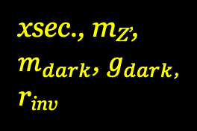
Resonant production of strongly coupled DM for semivisible jets
gauge portal
JHEP 06 (2022) 156
CMS EXO-19-020
semi-
visible jets
DM part
(visible) +
SM part
(invisible)
xsec., m_{Z’},
$m_{dark}$, $g_{dark}$,
r_{inv}

Slide 19
Resonant production of strongly coupled DM for semivisible jets
The first CMS study of jet ivsisible contribution with dark sector interpretation.
The fraction r_{inv} of stable invisible dark hadrons in between 0 (dijet, small MET)
and 1 (large MET)
JHEP 06 (2022) 156
CMS EXO-19-020

Slide 20
LLP dark showers with emerging jets
CMS EXO-22-015; arXiv:2403.01556 [hep-ex]
HV dark QCD, scalar portal,
dark meson LLP decays, b-quark FS
unflavored:
unflavored:
flavor-aligned:
flavor-aligned:

Slide 21

Soft Unclustered Energy Patterns (SUEPs)
$$m_{q_{D}}<Λ_{dark} , Λ_{dark}≪\sqrt{s}$$
CMS EXO-23-002; arXiv:2403.05311 [hep-ex]
light γ_{D}
M< 1 GeV
HV, quasi-conformal DS, dark mesons masses much smaller
than S mediator mass. The S charged under both SU(3) and SU(3)_{D}
Spherically symmetric FS distributions, high multiplicity of soft PS
Boltzmann distr. for PS p_{T}, depending on T_{dark} (Λ_{dark}) and m_{φ}
Decay φ → γ_{D}γ_{D}, → SM FS trough γ - γ_{D} mixing, prompt decays

Slide 22
WIMPs may still be in
hidden SUSY sector(s) (observable?? most likely not!)
“stealth” SUSY spectra (only as LLP signatures)
HV strongly coupled DS (many possible collider signatures)
? (HNL, ALPs…)
Notes:
22

Slide 23
Backup slides
Notes:
23

Slide 24
Combination of h₁₂₅ → invisible searches for ttbar and VH
resolved/boosted ttbarH
CMS HIG-21-007,
arXiv:2303.01214 [hep-ex]

Slide 25
Combination of h₁₂₅ → invisible searches
CMS HIG-21-007

Slide 26
Dark sector with Long-Lived Particles at the LHC
LLP White Paper:
arXiv:1903.04497
LLP theory motivations:
arXiv:1806.07396
LLP:
a proper lifetime cτ₀ is greater than or comparable to the characteristic size of the (sub)detectors
small cτ₀ that
comparable to the
inner tracker size, no
displaced tracks →
“standard” prompt decay
intermediate cτ₀ → LLP
very large/infinite
large cτ₀ → stable particles, “standard” MET signatures
displaced jets
Notes:
26

Slide 27
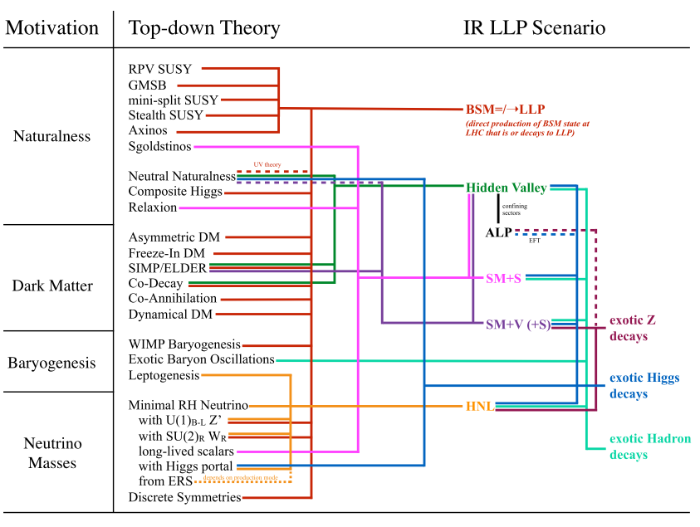
Inelastic dark matter at the LHC/LLP
https://arxiv.org/abs/1901.04040
Dark photon
Heavy neutral leptons (quarks)
Dark GB and/or Higgs(es)…
Higgs/GB/gluon/SUSY portals
    (Asymmetric DM/
    Baryogenesis)
      Dark SUSY
      Dark QCD
    Twin Higgs
    ALPs (CP-violation)…
DS: small couplings, compressed spectra, large hierarchy → large cτ
Notes:
27

Slide 28
LLP summary plots, CMS, 2023

