Slide 1
Измерение анизотропных потоков лямбда-гиперонов в экспериментах MPD и BM@N
Трошин В.В., Мамаев М.В., Парфёнов П.Е., Тараненко А.В.
ОИЯИ, НИЯУ МИФИ Сессия-конференция секции ядерной физики ОФН РАН 17-21 февраля 2025
Работа поддержана Министерством науки и высшего образования РФ, проект
"Фундаментальные и прикладные исследования на экспериментальном комплексе
класса мегасайенс NICA (ОИЯИ)" № FSWU-2025-0014

Slide 2
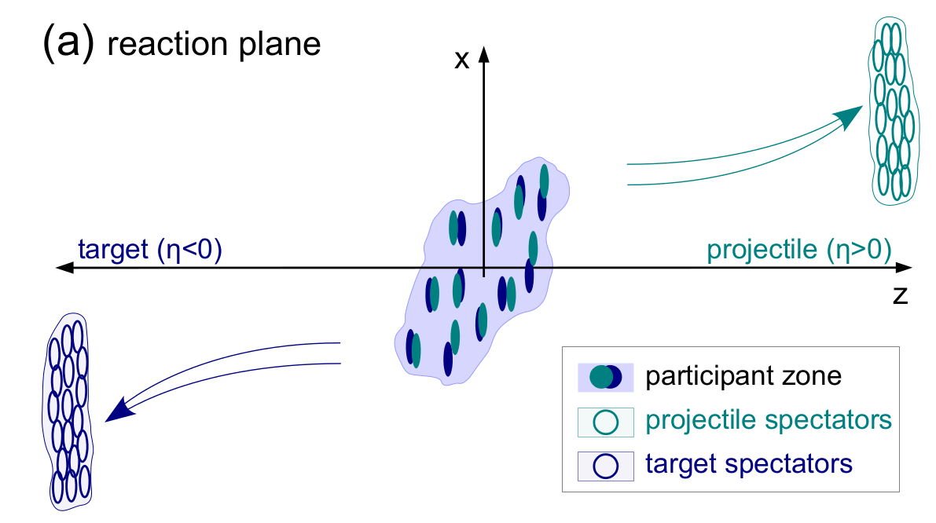
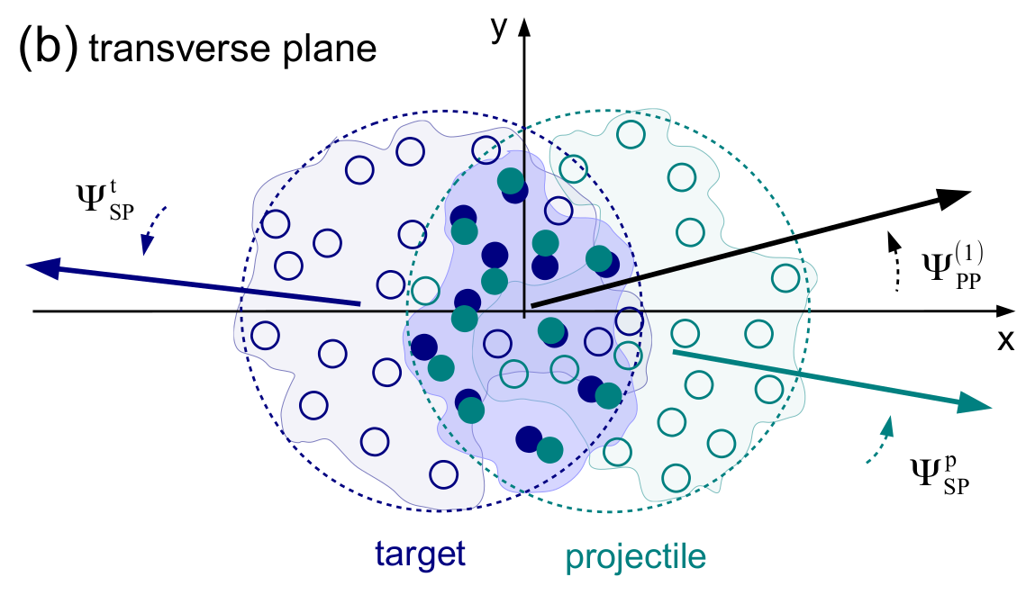
Anisotropic transverse flow
Spatial asymmetry of energy distribution at the initial state is transformed, through the strong interaction, into momentum anisotropy of the produced particles.
In the experiment reaction plane angle Ψ_{RP} can be approximated by
participant Ψ_{PP} or spectator Ψ_{SP} symmetry planes.

Slide 3
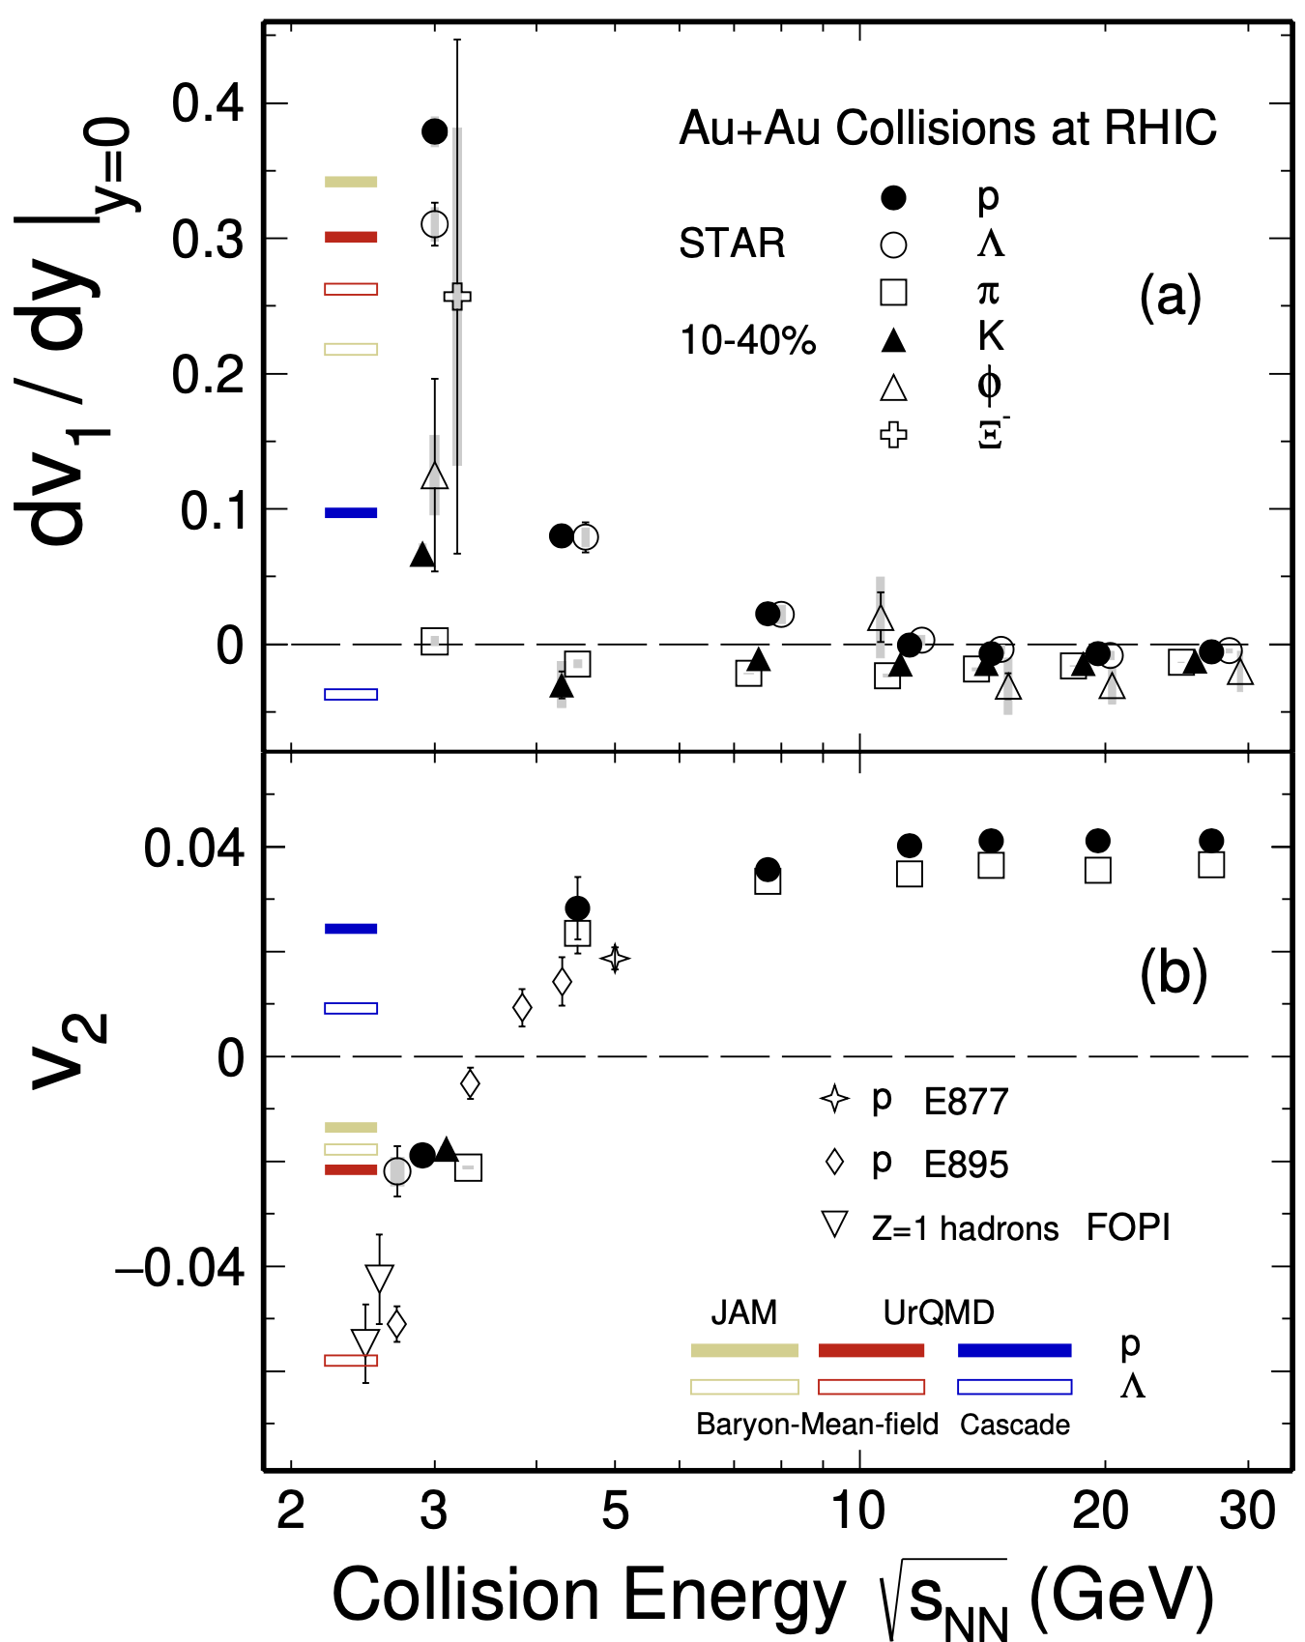
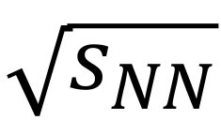
Anisotropic transverse flow in heavy-ion collisions at Nuclotron-NICA energies
Strong energy dependence of dv₁/dy and v₂ at SNN =4-11 GeV.
Anisotropic flow at FAIR/NICA energies is a delicate balance between:
The ability of pressure developed early in the reaction zone
Long passage time (strong shadowing by spectators).
Differential flow measurements v_{n}( SNN , centrality, pid, p_{T}, y) will help to study:
effects of collective (radial) expansion on anisotropic flow
interaction between collision spectators and produced matter
baryon number transport
Several experiments (MPD, BM@N, STAR FXT, CBM, HADES, NA61/SHINE) aim to study properties of the strongly-interacted matter in this energy region.
MPD FXT
BM@N
CBM
MPD
M. Abdallah et al. [STAR Collaboration] 2108.00908 [nucl-ex]

Slide 4
Aims to study flow of Λ
Λ potential is important to explanation of existence of two-solar-mass neutron stars
Constrained by directed flow of Λ
Models cannot fully describe anisotropic flow for NICA energy range
Best agreement with model includes interactions with hyperons
Yasushi Nara et al. Phys.Rev.C 106 (2022) 4, 044902

Slide 5
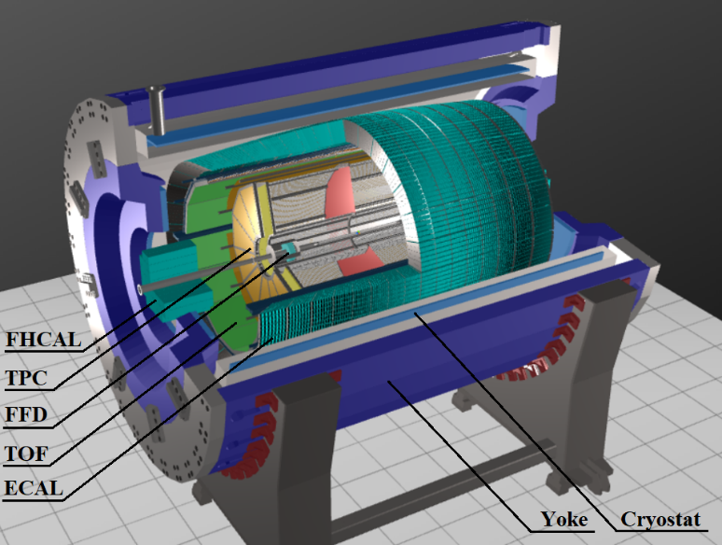
MPD experiment at NICA
Model
Simulation of MPD setup
GEANT4
Realistic data reconstruction
Obtaining results

Slide 6
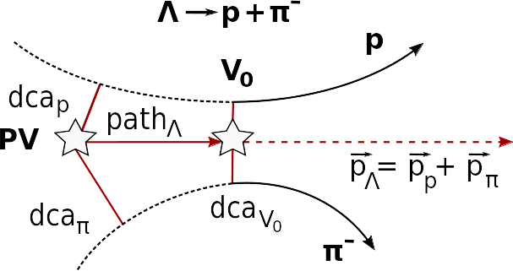
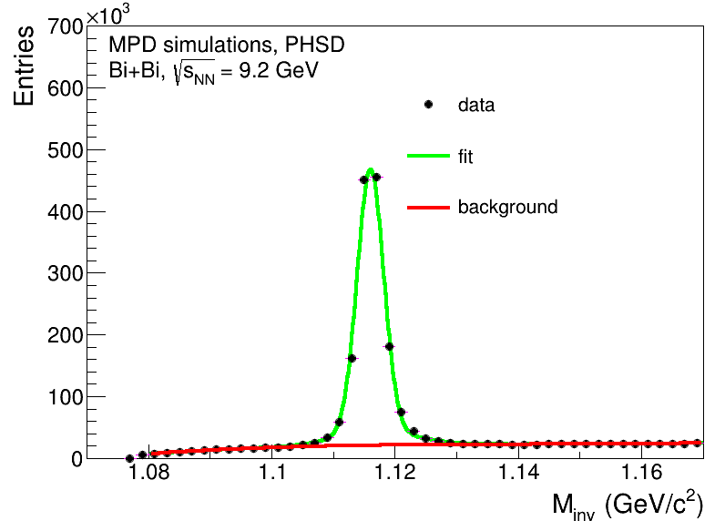
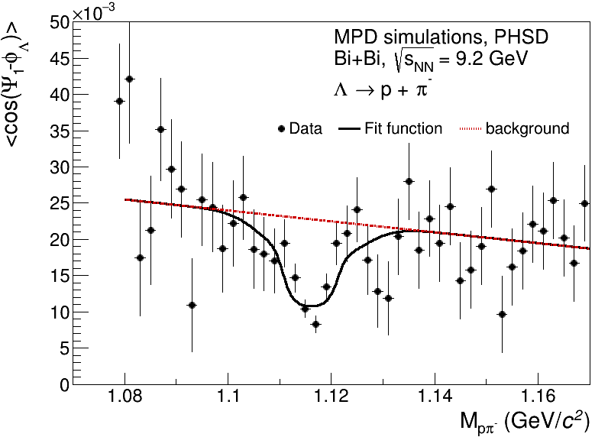
Λ hyperon reconstruction and anisotropic flow measurements
Centrality and track selection
Build Λ - from p and π⁻
Selection of Λ candidates
Fitting the m_{inv} distributions
Obtain R_{n}
Fitting v_{n} as a function of m_{inv}
PV — primary vertex
V₀ — vertex of hyperon decay
dca — distance of closest approach
path — decay length

Slide 7
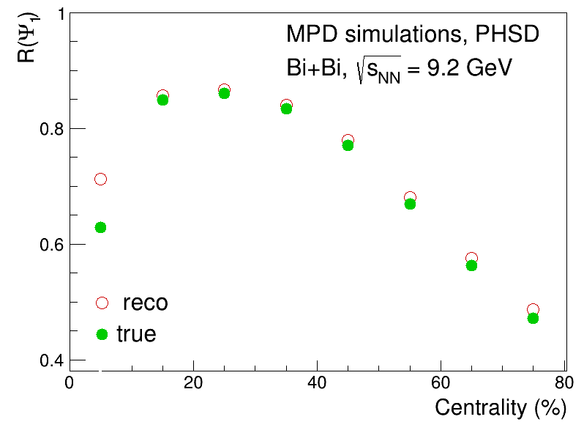
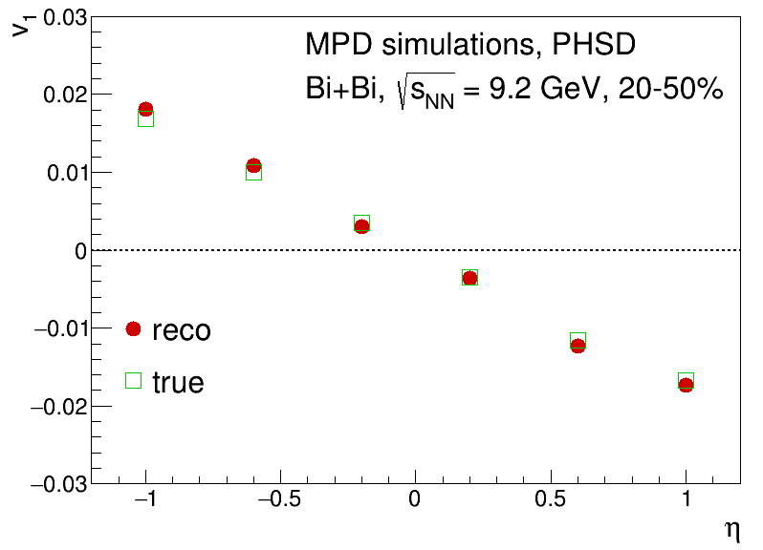
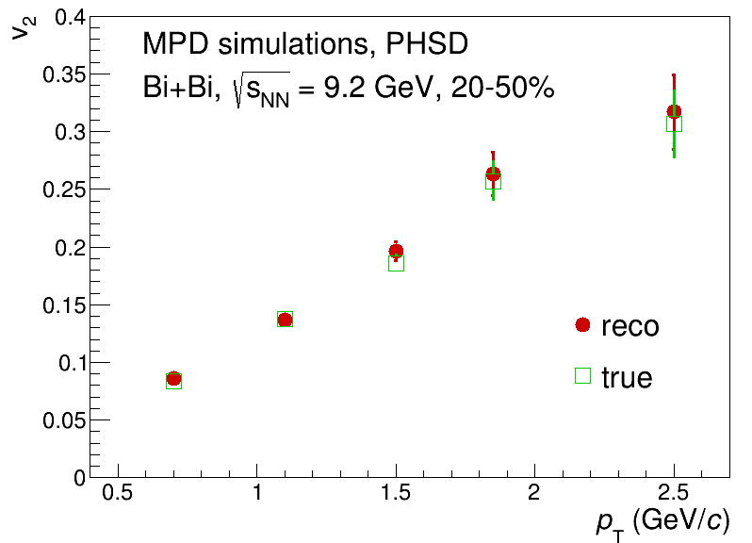
v₁ and v₂ of Λ hyperons for Bi+Bi at √S_{NN}=9.2 GeV with PHSD
Full scale reconstruction shows reasonable agreement with simulated data

Slide 8
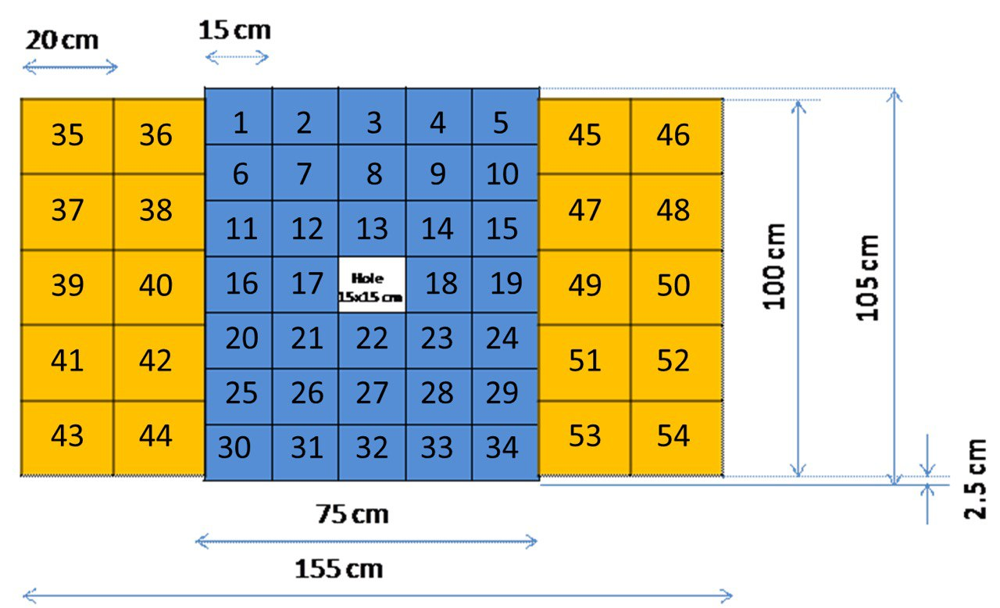
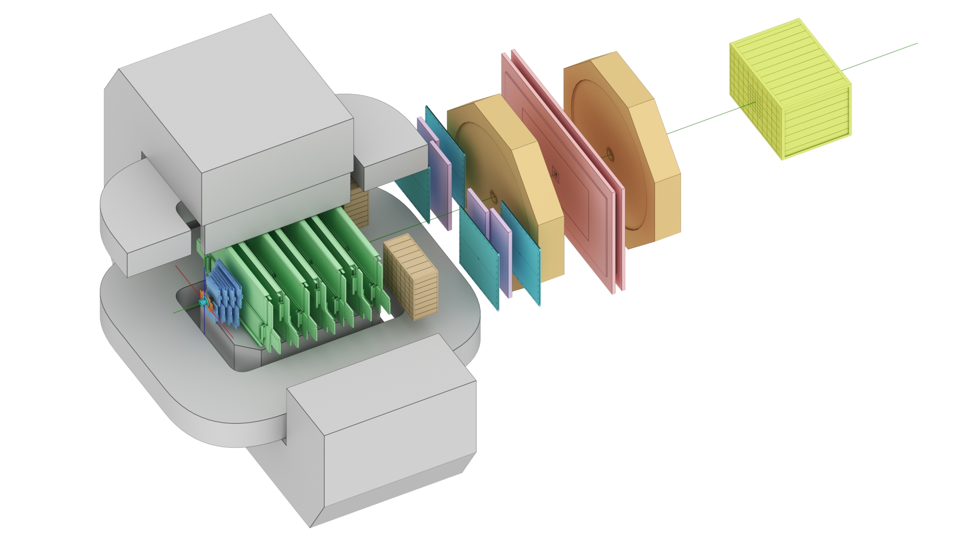
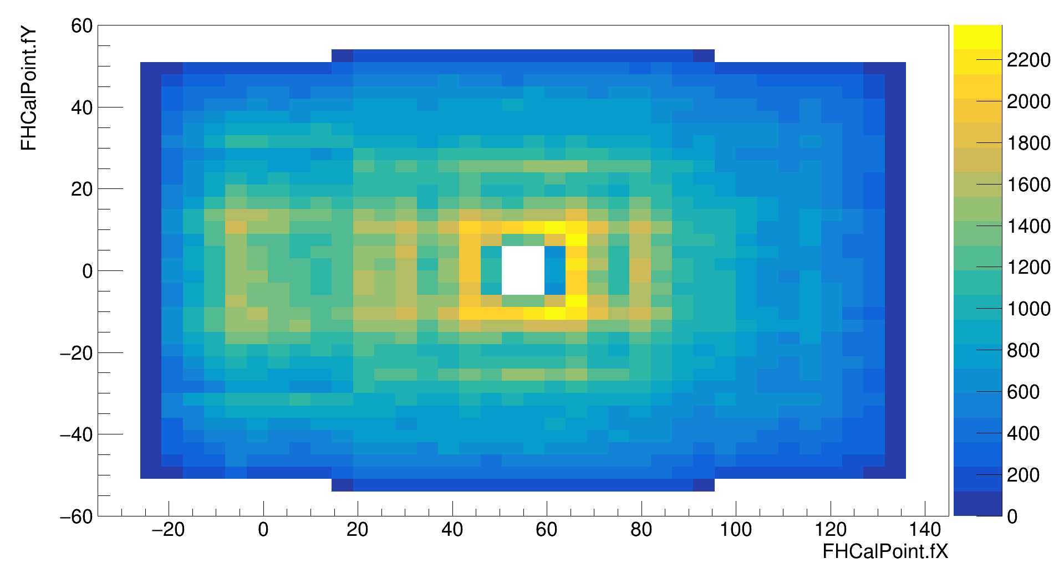
The BM@N experiment: recent Xe+Cs(I) 3.8 AGeV run
FHCal
Silicon + GEM
TOF-700
TOF-400
Time-of-flight
neutron
x=0
ion
proton
Tracking system
Symmetry plane estimation with the azimuthal asymmetry of projectile spector energy
Notes:
Схема эксперимента хадес на слайде.
Траектории рожденных частиц регистристрируются трекинговой системой, состоящей из …
Импульс восстанавливается по отклонению частиц в магнитном поле
Идентификация производится при помощи детекторов времени пролета … которые регистрируют время пролета. Зная длину траектории можно вычислить массу частицы.
Спектаторы регистрируются детектором FW. Поскольку они отклоняются в плоскости реакции материей в области перекрытия, спектаторы используются для оценки угла плоскости реакции.
Всего столько статистики ...

Slide 9
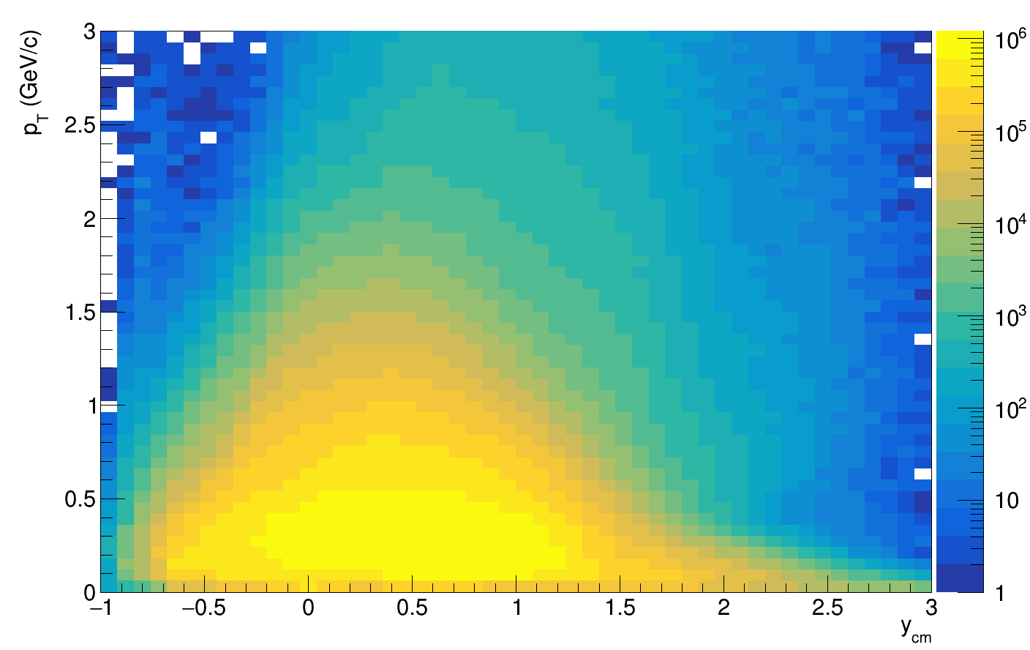
Flow vectors
F1
F2
F3
From momentum of each measured particle define a u_{n}-vector in transverse plane:
Tp
where φ is the azimuthal angle
Sum over a group of u_{n}-vectors in one event forms Q_{n}-vector:
Tπ-
T-: all negatively charged particles with:
1.5 < η < 4
p_{T} > 0.2 GeV/c
T+: all positively charged particles with:
2.0 < η < 3
p_{T} > 0.2 GeV/c
Ψ_{n}^{EP} is the event plane angle

Slide 10
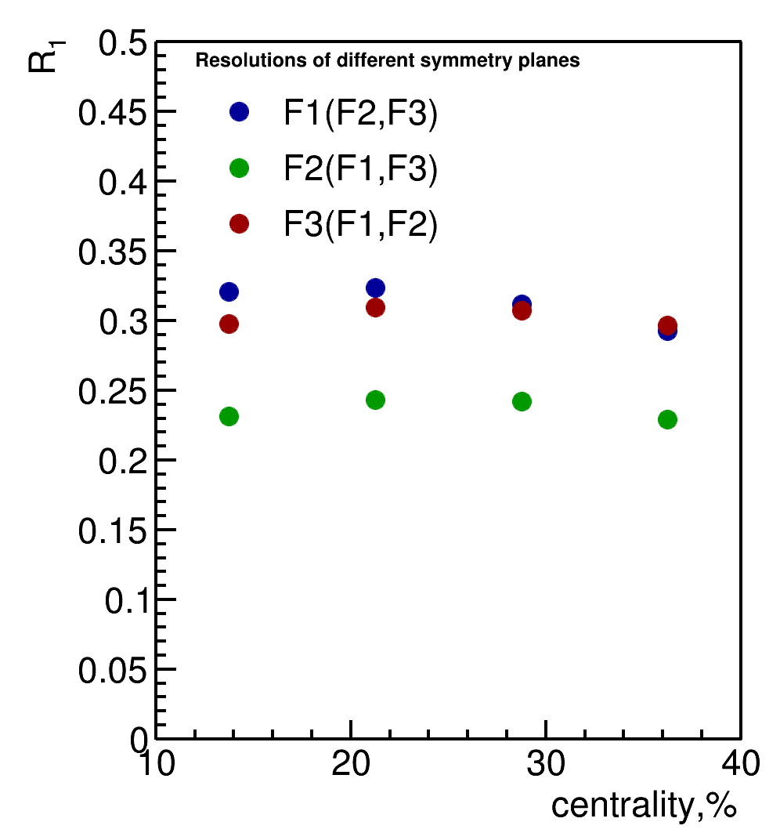
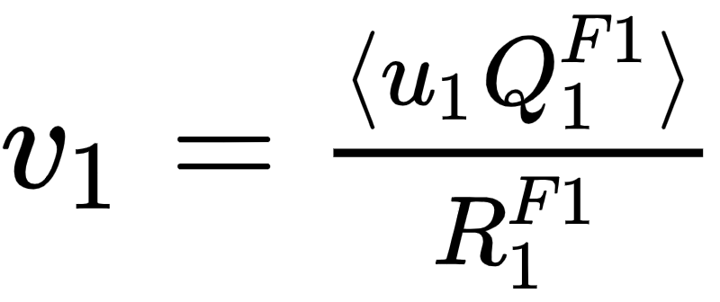
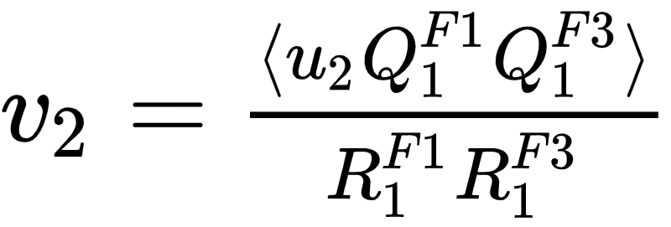
Flow methods for v_{n} calculation
Tested in HADES:
M Mamaev et al 2020 PPNuclei 53, 277–281
M Mamaev et al 2020 J. Phys.: Conf. Ser. 1690 012122
Scalar product (SP) method:
Where R₁ is the resolution correction factor
Symbol “F2(F1,F3)” means R₁ calculated via (3S resolution):
Corrections for non-uniform acceptance - see slide №15

Slide 11
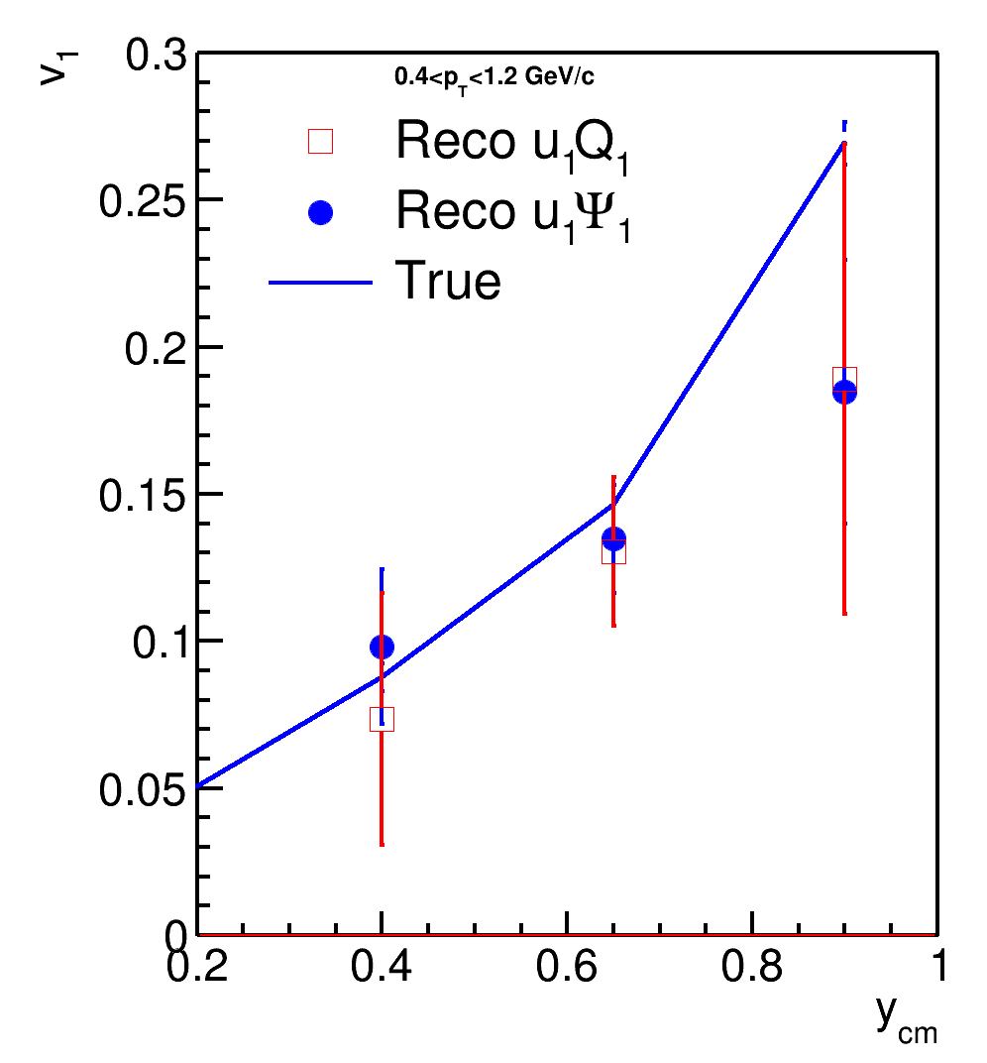
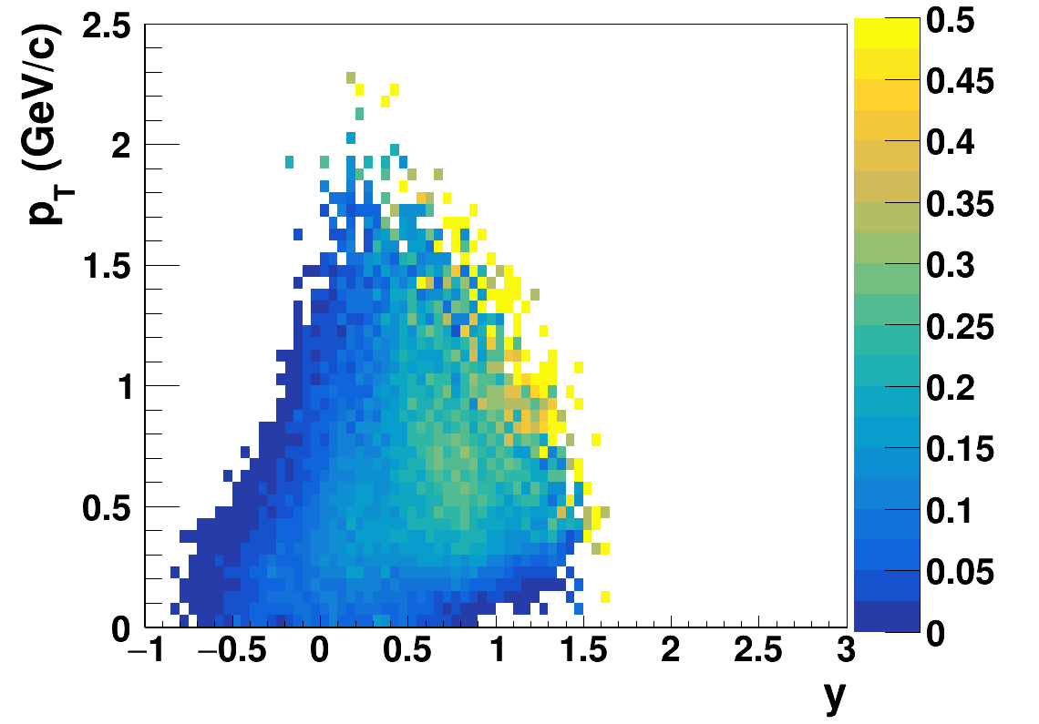
Performance study with JAM fully reconstructed data
For performance study 15 M events of fully reconstructed data from JAM model are used
Very limited p_{T}-rapidity coverage
An agreement with signal from model

Slide 12
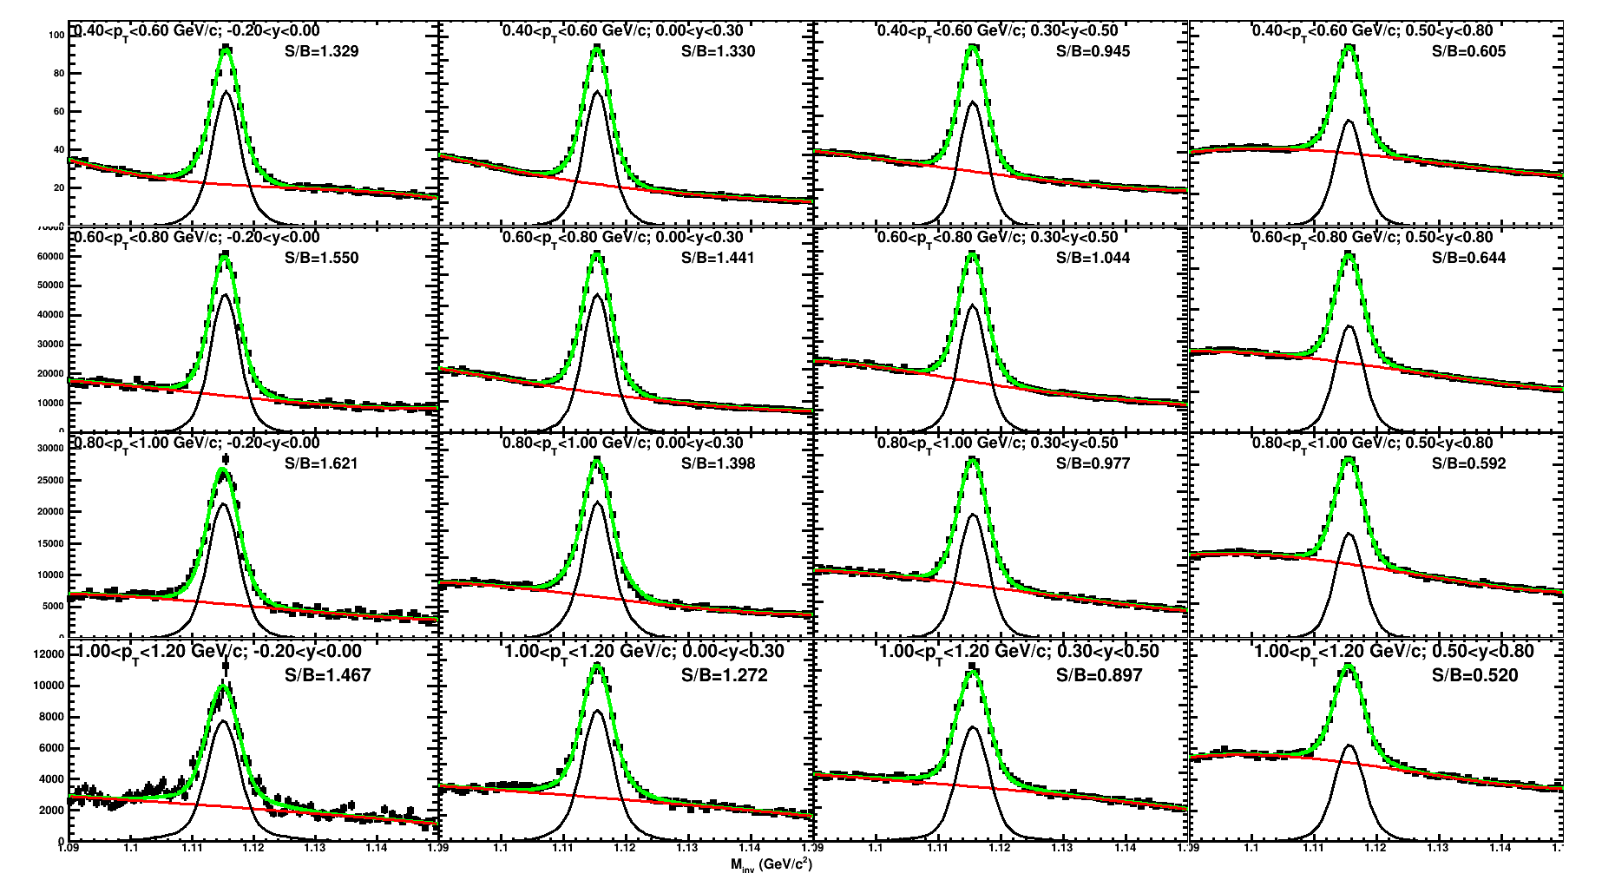
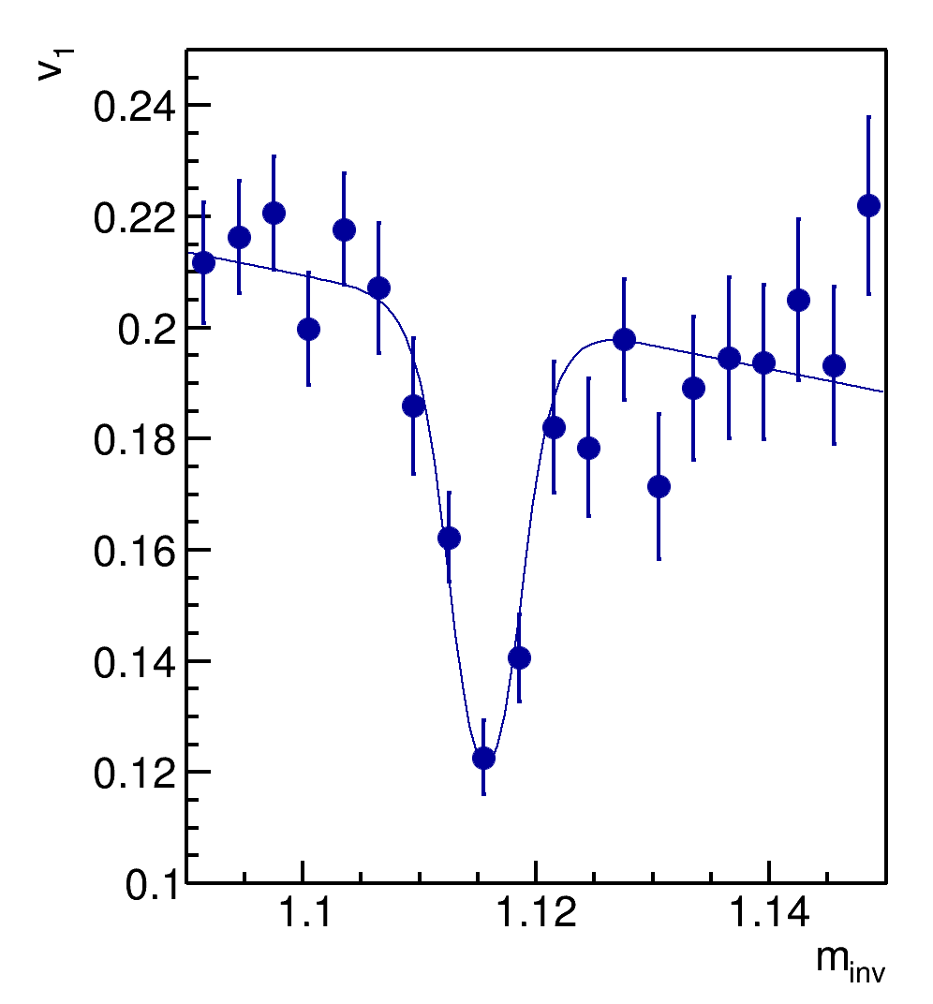
Fitting the m_{inv} distributions in p_{T}-y bins
Directed flow of Λ hyperons in Xe+Cs(I) collisions at 3.8 AGeV

Slide 13
Summary
Performance study for flow measurements of Λ hyperons for Bi+Bi at √S_{NN}=9.2 GeV with PHSD at MPD and Xe+Cs(I) at √S_{NN}=3.26 GeV with JAM at BM@N are provided
Invariant mass fit method for reconstructed data show an agreement with simulated data
Application of invariant mass fit method for directed flow measurements at recent BM@N Xe+Cs(I) experimental run is shown
Further analysis is under work
Outlook
Obtain rapidity and transverse momentum dependence of v₁ for experimental data.
Comparison results with existing data from other experiments
Further efficiency study and analysis of systematic effects

Slide 14
BACKUP

Slide 15
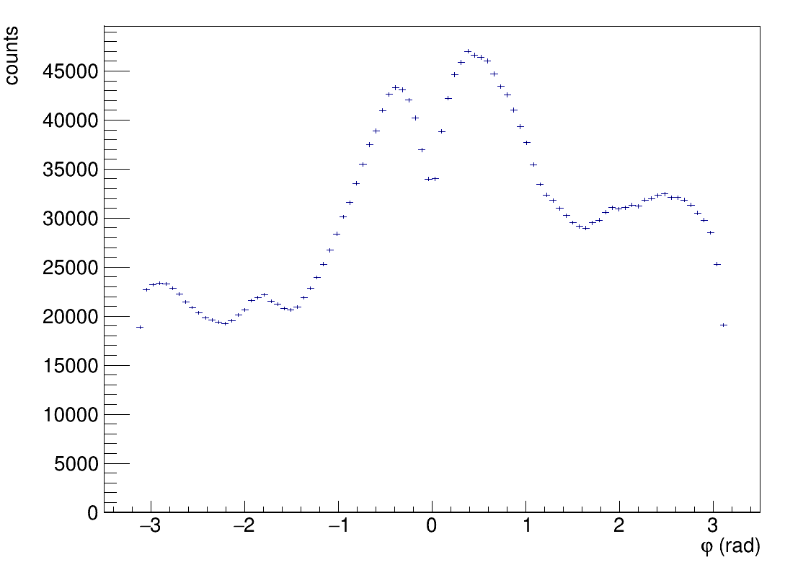
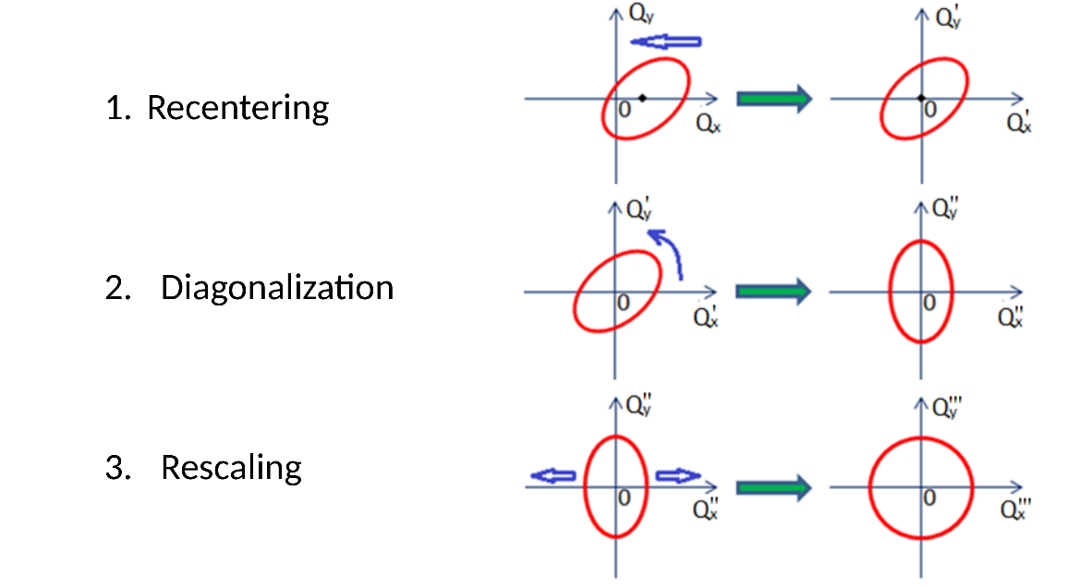
Corrections on acceptance
φ yield of Λ candidates
Corrections are based on method in: I. Selyuzhenkov and S. Voloshin PRC77, 034904 (2008)
2. Twist
Non-uniform acceptance - corrections are required

Slide 16
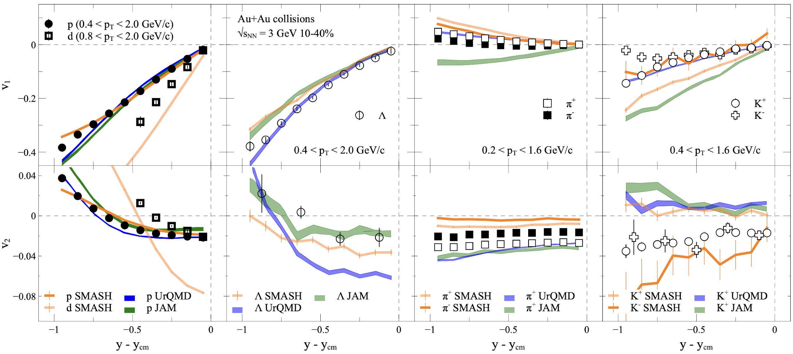
A. Sorensen et. al., Prog.Part.Nucl.Phys. 134 (2024) 104080

