Slide 1


Investigation of the structure of the lowest quadrupole excitations in Ge isotopes
E. V. Mardyban, N. N. Arsenyev, T. M. Shneidman, A. P. Severyukhin

Slide 2
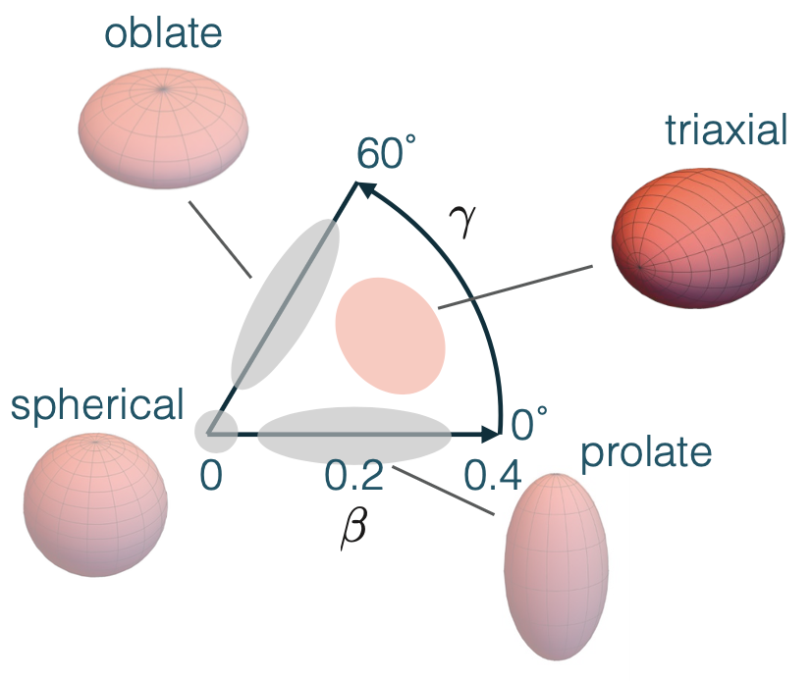
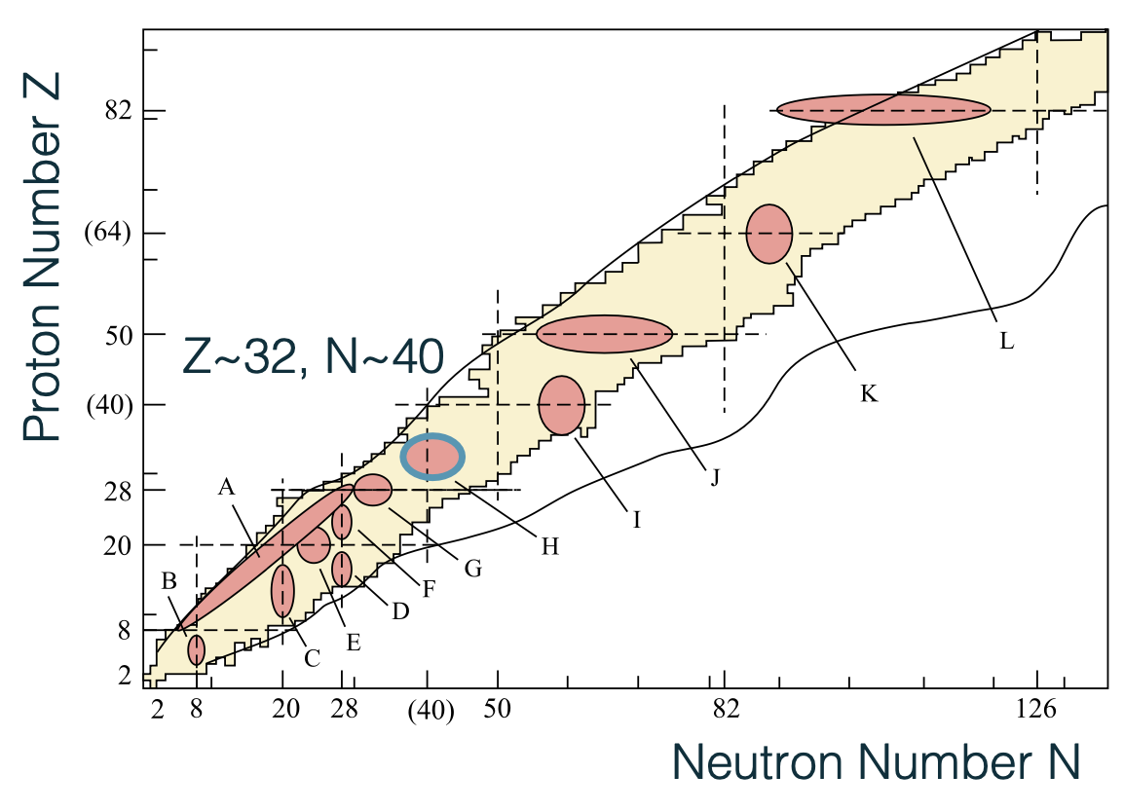
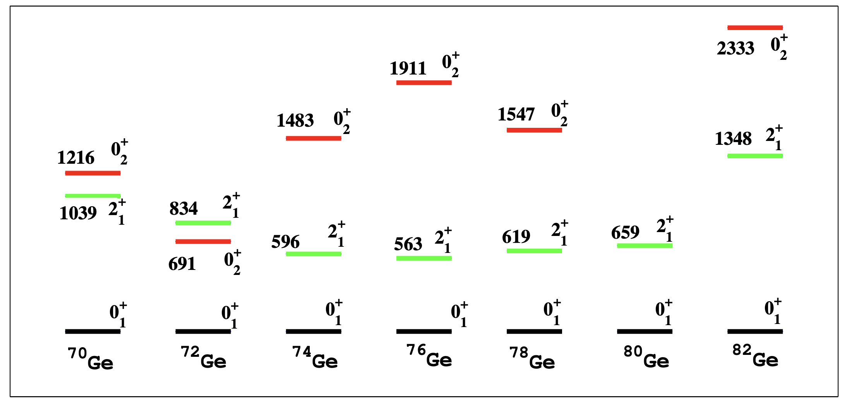
Introduction
by Carlotta Porzio
Heyde and Wood,
Rev. of Mod. Phys. 83, 1467 (2011)
by J. G. Hirsch and P. C. Srivastava

Slide 3
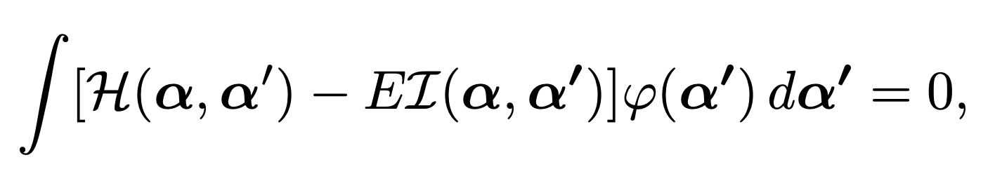
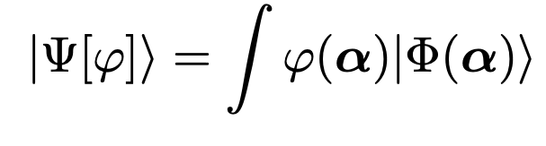


Model
Variational principle with trial wave functions in the form
leads to the following Hill Wheeler integral equation
Assuming a Gaussian overlap approximation (GOA) for wavefunction:
can be obtain the collective Hamiltonian
Using the components of the quadrupole tensor in the internal coordinate system as a collective coordinate
Stanisław G Rohoziński 2012 J. Phys. G: Nucl. Part. Phys. 39 095104
T. Niksic, Z.P. Li, D. Vretenar, L. Prochniak, J. Meng, and P. Ring, Phys.Rev. C 79, 034303 (2009)

Slide 4
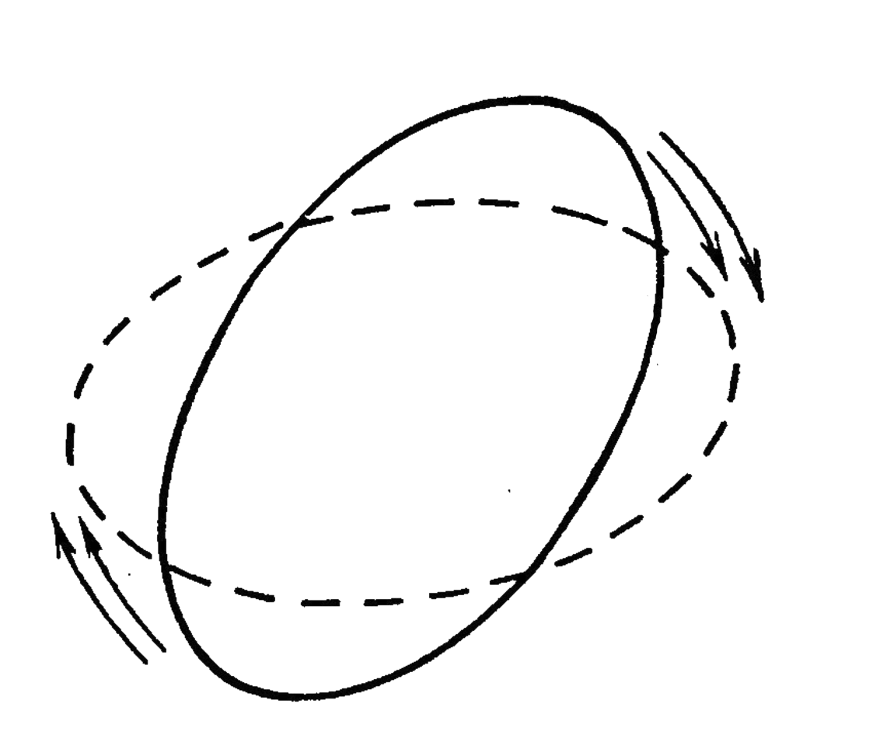
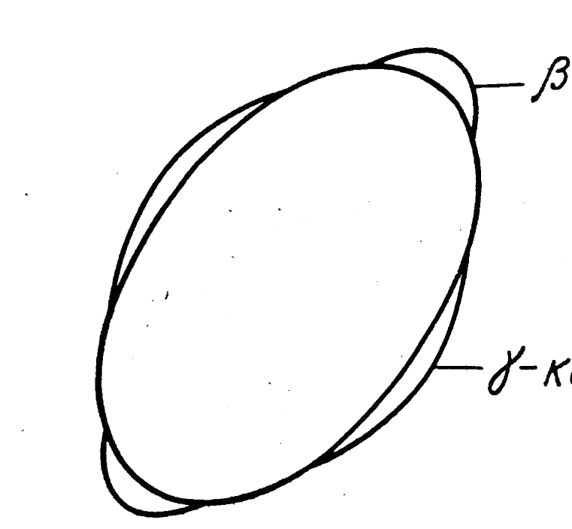
Model
The quadrupole collective Hamiltonian can be written in general form as
Types of collective motion described by the quadrupole Hamiltonian
where and - determinant of the vibration inertia tensor:
Moments of inertia are expressed as:
T. Niksic, Z.P. Li, D. Vretenar, L. Prochniak, J. Meng, and P. Ring, Phys.Rev. C 79, 034303 (2009)

Slide 5
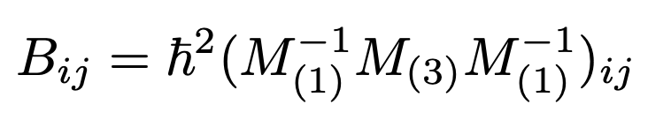
Model
The collective mass is expressed in cranking approximation as
The moment of inertia is calculated as
Potential energy is calculated using the RMF approach
T. Niksic, Z.P. Li, D. Vretenar, L. Prochniak, J. Meng, and P. Ring, Phys.Rev. C 79, 034303 (2009)

Slide 6
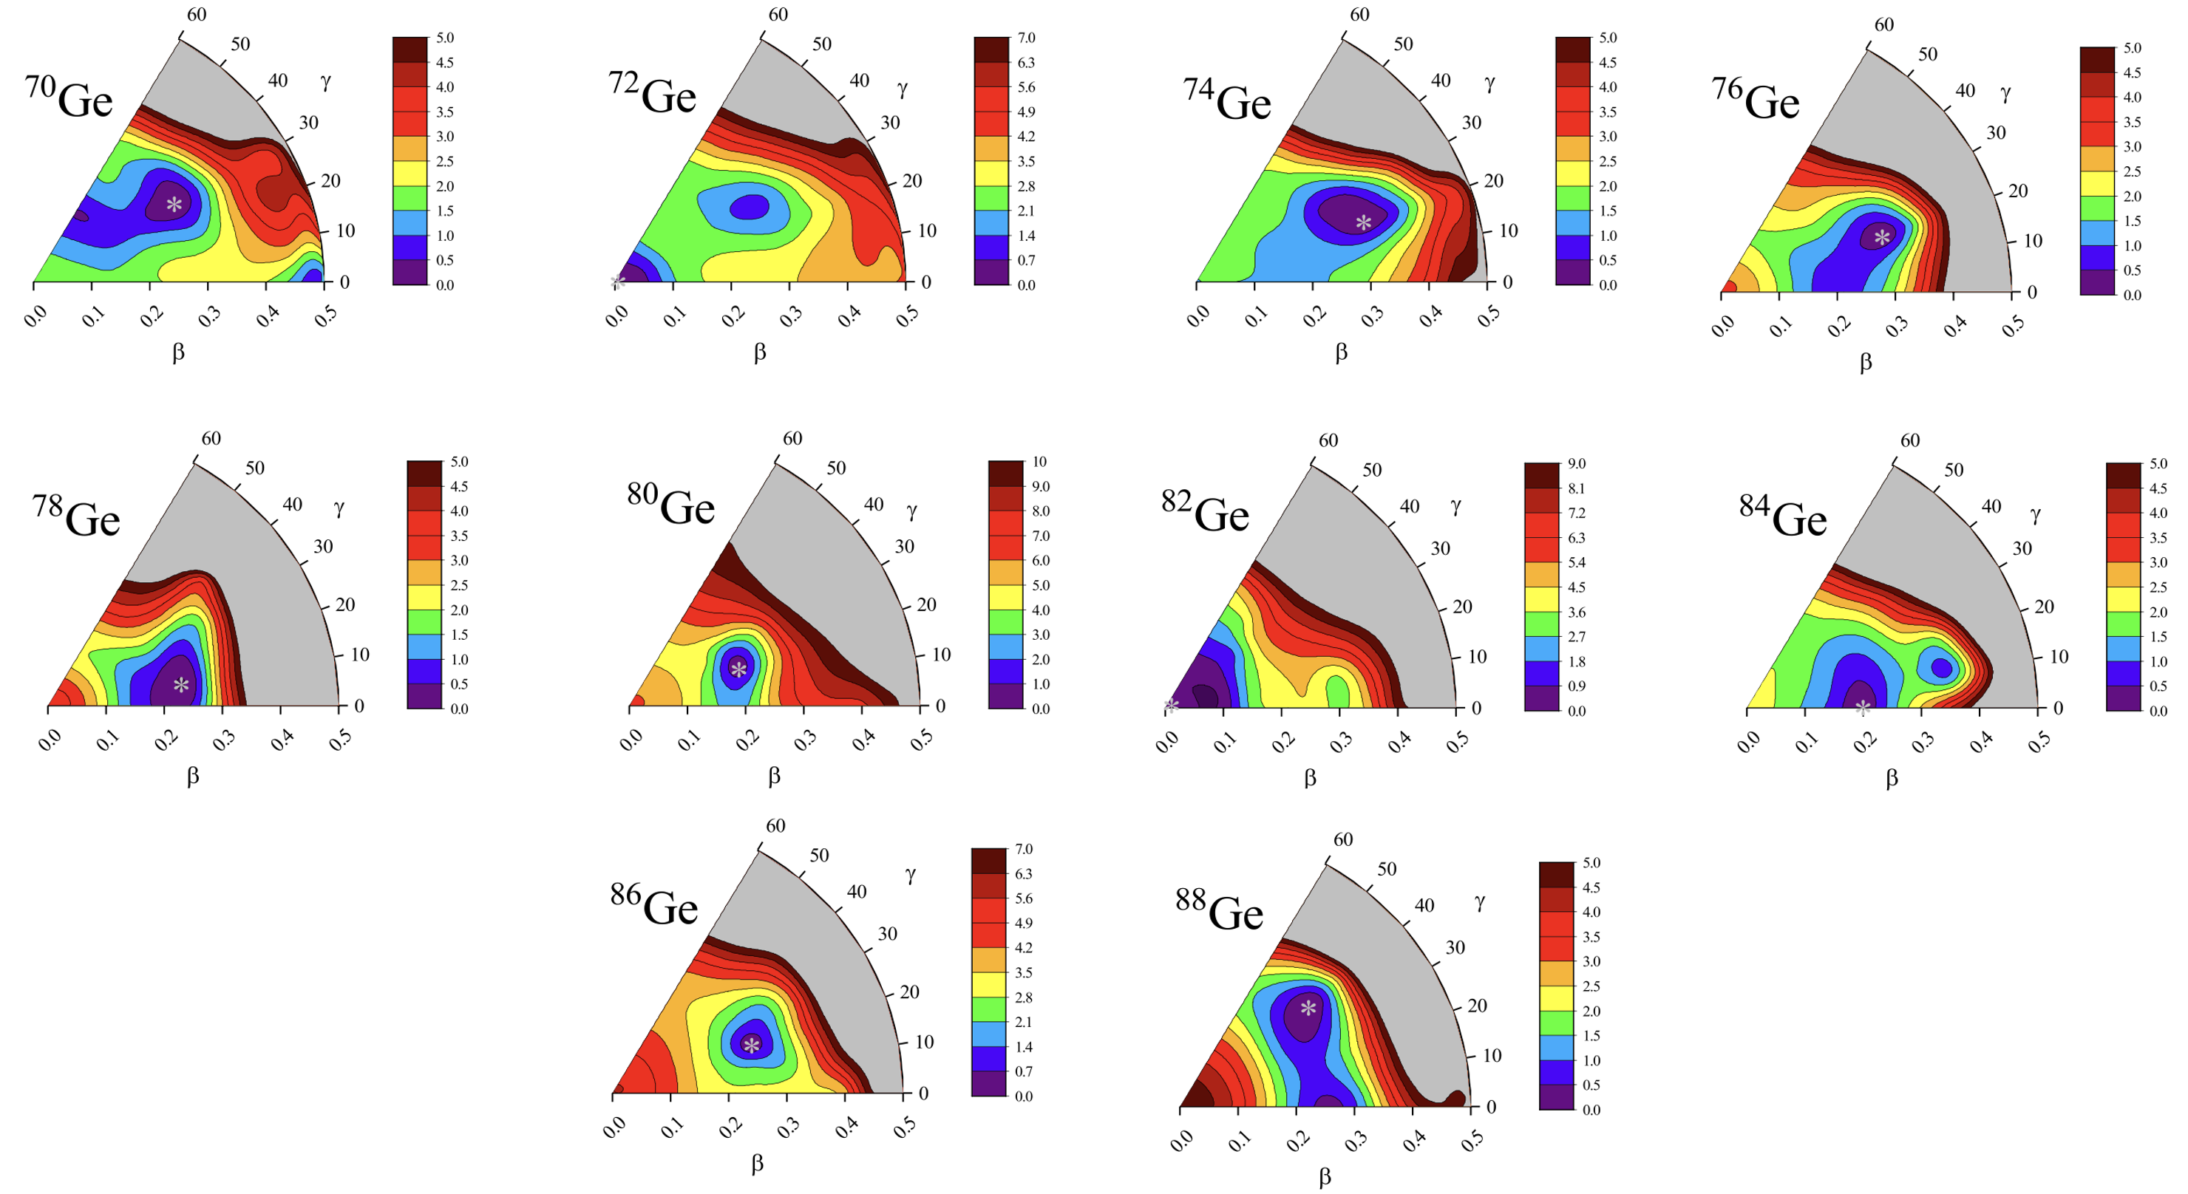
Results
Bing-Nan Lu, Jie Zhao, En-Guang Zhao,and Shan-Gui Zhou, Phys. Rev C 89, 014323 (2014)
Y. K. Gambhir, P. Ring, and A. Thimet, Ann. Phys. 198, 132 (1990).

Slide 7
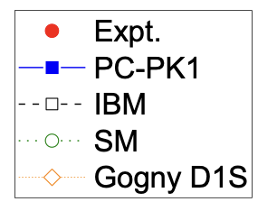
Results
SM+JUN45 – Honma et al., PRC80, 064323 (2009); IBM+D1M – Nomura et al., PRC95, 064310 (2017);
CFHB+5DCH – Delaroche et al., PRC81, 014303 (2010)

Slide 8
Results
SM+JUN45 – Honma et al., PRC80, 064323 (2009); IBM+D1M – Nomura et al., PRC95, 064310 (2017);
CFHB+5DCH – Delaroche et al., PRC81, 014303 (2010)

Slide 9
Conclusion
The structure of the lowest quadrupole excitations in Ge isotopes has been studied
There is good agreement with experimental data and predictions of other approaches
Transition probabilities and energies of the lowest states for neutron-rich isotopes of Ge are predicted
Further research is needed
The main results are included in
N. N. Arsenyev, E. V. Mardyban, and T. M. Shneidman, Int. J. Mod. Phys. E, 2441021 (2024)
Thank you for your attention!

Slide 10
Results
SM+JUN45 – Honma et al., PRC80, 064323 (2009); IBM+D1M – Nomura et al., PRC95, 064310 (2017);
CFHB+5DCH – Delaroche et al., PRC81, 014303 (2010)

Slide 11
Results
SM+JUN45 – Honma et al., PRC80, 064323 (2009); IBM+D1M – Nomura et al., PRC95, 064310 (2017);
CFHB+5DCH – Delaroche et al., PRC81, 014303 (2010)

Slide 12



