Slide 1


Low-energy spectra of nobelium isotopes: Skyrme random-phase-approximation analysis
M.A. Mardyban^{1,2}, V. O. Nesterenko^{1,2}, R.V. Jolos^{1,2},
P.-G. Reinhard³, A. Repko⁴
¹Laboratory of Theoretical Physics, Joint Institute for Nuclear Research, Dubna, Moscow Region 141980, Russia
² Dubna State University, Dubna, Moscow Region 141982, Russia
³ Institut für Theoretische Physik II, Universität Erlangen, D-91058, Erlangen, Germany
⁴Institute of Physics, Slovak Academy of Sciences, 84511 Bratislava, Slovakia
2025

Slide 2
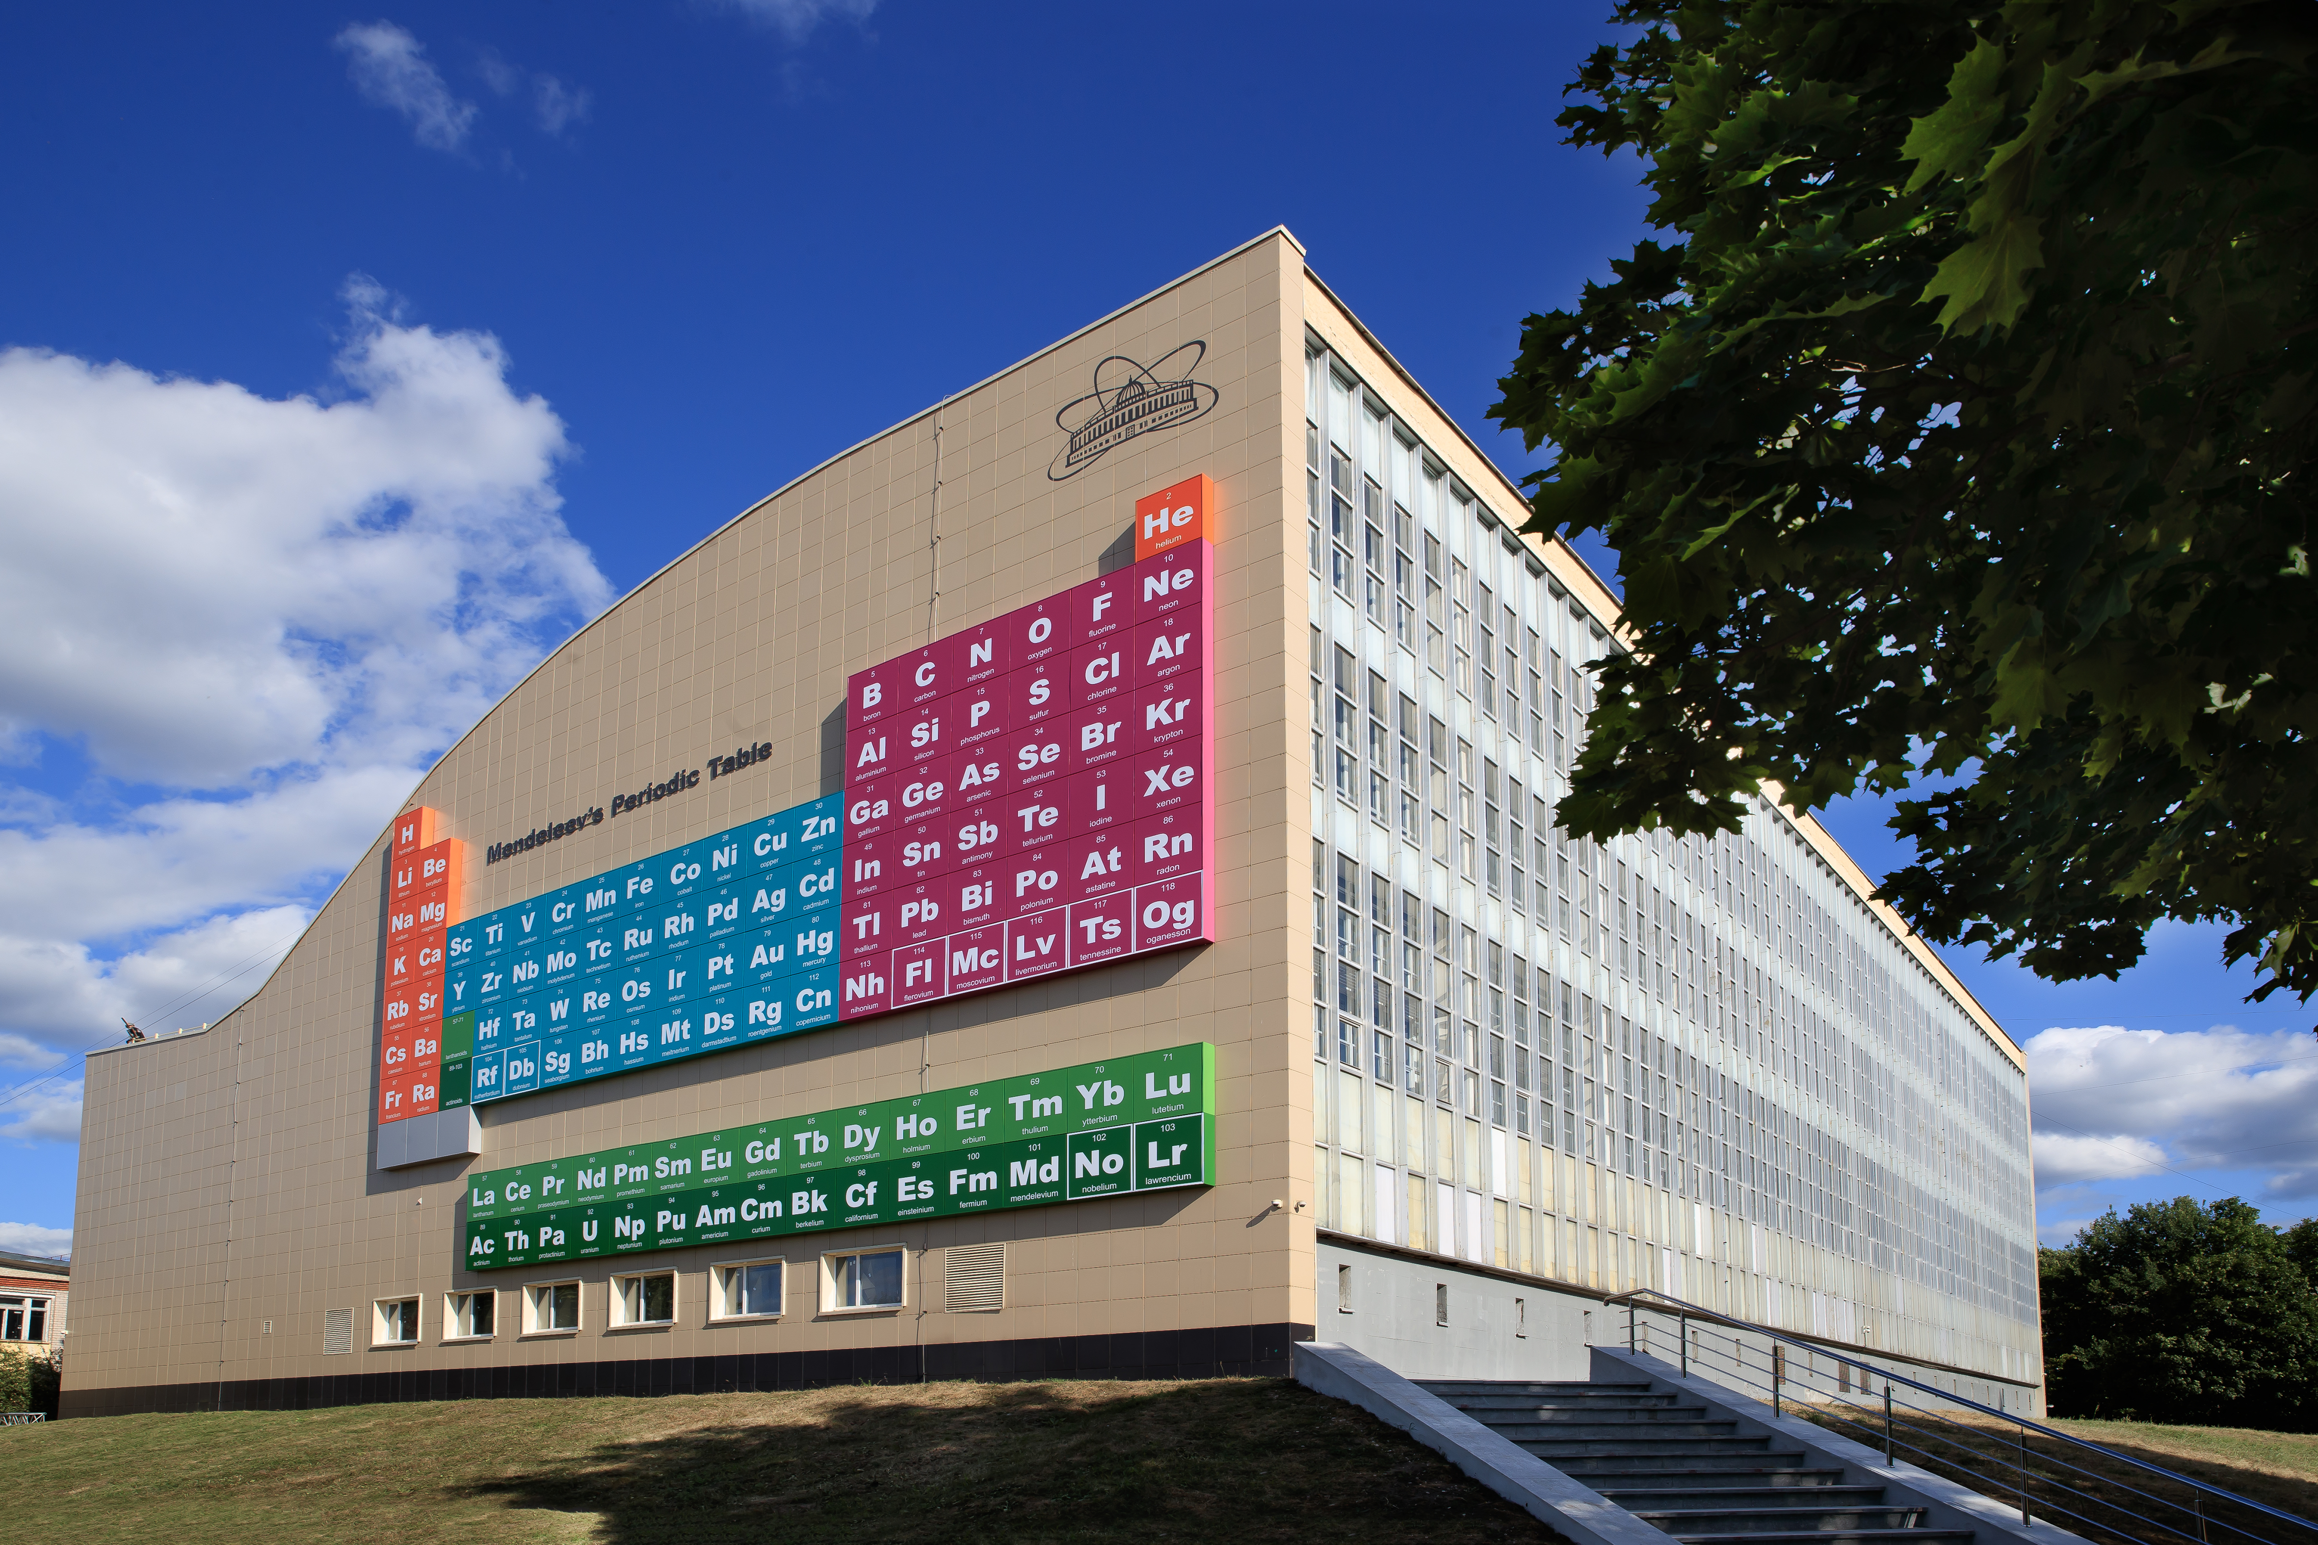
Spectroscopy of superheavy nuclei is now one of the most hot research areas
Perhaps, the most extensive experimental data are collected for transfermium region, in particular for nobelium isotopes

Slide 3
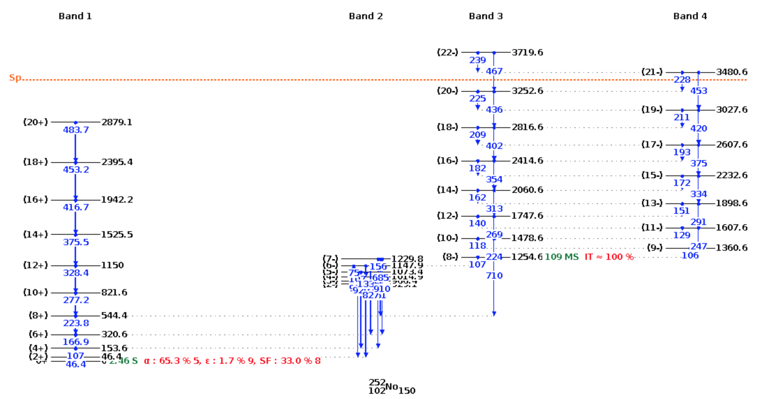
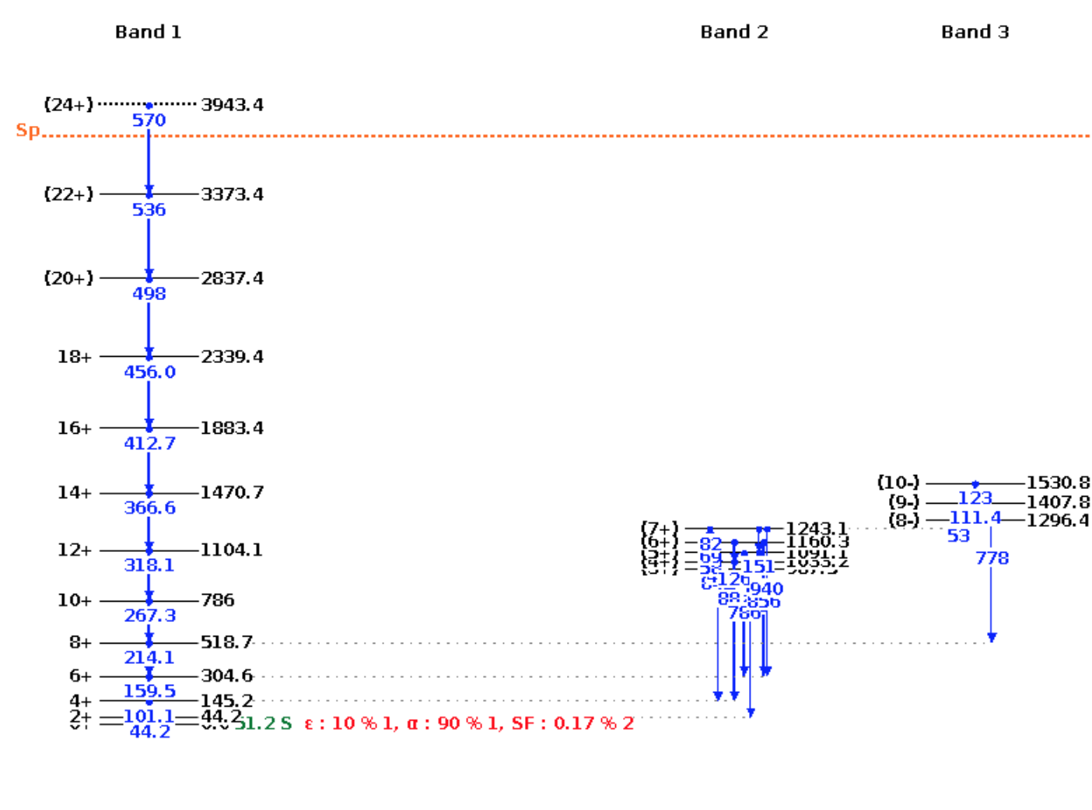
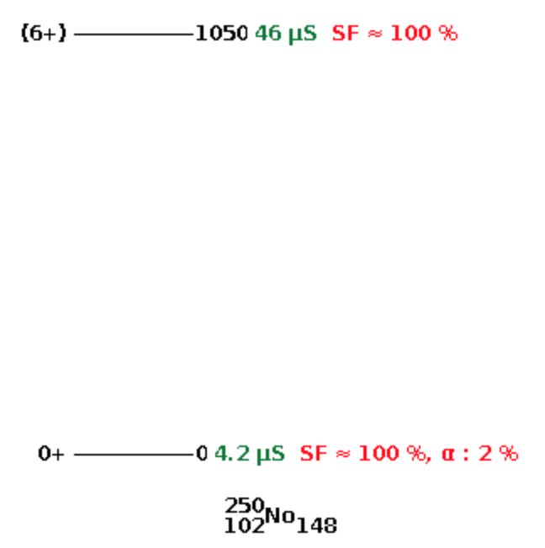

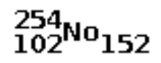
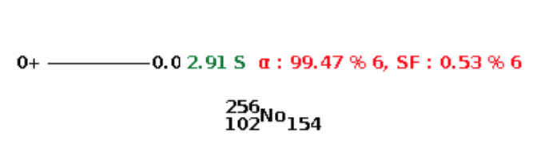
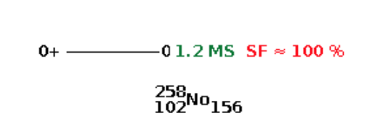
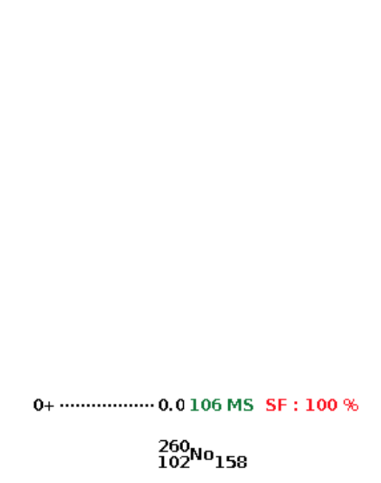
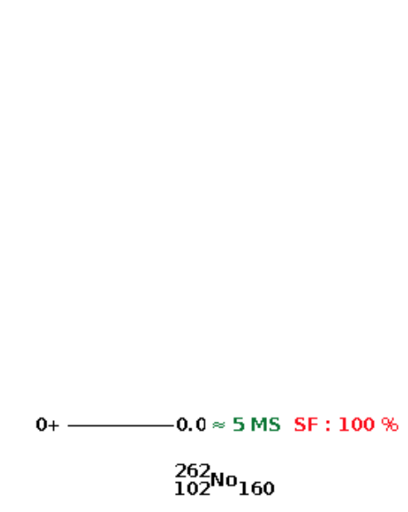
At the moment, there are experimental* spectroscopic data only for 3/7 nuclei: ^{250,252,254}No
>> | >
* NNDC data base

Slide 4
The chain of even-even Nobelium nuclei is one of the most studied superheavy nuclei:
[A. D. Efimov, I. N. Izosimov, JINR-E6-2022-19 (2022)]
[G.G. Adamian, N.V. Antonenko and W. Scheid, Phys. Rev., 024320,C 81 (2010)]
[R.V. Jolos, L.A. Malov, N.Yu Shirikova and A.V.Sushkov, J.Phys. G: Nucl. Part. Phys, 115103 (2011)]
The low-lying spectrum of ^{250,252,254}No;
Quadrupole moment of ^{252,254}No
Dipole giant resonance in ^{252,254}No;
The scissors mode of ²⁵⁰⁻²⁵⁶No;
Single-particle properties and rotational bands in the ^{252,254}No;
Spontaneous fission for the nuclei ²⁵⁰⁻²⁶⁰No
[R.V. Jolos et all, Phys. Part. Nucl. Lett. Vol. 19, No. 6 (2022)]
[W. Kleinig et all, Phys. Rev. C 78, 044313 (2008)]
[E.B. Balbutsev, I.V. Molodtsova, preprint arXiv: 2309.09340v2 (2023)]
[Yue Shi et all, Phys. Rev. C 89, 034309 (2014)]
[J. Dobaczewski et all, Nucl. Phys. A 944, 388 (2015)]
[R. Rodriguez-Guzman, L.M. Robledo, Phys. Rev. C 98, 034308 (2018)]
But, despite the great interest in these nuclei, the characteristics of the ground state of these isotopes are still poorly studied…

Slide 5
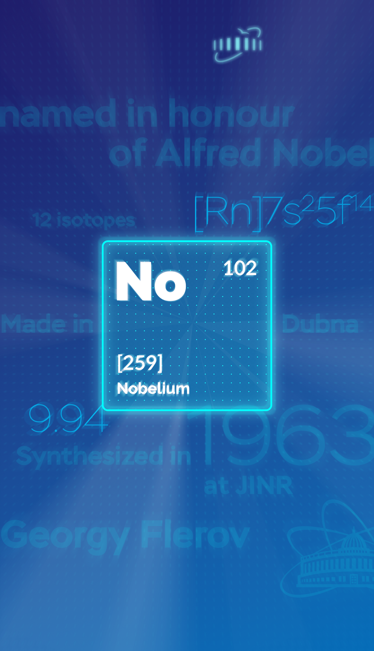
Despite an impressive theoretical effort:
Even modern self-consistent models still give rather different results and exhibit troubles in description of shell structures and other features seen in experiment
This work was partly done within QPM, IBM, double nuclear system, and cluster models (however, the above models are not self-consistent)
It is worth to enlarge the scope of calculated characteristics of superheavy nuclei and inspect, within the same self-consistent theory, a full set of low-energy vibrational states of main multipolarities:
K^{π} = 0⁺, 2⁺, 3⁺, 0⁻, 1⁻, 2⁻, 8⁻

Slide 6
The main attention is paid to ^{252,254}No where calculated:
K^{π}= 8⁻ isomers
(at 1.361 MeV in ²⁵²No and 1.747 MeV in ²⁵⁴No)
Pairing vibrations or superdeformation K^{π} = 0⁺
(at 0.77 MeV in ²⁵²No and 0.22 MeV in ²⁵⁴No)
States K^{π}=2⁺
(1.58 MeV in ²⁵²No and 1.31 MeV in ²⁵⁴No)
Hexadecapole states with K^{π} = 3⁺ and 4⁺
Octupole states with K^{π} = 0⁻, 1⁻, 2⁻ and 3⁻
Superdeformation in ^{250,252,254}No

Slide 7
The main attention is paid to ^{252,254}No where calculated:
K^{π}= 8⁻ isomers
(at 1.361 MeV in ²⁵²No and 1.747 MeV in ²⁵⁴No)
Pairing vibrations or superdeformation K^{π} = 0⁺
(at 0.77 MeV in ²⁵²No and 0.22 MeV in ²⁵⁴No)
States K^{π}=2⁺
(1.58 MeV in ²⁵²No and 1.31 MeV in ²⁵⁴No)
Hexadecapole states with K^{π} = 3⁺ and 4⁺
Octupole states with K^{π} = 0⁻, 1⁻, 2⁻ and 3⁻
Superdeformation in ^{250,252,254}No

Slide 8
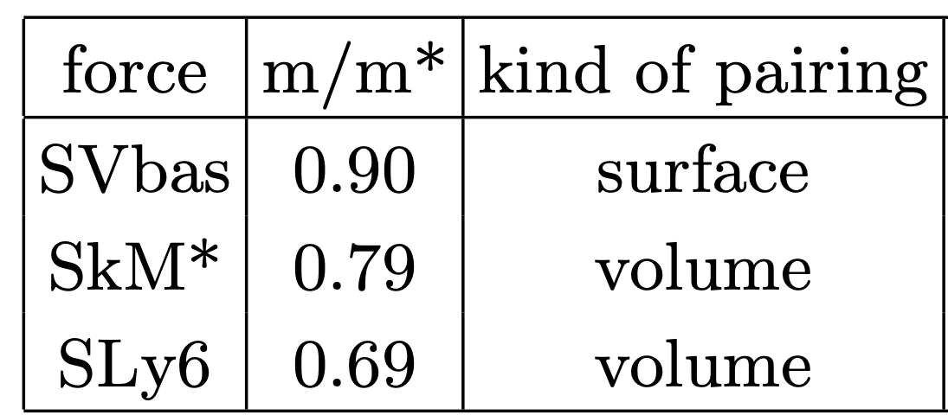
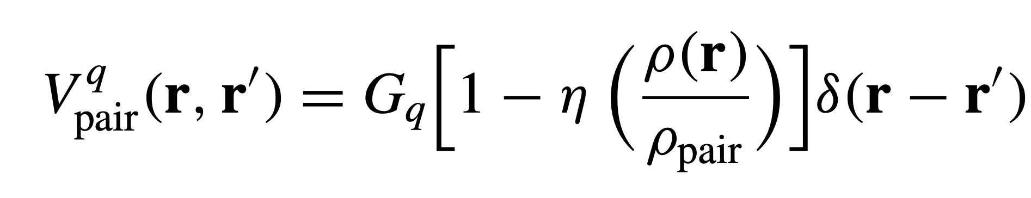
Skyrme forces
[P. Klupfel et al, PRC 79 034310 (2009)]
[J. Bartel et al, NPA 386, 79 (1982)]
[E. Chabanat et al, NPA, 635 231 (1998)]
Where Gq are pairing strength constants (q = p,n).
We get so-called density-dependent surface pairing for η = 1 and
volume pairing for η = 0
Calculation details:
Codes – SkyAx [P.-G. Reinhard et al, Comp. Phys. Communic. 258, 107603 (2021)]
QRPA [A. Repko et al, arXiv:1510.01248 (nucl-th), 2015]
Accurate extraction of spurious admixtures
[V. O. Nesterenko et al, Eur. Phys. J. A 55, 213 (2019)]
2D grid in cylindric coordinates
All proton and neutron s-p levels up to +40 MeV

Slide 9

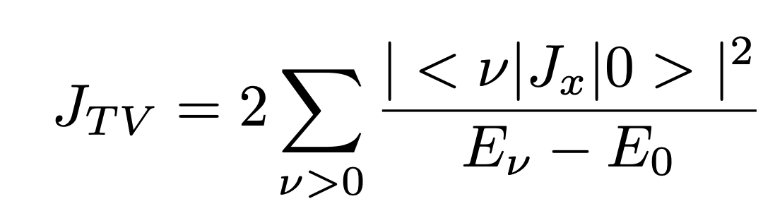

The characteristics of the ground states of ²⁵⁰⁻²⁶²No
with increasing number neutrons
Initially it was assumed that these characteristics would evolve monotonically, but we see irregularity at ^{252, 254}No

Slide 10
The characteristics of the ground states of ²⁵⁰⁻²⁶²No
with increasing number neutrons
Initially it was assumed that these characteristics would evolve monotonically, but we see irregularity at ^{252, 254}No

Slide 11
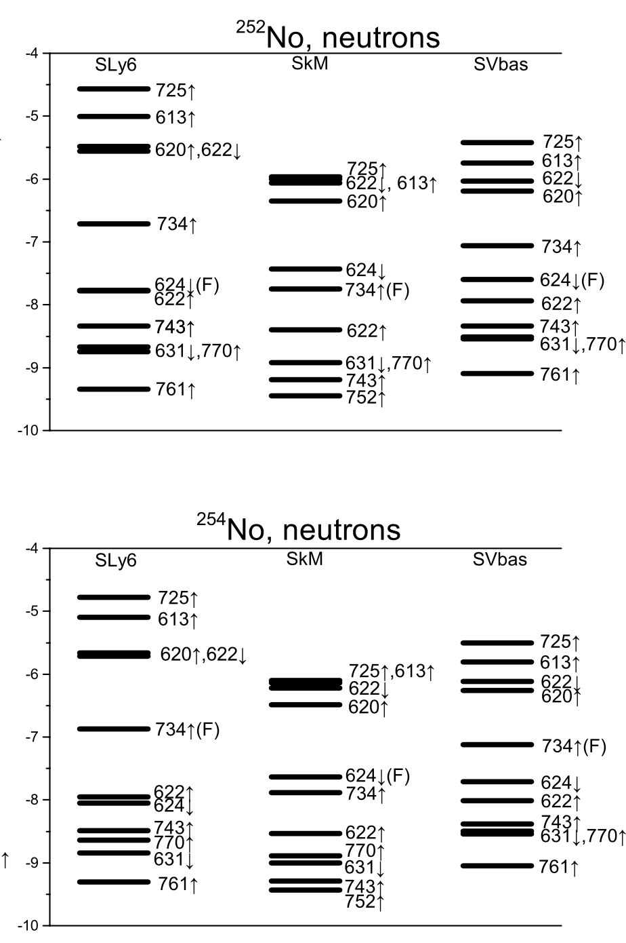
Does this irregularity (decline in neutron pairing)
depend on the chosen Skyrme force?
SLy6
SVbas
SkM
SLy6
SVbas
SkM
All 3 Skyrme forces support this irregularity;
For ²⁵⁴No the Fermi level isolated, so neutron pairing almost disappears;
For ²⁵²No the Fermi level is also quite far from neighboring levels, so pairing is also poorly developed

Slide 12
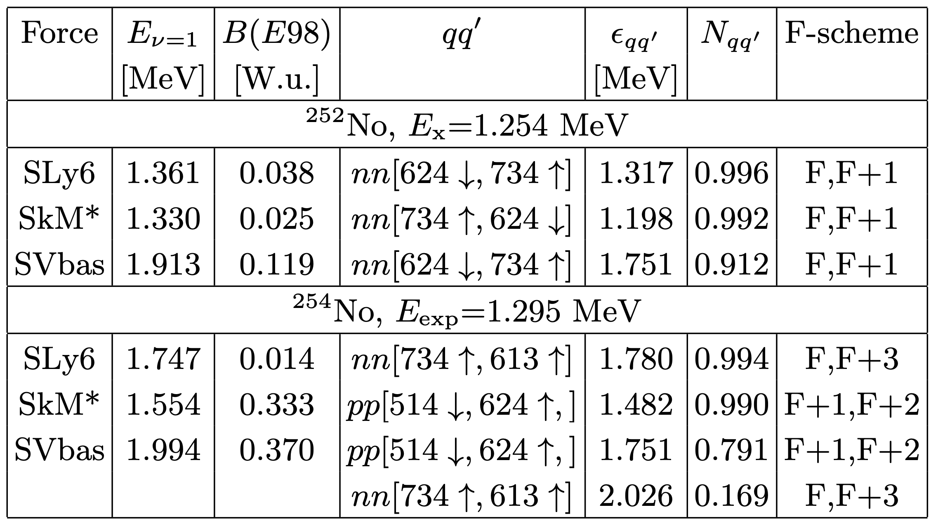
K^{π}= 8⁻ isomers
²⁵²No: the 8⁻ state is usually assigned as neutron 2qp configuration
nn[734 ↑, 624 ↓]
R.-D. Herzberg and P.T. Greenlees, Prog. Part. Nucl. Phys. 61, 674 (2008)
F.P. Heßberger, arXiv:2309.10468v2[nucl-ex].
B. Sulignano et al, Eur. Phys. J. A 33, 327 (2007).
²⁵⁴No: forces predict different 2qp configurations
nn[734 ↑, 613 ↓] and pp[514 ↓, 624 ↑]
V.G. Soloviev, A.V. Sushkov, A.Yu. Shirikova, Sov. J. Nucl. Phys. 54, 748 (1991)
R.M. Clark et al, Phys. Lett. B690, 19 (2010)
R.V. Jolos, L.A. Malov, N.Yu. Shirikova and A.V. Sushkov, J. Phys. G: Nucl. Part. Phys. 38, 115103 (2011).
Xiao-Tao He, Shu-Young Zhao, Zhen-Hua Zhang and Zhong-Zhou Ren, Chines Physics C 44, 034106 (2020)
G.G. Adamian, N.V. Antonenko, anf W. Scheid, Phys. Rev. C 81, 024320 (2010)
F.P. Hessberger et al, Eur. Phys. J A43, 55 (2010)
Features of calculated 8⁻ states in ^{252,254}No:
QRPA excitation energies E_{ν} =1,
reduced transition probabilities B(E98),
the main 2qp component qq′, its energy ε_{qq′} , contribution to the state norm N_{qq′} and F-scheme of 2qp excitation.

Slide 13
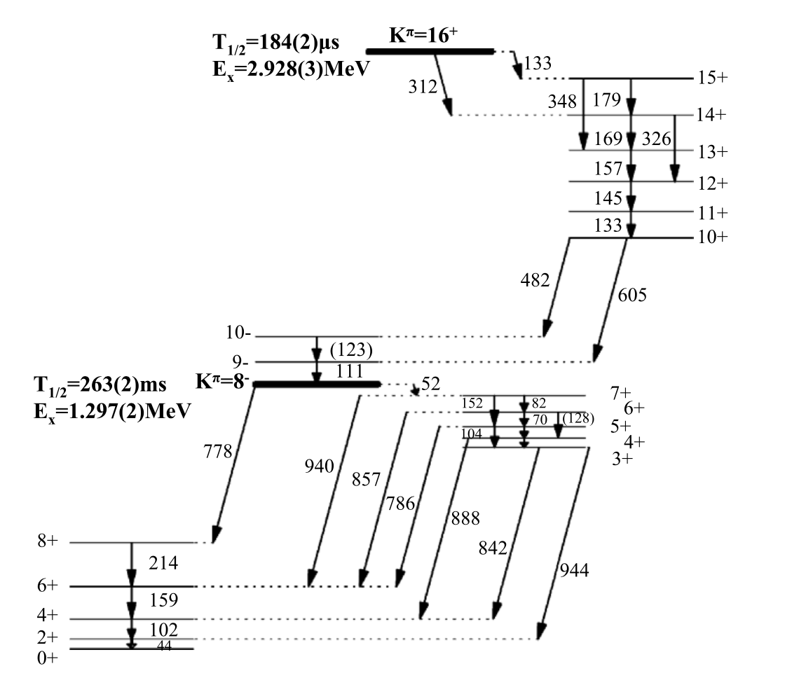
K^{π}= 8⁻ isomers
²⁵²No: the 8⁻ state is usually assigned as neutron 2qp configuration
nn[734 ↑, 624 ↓]
R.-D. Herzberg and P.T. Greenlees, Prog. Part. Nucl. Phys. 61, 674 (2008)
F.P. Heßberger, arXiv:2309.10468v2[nucl-ex].
B. Sulignano et al, Eur. Phys. J. A 33, 327 (2007).
²⁵⁴No: forces predict different 2qp configurations
nn[734 ↑, 613 ↓] and pp[514 ↓, 624 ↑]
V.G. Soloviev, A.V. Sushkov, A.Yu. Shirikova, Sov. J. Nucl. Phys. 54, 748 (1991)
R.M. Clark et al, Phys. Lett. B690, 19 (2010)
R.V. Jolos, L.A. Malov, N.Yu. Shirikova and A.V. Sushkov, J. Phys. G: Nucl. Part. Phys. 38, 115103 (2011).
Xiao-Tao He, Shu-Young Zhao, Zhen-Hua Zhang and Zhong-Zhou Ren, Chines Physics C 44, 034106 (2020)
G.G. Adamian, N.V. Antonenko, anf W. Scheid, Phys. Rev. C 81, 024320 (2010)
F.P. Hessberger et al, Eur. Phys. J A43, 55 (2010)
Features of calculated 8− states in ^{252,254}No:
QRPA excitation energies E_{ν} =1,
reduced transition probabilities B(E98),
the main 2qp component qq′, its energy ε_{qq′} , contribution to the state norm N_{qq′} and F-scheme of 2qp excitation.
R.M. Clark et al, Phys. Lett. B690, 19 (2010)

Slide 14
K^{π}= 8⁻ isomers
²⁵²No: the 8⁻ state is usually assigned as neutron 2qp configuration
nn[734 ↑, 624 ↓]
R.-D. Herzberg and P.T. Greenlees, Prog. Part. Nucl. Phys. 61, 674 (2008)
F.P. Heßberger, arXiv:2309.10468v2[nucl-ex].
B. Sulignano et al, Eur. Phys. J. A 33, 327 (2007).
[nn(734 ↑, 725 ↑)]
²⁵⁴No: forces predict different 2qp configurations
nn[734 ↑, 613 ↓] and pp[514 ↓, 624 ↑]
[nn(734 ↑, 725 ↑)]
V.G. Soloviev, A.V. Sushkov, A.Yu. Shirikova, Sov. J. Nucl. Phys. 54, 748 (1991)
R.M. Clark et al, Phys. Lett. B690, 19 (2010)
R.V. Jolos, L.A. Malov, N.Yu. Shirikova and A.V. Sushkov, J. Phys. G: Nucl. Part. Phys. 38, 115103 (2011).
Xiao-Tao He, Shu-Young Zhao, Zhen-Hua Zhang and Zhong-Zhou Ren, Chines Physics C 44, 034106 (2020)
G.G. Adamian, N.V. Antonenko, anf W. Scheid, Phys. Rev. C 81, 024320 (2010)
F.P. Hessberger et al, Eur. Phys. J A43, 55 (2010)
Features of calculated 8− states in ^{252,254}No:
QRPA excitation energies E_{ν} =1,
reduced transition probabilities B(E98),
the main 2qp component qq′, its energy ε_{qq′} , contribution to the state norm N_{qq′} and F-scheme of 2qp excitation.
R.M. Clark et al, Phys. Lett. B690, 19 (2010)

Slide 15
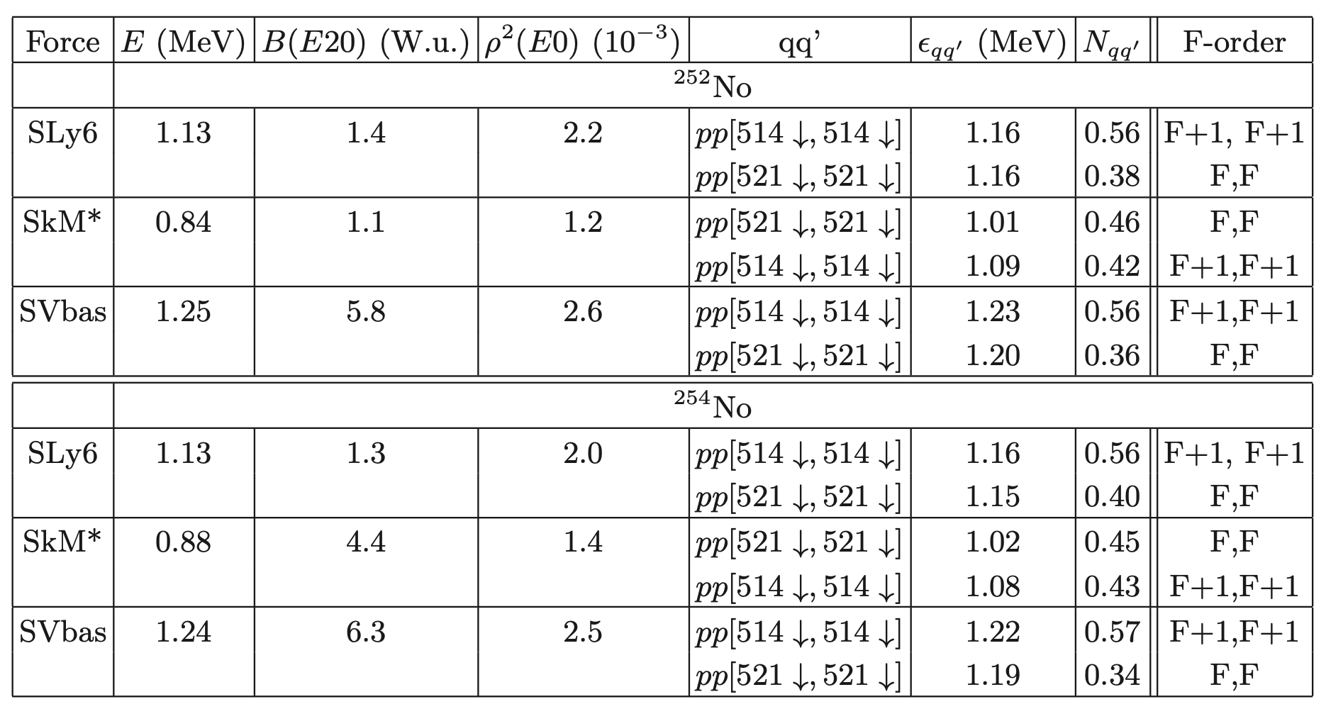
Pairing vibrations K^{π} = 0⁺
Calculations predict for the lowest K^{π} = 0⁺ state in ²⁵⁴No an exceptionally low excitation energy 0.22 MeV (this state is basically pairing vibrational)
Recent shell-model calculations with the projection after variation also predicts K^{π} = 0⁺ state with E=0.86 MeV as the lowest non-rotational state of ²⁵⁴No
(D.D. Dao and F. Nowacki, Phys. Rev. C 105, 054314 (2022))
[M. Forge et al 2023 J. Phys.: Conf. Ser. 2586 012083] also predicts K^{π} = 0⁺ state with E=0.89 MeV (shape coexistence)
So, excited 0+ states below 1 MeV in superheavy nuclei are quite possible

Slide 16
At the moment, there are experimental* spectroscopic data only for 3/7 nuclei: ^{250,252,254}No
>> | >
* NNDC data base

Slide 17
Pairing vibrations K^{π} = 0⁺
Calculations predict for the lowest K^{π} = 0⁺ state in ²⁵⁴No an exceptionally low excitation energy 0.22 MeV (this state is basically pairing vibrational)
Recent shell-model calculations with the projection after variation also predicts K^{π} = 0⁺ state with E=0.86 MeV as the lowest non-rotational state of ²⁵⁴No
(D.D. Dao and F. Nowacki, Phys. Rev. C 105, 054314 (2022))
[M. Forge et al 2023 J. Phys.: Conf. Ser. 2586 012083] also predicts K^{π} = 0⁺ state with E=0.89 MeV (shape coexistence)
So, excited 0+ states below 1 MeV in superheavy nuclei are quite possible

Slide 18
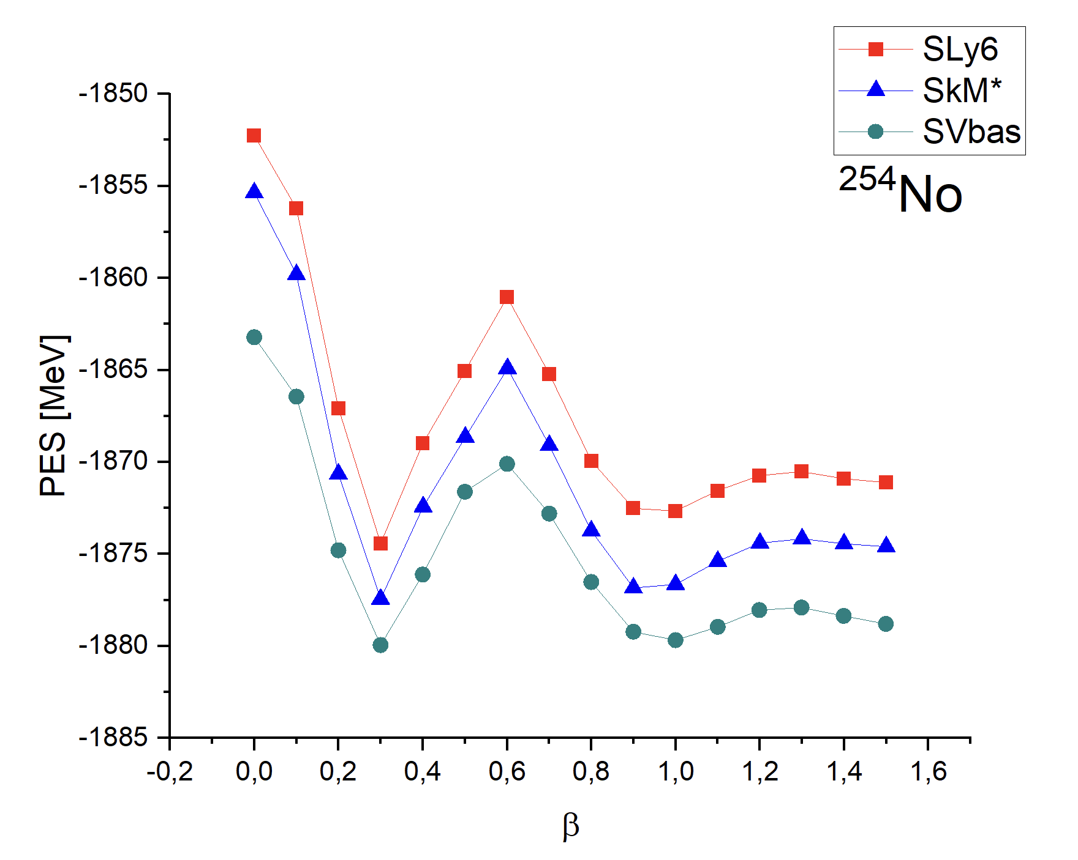

Few words about superdeformation:
All 3 Skyrme forces
demonstrate second minimum
$β≈1$
As before, let's focus on SLy6

Slide 19

^{250,252,254}No demonstrate superdeformation
(second minimum near $β=1)$

Slide 20
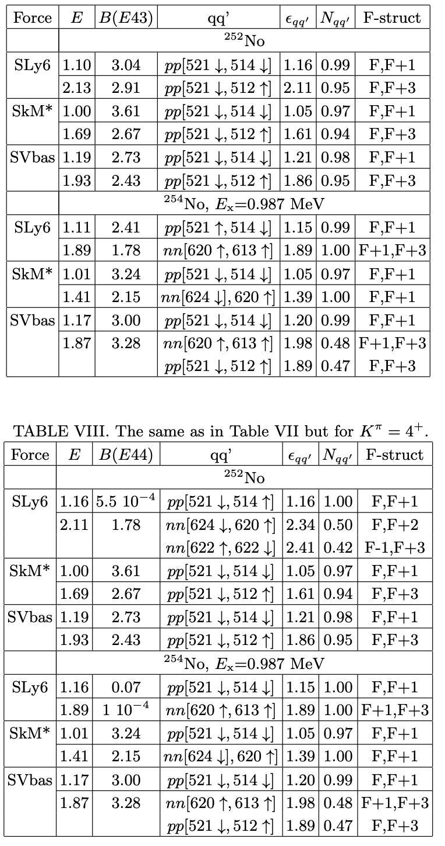
Hexadecapole states with K^{π} = 3⁺ and 4⁺
The first 3+ state is purely 2qp
All the forces predict for this state the proton 2qp configuration pp[521 ↓, 514 ↓]
So, we see that effect of the hexadecapole residual interaction for 3⁺ states in ^{252,254}No is negligible
The calculated 4+ states in ^{252,254}No have the energies and structure very similar to 3+ states. This is not surprising since both kinds of states are basically formed by the same proton 2qp configuration pp[521 ↓, 514 ↓] with |K1 − K2|=3 and K1 + K2=4.

Slide 21
Hexadecapole states with K^{π} = 3⁺ and 4⁺
The first 3+ state is purely 2qp
All the forces predict for this state the proton 2qp configuration pp[521 ↓, 514 ↓]
So, we see that effect of the hexadecapole residual interaction for 3⁺ states in ^{252,254}No is negligible
The calculated 4+ states in ^{252,254}No have the energies and structure very similar to 3+ states. This is not surprising since both kinds of states are basically formed by the same proton 2qp configuration pp[521 ↓, 514 ↓] with |K1 − K2|=3 and K1 + K2=4.

Slide 22
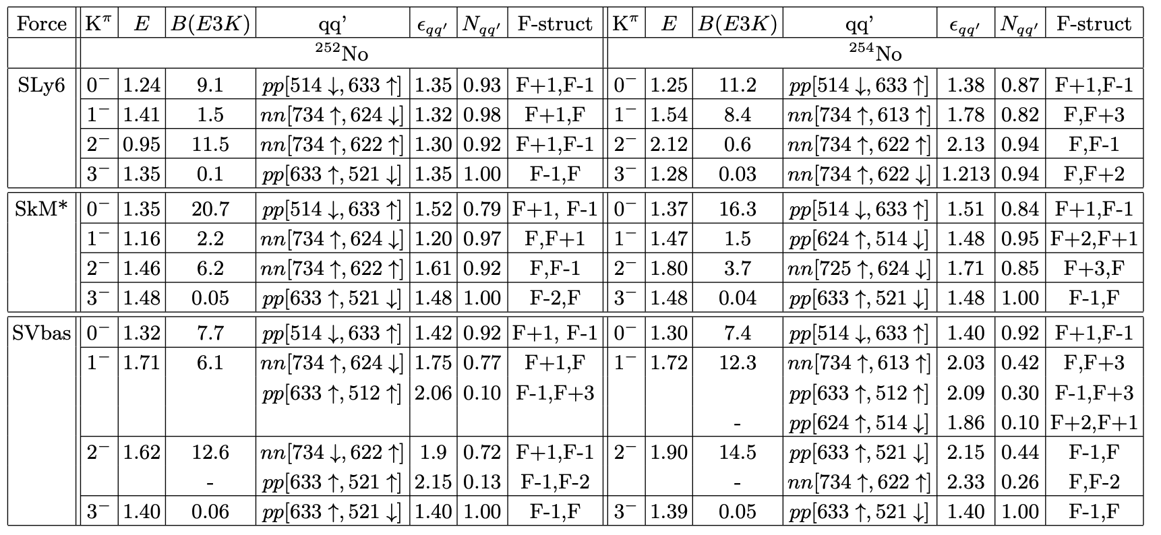
Octupole states with K^{π} = 0⁻, 1⁻, 2⁻ and 3⁻
In agreement with the experimental analysis, all three Skyrme forces suggest for the first 2⁻ state in ²⁵²No the 2qp configuration nn[734 ↑, 622 ↑]
In the QPM study [R.V. Jolos, L.A. Malov, N.Yu. Shirikova and A.V. Sushkov, J. Phys. G: Nucl. Part. Phys. 38, 115103 (2011)],
the first 2⁻ state is the lowest among the octupole excitations in ²⁵²No. We get the same result for SLy6 but not for SkM* and SVbas.
In ²⁵⁴No, our calculations for the first 2⁻ stat give rather high energies (1.80-2.12 MeV) and essentially different structure and collectivity.

Slide 23
Octupole states with K^{π} = 0⁻, 1⁻, 2⁻ and 3⁻
In agreement with the experimental analysis, all three Skyrme forces suggest for the first 2⁻ state in ²⁵²No the 2qp configuration nn[734 ↑, 622 ↑]
In the QPM study [R.V. Jolos, L.A. Malov, N.Yu. Shirikova and A.V. Sushkov, J. Phys. G: Nucl. Part. Phys. 38, 115103 (2011)],
the first 2⁻ state is the lowest among the octupole excitations in ²⁵²No. We get the same result for SLy6 but not for SkM* and SVbas.
In ²⁵⁴No, our calculations for the first 2⁻ stat give rather high energies (1.80-2.12 MeV) and essentially different structure and collectivity.

Slide 24
Octupole states with K^{π} = 0⁻, 1⁻, 2⁻ and 3⁻
In agreement with the experimental analysis, all three Skyrme forces suggest for the first 2⁻ state in ²⁵²No the 2qp configuration nn[734 ↑, 622 ↑]
In the QPM study [R.V. Jolos, L.A. Malov, N.Yu. Shirikova and A.V. Sushkov, J. Phys. G: Nucl. Part. Phys. 38, 115103 (2011)],
the first 2⁻ state is the lowest among the octupole excitations in ²⁵²No. We get the same result for SLy6 but not for SkM* and SVbas.
In ²⁵⁴No, our calculations for the first 2⁻ stat give rather high energies (1.80-2.12 MeV) and essentially different structure and collectivity.

Slide 25
The band of the ground state is slightly compressed
The band, which built on state 2⁻ is described well and the two others bands are also described satisfactorily

Slide 26
We also describing the 3 experimental bands quite well and working to carry out the more detailed analyzes about the band starting with 8⁻

Slide 27
Conclusion
The low-energy spectra of the Nobelium chain were studied within the framework of three
Skyrme forces (SLy6, SkM*, SVbas) with different types of pairing
It was shown that for the ground state bands of ²⁵⁰⁻²⁶⁰No the irregularity occurs
in the region ²⁵²⁻²⁵⁴No
For ^{252,254}No isotopes this irregularity associated with pairing effect and evolution of the single-particle spectrum
All three Skyrme forces maintain this irregularity, despite different types of neutron pairing (volume/surface)
The theoretically obtained bands for the lower spectrum for ^{252, 254}No are in good agreement with experiment
We also make the predictions about low-energy bands of different multipolarity
(K^{π} = 0⁺, 2⁺, 3⁺, 0⁻, 1⁻, 2⁻, 8⁻), some of then can be found experimentally for ^{252,254}No

Slide 28

Thank you for your attention!
_______
Low-energy spectra of nobelium isotopes: Skyrme random-phase-approximation analysis
Authors: V. O. Nesterenko, M. A. Mardyban, A. Repko, R. V. Jolos, P. -G. Reinhard

Slide 30
Backup slides

Slide 31
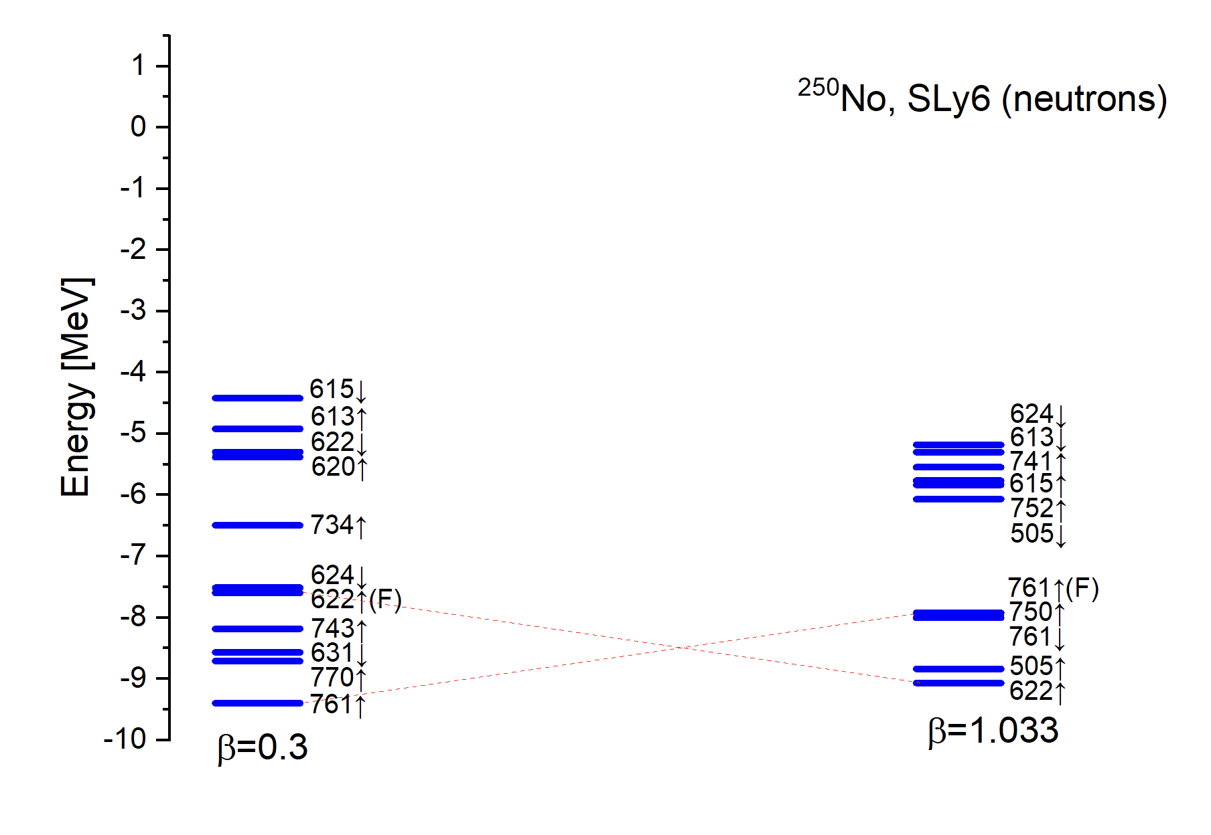
Dynamic of neutron spectrum with
𝛽=0.3 (equilibrium deformation)
and 𝛽=1
There is a gap near the Fermi level (in both case)
which can give strong pairing effects

Slide 32
Our tasks are:
- to analyze the occurrence of the irregularity for ^{252,254}No
- to make predictions not only for the ground state energy band, but for other bands too
The irregularity in ²⁵²No and ²⁵⁴No at low-energy spectrum

Slide 33
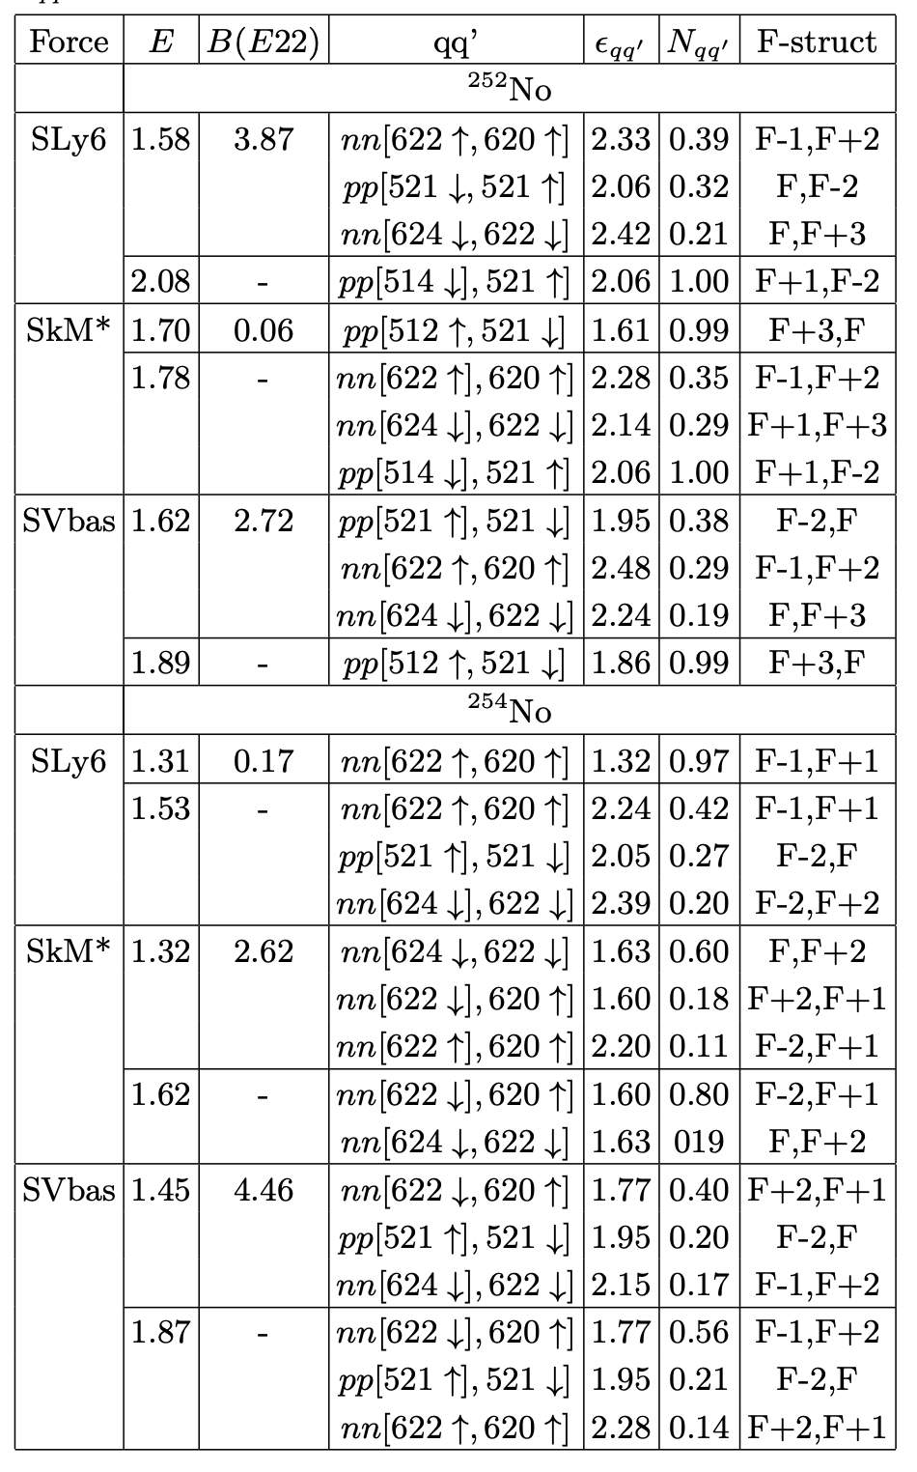
States K^{π} = 2
In most of the cases, if the first state is collective, then the next one is 2qp and vice versa, but:
The first K^{π} = 2⁺ - states are γ-vibrational collective in ²⁵²No (SLy6, SV-bas) and in ²⁵⁴No (SkM*, SV-bas)
Instead, the first 2⁺ states are purely 2qp in ²⁵²No (SkM*) and in ²⁵⁴No (SLy6)
Anyway, all the calculated 2+ lie above the observed 2⁻ (²⁵²No) and 3⁺ (²⁵²No) K-isomers
We know only IBM calculations
[A. D. Efimov and I. N. Izosimov, Phys. Atom. Nucl. 84, 660 (2021)];
[A. D. Efimov and I. N. Izosimov, JINR-E6-2022-19 (2022)]
In contrast to our results, calculations predict K^{π} = 2⁺ states at 1.09 MeV (²⁵²No) and 0.94 MeV (²⁵⁴No).
To estimate the true relevance of various theoretical results for No isotopes, the experimental data are necessary.

Slide 34
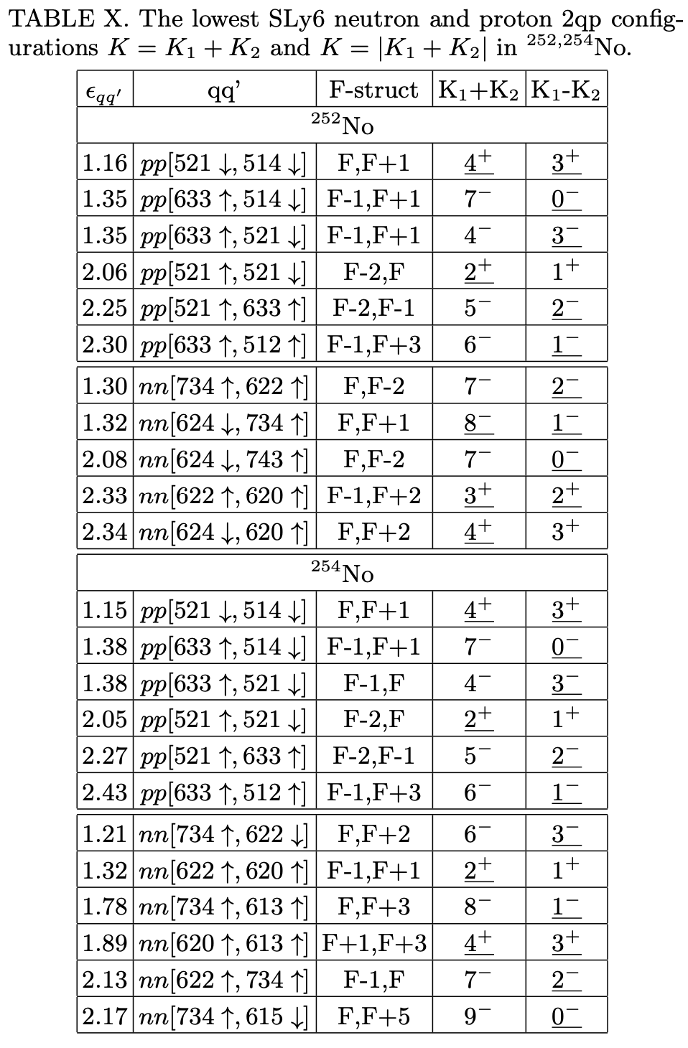
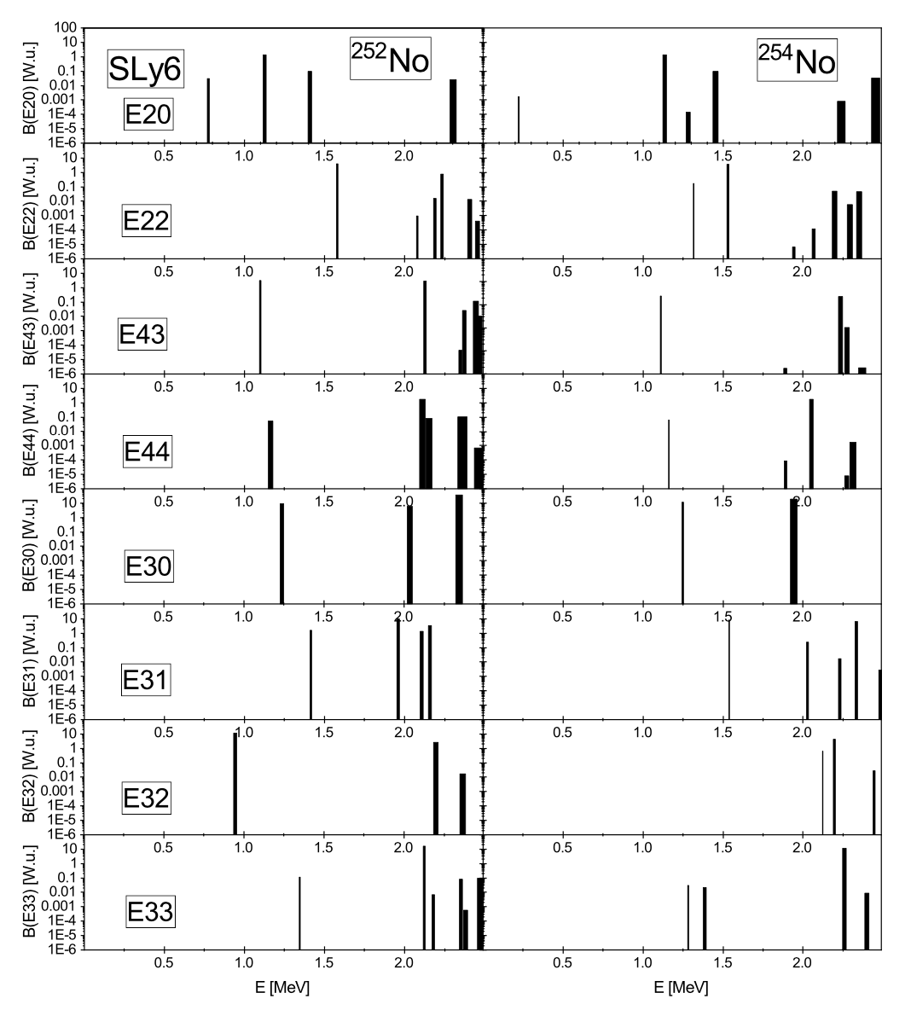

Slide 35
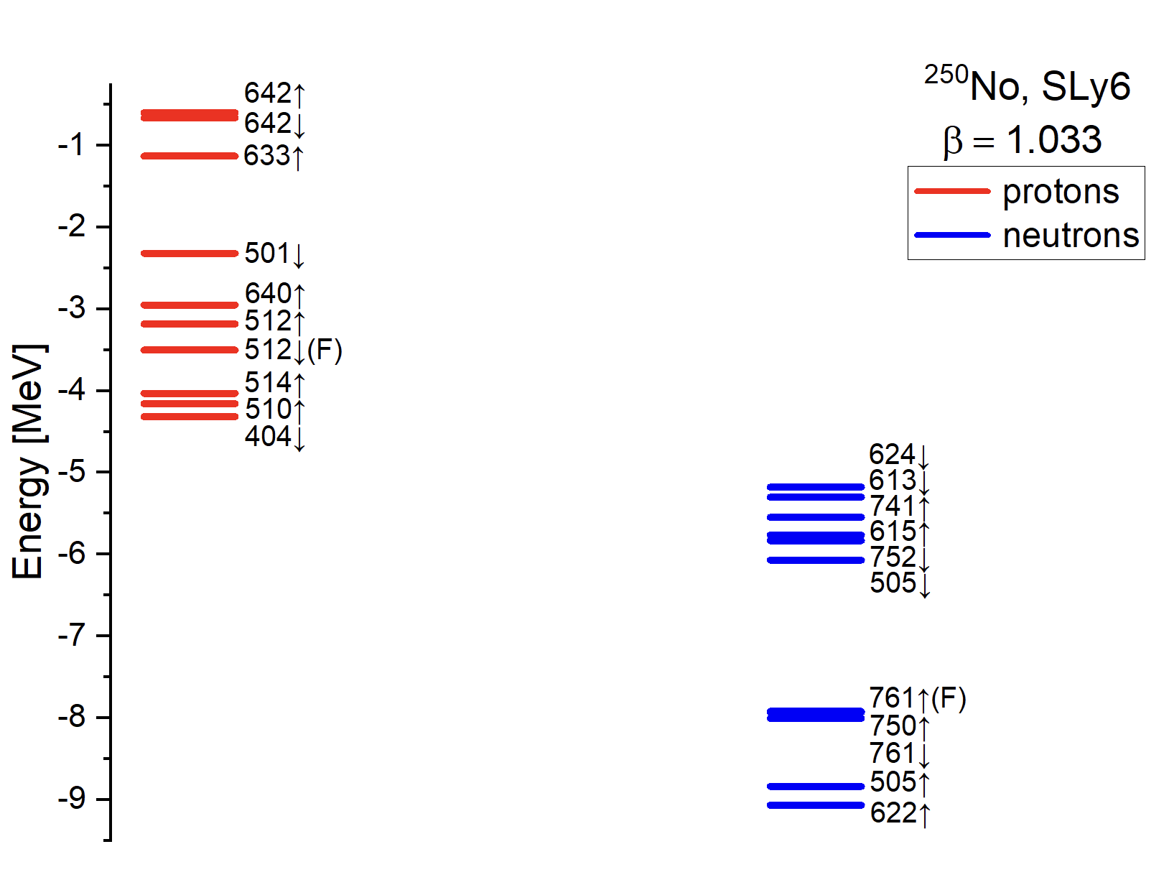

Slide 36
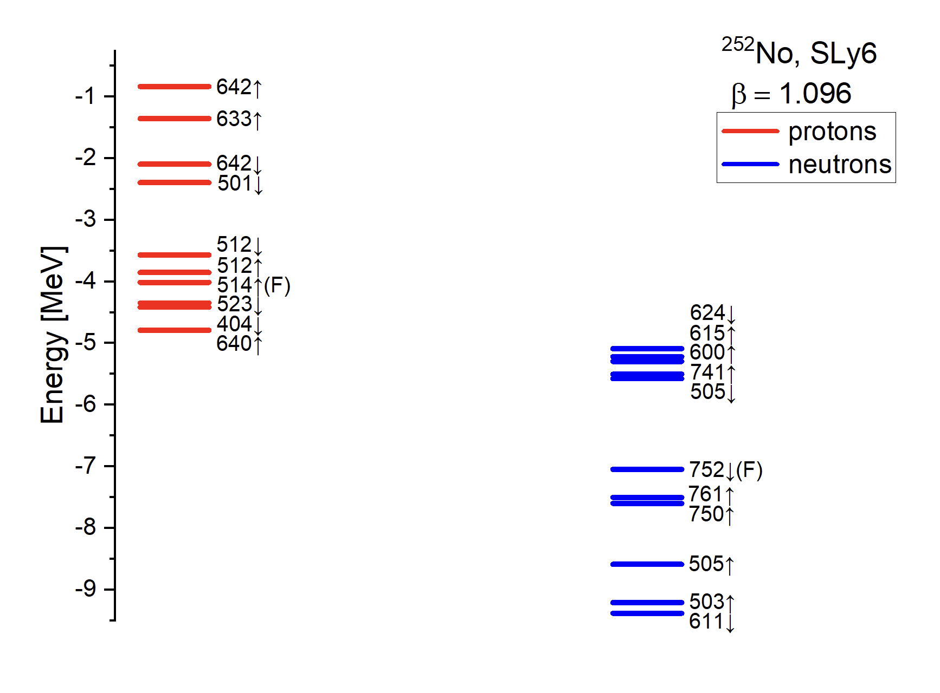

Slide 37
