Slide 1

Fundamental Symmetreis at NICA
(EDM, Axions, Parity and Time-Reversal Violation as Windows to
Baryogenesis and Dark Matter )
N.N. Nkolaev, Yu.N. Senichev
L.D.Landau Institute of Theoretical Physis, Chernogolovka
N.N.Bogoliubov Laboratory of Theoretical Physics, JINR, Dubna
Institute of Nuclear Research, Troitsk
«Физика фундаментальных взаимодействий»
К 70-летию со дня рождения Валерия Анатольевича Рубакова.
Президиум РАН, Москва, 17 -21 февраля 2025 г.
J.D. Bjorken (1987, with reference to spin crisis): “Polarization data has often been the graveyard of fashionable theories. If theorists had their way, they might well ban such measurements altogether out of self-protection”.

Slide 2
After RHIC → SPD@NICA assumes leadership in hafronic collider spin physics for decades to come → it is absolutely imperative to make NICA a versatile spin physics workhorse
Principal physics goal: gluon helicity in nucleons as an window at the spin crisis in QCD
A. Arbuzov et al., Prog.Part.Nucl.Phys. 119 (2021), 103858
Strong need for extension to fundamental symmetries; EDM, axions, parity and T-violation
Review: S. Vergeles et al., Usp.Fiz.Nauk 193 (2023) 2, 113-154;
I.Кoop et al Phys.Part.Nucl. 52 (2021) 4, 549-554
New ideas on update of existing infrastructure of NICA complex
Yu.N. Senichev et al., J.Phys.Conf.Ser. 2420 (2023) 1, 012052; JACoW IPAC2022 (2022), MOPOTK02
Yu.N. Senichev, talk at this conference
Focus of this talk: spin of particles in storage rings as an axion antenna
Basic approach: NMR-like signal in the pseudomagnetic field of axion halo in our galaxy

Slide 3
A state of the art in precision spin dynamics in storage rings
(more than a decade of JEDI @ COSY)

Slide 4
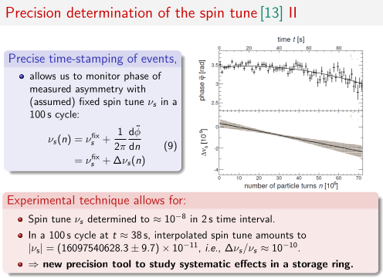
JEDI Collab. @ COSY
Excellent example of
Ramsay’s theorem
in action

Slide 6
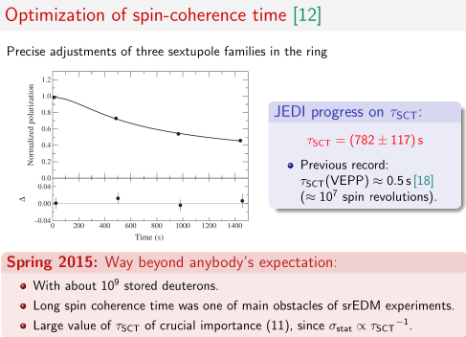
Stretching SCT by
Koop-Shatunov technique of
chromaticity minimization
JEDI: routine operation with coherence time of ~ 1500 s

Slide 7
CP Puzzle in QCD: P & T violating
, preserves renormalizibilty
Unobservable in perturbation theory, but Adler-Bell-Jackiw anomaly and instanton vacuum give
observable CP violation
Exact Peccei-Quinn chiral symmetry U(1)_{PQ} if there is a massless quark
EDM of nucleons
PSI (2020):
→
Swap the QCD angle for the dynamic pseudoscalaar field:
Spontaneous breaking of U(1)_{PQ} → light pseudoscalar axion as a likely source of dark matter
Weinberg (1978) from πNN to aNN → --: , ,

Slide 8
Relic axion dark matter
Coherent axion galactic halo Preskill, Wise, Wilczek (1983)
Abbott, Sikivie (1983)
Dine, Fischler (1983)
Review: Sikivie (2021)
Oscillating EDM
Axion halo acts on spin as a psedomagnetic field (P. Vorobiev, I.Kolokolov, I. Fogel (1989), R. Barbieri (1989))
Spins in storage rings move ∼1000 times faster than Earth w.r.t. galatic halo axions → enhanced pseudomagnetic field, Foldy-Wouthuysen treatment is mandatrory Silenko (2022)
Instantaneous spin rotation
pseudomagnetic field (= rf solenoid) oscillating EDM (= Wien filter)
π/2 phase shift of two spin rotators with orthogonal spin rotation axes --- spin rotations are in sync
Axion induced resonance spin-flip angular velocity Silenko (2022), NNN (2022)
is independent of the spin-axion phase difference

Slide 9
Dynamics of the Froissart-Stora scan: axion phase ambiguity
Duration of the spin-jump must be shorter than the axion coherence time
JEDI sensitive to m_{a} = 0.5 neV, lab velocity wrt axions halo v ~10⁻³ → τ ∼ 10 s, tune ramp rate properly
At least 1 s for single determination of the spin phase
Spin-flip frequency is independent of the entirely unknown relative spin-axion phase Δ
But the resonant spin jump is ~ cos Δ
Multiple bunch solution for the phase problem
N.B. Rotation of spin from the initial vertical to the horizontal one is entirely free of the phase ambiguity → axion signal is an nemergece of precessing in-plane velocity

Slide 10
90% confidence level sensitivity for excluding the axion (ALP) induced oscillating EDM of the deuteron (assuming the EDM dominance)
Basically no direct experimental upper bounds in the PDG tables on the static EDM of bare protons and deuterons to compare with
JEDI @ COSY
Tune antenna rampimg beam energy
Altogether 103 ramps
Frequency range 120-121.4 kHz
Axion mass range 4.95-5.02 neV/c²

Slide 11
Axions at PTR and NICA facility( Nuclotron and 8-ring) NNN (2022)
PTR (CPEDM): prototype hybrid E+B confinement of 45 MeV frozen spin protons on orbit
Prime motivation: test of the frozen spin approach to a search for the EDM of protons
Cyclotron frequency
Frozen spin =0 → zero mass axion antenna
Lift the frozen spin condition, but retain the beam momentum and cyclotron frequency (WF regime)
The axion resonance at , broadband axion antenna: ~ 0-0.5 MHz
Change of paradigm for protons: look for axion induced rotation of the vertical spin into ring plane, buildup of precessing in-plane polarizatioin
WF regime can well be realized at
NICA with bypasses
Modified Nuclotron with extenbded straight sections ( Yu.N. Senichev’s talk)
Straight section of the 8-ring as polarization preserving injector to NICA

Slide 12
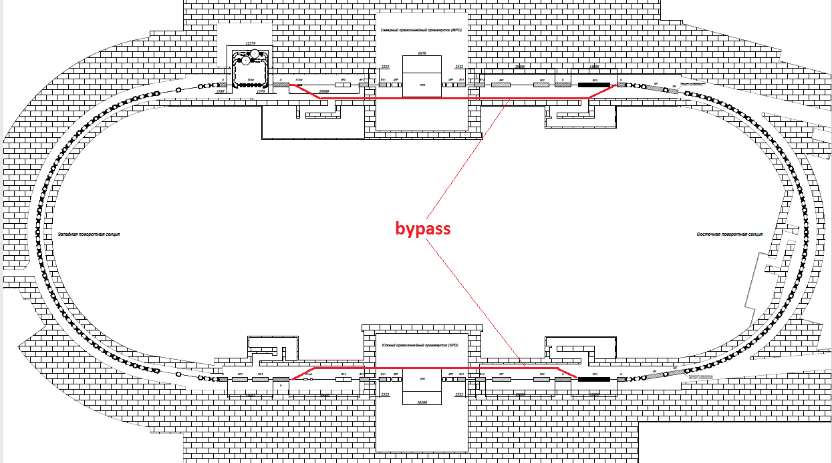
NICA as a hybrid axion antenna with E+B bypasses
Prime motivation: quaisi-frozen deuteron spin at NICA to search for the deuteron EDM
Two approx. 100 m bypasses will endow NICA with partial features of PTR
Bypasses with magentic dipoles and electric deflectors act on spin as static WFs
Still better: long straight sections in the new Nuclotron (under discussion)
Y. Senichev et al. (2022)
More in Senichev’s talk
Bypass guarantees
no interference with
SPD and MPD operation !

Slide 13
Bypass/Straight sections
Scan maintaining the integral Wien filter features
Effective length of the Wien filter per straight section ~ 10 m
Band width at a fixed energy and orbit
Polarimetry preferred proton energy ~270 MeV
Protons: axion resonance buildup of the horizontal polarization
Need time-stamped polarimetry for detection of the precessing horizontal polarization
Fourier analysis of oscillating horizontal polarization is basically free of systematics
Proton antenna more sensitive than the deuteron one: larger magnetic moment, lower mass
(1+G) q E L
Δf_{s} =
________
f_{rev} → 2 x 15/γ²β kHz
2π mc²γ²β²

Slide 14
Selected references
Classic papers: R.D. Peccei and H.R. Quinn, Phys. Rev. Let., 38, 1440 (1977)
S. Weinberg, Phys. Rev. Lett. 40, 279 (1978)
F. Wilczek, Phys. Rev. Lett. 40, 279 (1978)
V. Baluni, Phys. Rev. D., 19, 2227 (1979)
R.J. Crewther et al., Phys. Lett. B88, 123 (1979), B91, 497 (1980)
Pseudomagnetic field and NMR phenomena: P.V. Vorov’ev, I.V. Kolokolov, V.F. Fogel, JETP Lett., 50, 65 (1989)
Reviews: P. Sikivie, Rev. Mod. Phys., 93 (1), 015004 (2021) and references therein
S. Vergeles, N. Nikolaev, Yu. Obukhov, A. Silenko and O. Teryaev, Physics – Uspekhi, 66(2), 147 (2023) and references therein
Le Passe–muraille: A.A. Anselm, Sov. J. Nucl. Phys. 42, 936 (1985)
S.V. Troitsky, JETP Lett. 116 (2022) 11, 767-770
D.Salnikov et al., JETP Lett.,117, 889–897 (2023)
Supernova axions: N. Bar, K. Blum and G. D’Amico, Phys. Rev. D., 101, 13025 (2020)
Oscillating EDMs: P.W. Graham et al., Phys. Rev. D97, 055006 (2018)
Axions in storage rings: J. Pretz et al., Eur. Phys. J., C80, 107 (2020)
A. Silenko, Eur. Phys. J., C82, 856 (2022)
N. Nikolaev, JETP Lett. 115(11), 523 (2022)
JEDI@COSY: first search for axions in SR : S. Karanth et al. , Phys. Rev. X., 13? 031004 (2023) and extensive list of references therein
Axions and EDM at NICA: Y. Senichev et al., J. Phys: Conf. Ser. 2420, 012052 (2023); JACoW Publ., IPAC-22, 492 (2022)

Slide 15
Summary and outlook
Any new facility has to have a versatile physics program with multipurpose detectors
It is imperative to extend the physics program of SPD to novel tests of fundamental symmetries
Don’t overlok a potential of the external target experiments.
Спасибо за терпение и внимание!

Slide 16
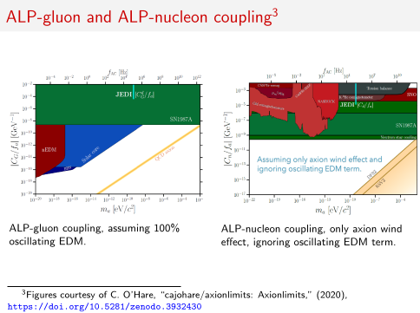

Slide 17
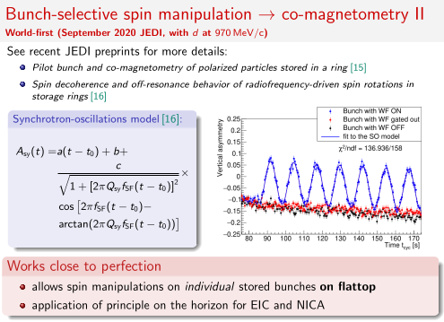
J. Slim et al.,
2309.06561 [physics.ins-det]
N. Nikolaev et al.,
2309.05080 [physics.acc-ph]

Slide 18
1. Senichev Y, Aksentev A, Ivanov A and Valetov E., Frequency domain method of the search for the deuteron electric dipole moment in a storage ring with imperfections, preprint arxiv:1711.06512 [physics.acc-ph], 2017
2. A E Aksentev and Y V Senichev, Frequency domain method of the search for the electric dipole moment in a storage ring, J. Phys. Conf. Ser.1435, 012026 (2020), URL https://doi.org/10.1088/1742-6596/1435/1/012047.
3. A. A. Melnikov, Yu. V. Senichev, A. E. Aksentyev, S. D.Kolokolchikov, The nature of spin decoherence of a polarized beam of light nuclei in a storage ring for EDM search, Письма в ЖЭТФ, 118 (2023) 713-720

Slide 19
Testing SM by Parity Violation (PV)
The observable: PV beam helicity dependence of the total X-section and elastic scattering
New approach: single turn extraction of horizontal polarized beam onto extrenal target--- time-tag control of the extracted horizontal beam helicity
A challenge to experimentalists: the expected asymmetries are few 10⁻⁸ to 10⁻⁷ ⁻⁻⁻ counting events is entirely hopeless, measure beam current upstream and downstream thick nuclear target instead
I.A. Koop, A.I. Milstein, N.N. Nikolaev, A.S. Popov, S.G. Salnikov, P.Yu. Shatunov, Yu.M. Shatunov, Tests of Fundamental Discrete Symmetries at the NICA Facility: Addendum to the Spin Physics Programme, Physics of Particles and Nuclei, 52(4), 549-554 (2021); Physics of Particles and Nuclei, 52(6), 1044-1119 (2021)
Polarimetry requirements: < 1 GeV/c deuterons are favored
High energy: B.G. Zakharov, Sov. J. Nucl. Phys. Sov. J. Nucl. Phys., 42 (3), 479-482 (1985)]

Slide 20
PV expt with deuterons extracted from Nuclotron – 2
Counting single events is unrealistic (?): measure the total charges of bunches in front of and behind the external target.
Non-invasive measurement of the beam charge by Rogowski coils
Bunched beam: signal from the Rogowski coil = the derivative of the beam current
Two integratons:
1-st integration → current of the bunch
2-nd integration → total charge in the bunch
Upstreasm and downstream families of 3-5 Rogowski coils for crosscheck and boosting the precision
The complementary polarimetry behind the target to monitor the polarization of the beam
PV asymmetries < 10⁻⁷ are within the reach in 1 month at NICA

Slide 21
PV expt with single-turn extraction of deuterons from Nuclotron
I.A. Koop, A.I. Mil’shtein, N.N. Nikolaev, A.S. Popov, C.G. Sal’nikov, P.Yu. Shatunov, Yu.M. Shatunov, Physics of Particles and Nuclei, 52(4), 549-554 (2021)
Store vertically polarized beam (upgraded Nuclotron to boost intensity)
Fast (< 1 s) rotation of spin from vertical to the in-plane by RF spin flipper (solenoid)
JEDI: the precessing spin phase is measured by time-stamp of oscillating radial polarization : P_{x} = +/-1 at internal polarimeter within 1-2 s
Time stamp allows single-turn extraction of the bunch of any desired helixity: P_{z} = +/-1 for PV studies
Fourier anlysis of the PV would reduce systematics
Beam prep & spin-flip & polarimetry & extraction cycle shorter than 5 s → > 5x10⁵ cycles per month
No stringent demands for the deuteron beam cooling from the spin coherence time consideration (5 s << 1400 s of JEDI)
Protons might be problematic because of short spin coherence time?
A possibility to run PV expt in Nuclotron parasitically while NICA is busy in the collider mode ?
Modest additions to Nuclotron: RF spin flipper and polarimeter --- they are imperative anyway

Slide 22
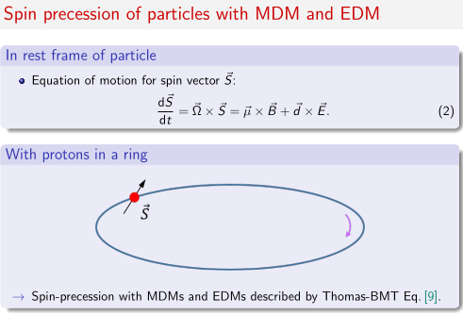
N. Ramsey’s theorem: frequency
is a unique observable measureable
to a very high precision
Ultracold neutrons: F.L. Shapiro
(1967, JINR)
Breakthrough UCN experiment:
I.S. Altarev et al. (1980, 1981, ЛИЯФ)
Neutron EDM: collinear E and B.
Signal of EDM = shift of the spin
precession frequency after flip
of the electric field

Slide 23
What is the state of art in PV?
SIN (PSI): pp elastic scattering at 45 MeV (SIN), several years of running, S. Kystrin et al. PRL 58 (1987) 1616
A_{PV} = (1.5 +/- 0.22) 10⁻⁷
Consistent with expectations from low-energy meson exchange model
ANL ZGS: p(H₂0), 5.1 GeV, Nigel Lockyer et al. Phys.Rev. D30 (1084) 860
A_{PV} = (26.5 +/- 6.0 +/- 3.6 ) 10⁻⁷
None of theorists has ever been able to explain this gigantic effect

Slide 24
Spin coherence time: crucial issue for protons
C. Weidemann et al., Phys. Rev. ST Accelerators and Beams, 18, 020101 (2015)
49.3 MeV protons in COSY
Without spin-flips the vertical polarization lifetime (2.7 +/- 0.5) 10³ s
99 spin flips during 300 s
Flipping polarization lifetime 240 s.
Strong evidence for the polarization loss by spin decoherence in the horizontal plane
Arguablly the spin coherence time ~ 1/(Gβ²γ)² A.Lechrach et al. e-Print: 1201.5773 [hep-ex]
Low energy protons are preferred
More experimental scrutiny on stretchcing spin coherence time of protons is in order (sextupoles ?)

