Slide 1
Ksider - Own work, CC BY 3.0, https://commons.wikimedia.org/w/index.php?curid=31992869
First physics studies planned with the MPD experiment at NICA in Bi+Bi collisions
at √ sNN = 9.2 GeV
G. Feofilov* (for MPD Collaboration at NICA) *St. Petersburg State University, St. Petersburg, RF E-mail: g.feofilov@spbu.ru
Moscow, Russia, February 17, 2025, 15:00-15:15
The author acknowledges Saint-Petersburg State University for a research project 103821868
Notes:
1

Slide 2
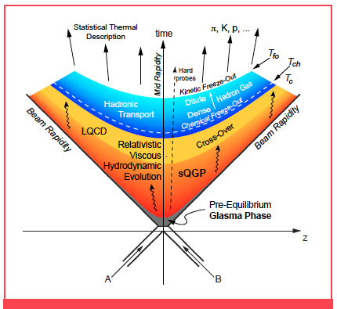
Introduction. Space-time stages of nucleus-nucleus collision at LHC and QGP
Pre-equilibrium phase
τ_{eq}< 0.5 fm/c
QGP medium
Almost perfect liquid: η/s ~ 0.1
Temperature: ~300 MeV from the photon spectrum inverse slope
Large volume: ~5000 fm³
Mean life time: τ ~ 10 fm/c
Energy density (in central Pb-Pb collisions at 5.02 TeV): ≈20 GeV/fm³ (>>ε_{crit} ≈ 1 GeV/fm³)
Mixed phase
Chemical freeze-out:
particle composition is fixed
at T_{ch} ~ 155 MeV
Thermal freeze-out:
particle p_{T} spectra are fixed
at T_{tfo} ~ 100 MeV
[1] http://www.nupecc.org/lrp2016/Documents/lrp2017.pdf
[2] ALICE Collaboration, “The ALICE experiment. A journey through QCD” , arXiv:2211.04384, Eur. Phys. J. C 84 (2024) 813 https://doi.org/10.1140/epjc/s10052-024-12935-y
z
i
From LHC to lower energies →
4 April 2024, G.Feofilov (for ALICE Collaboration)
Notes:
fast equilibration, within roughly 10^{–24} s,
The resulting deconfined and thermalised medium expands and cools over the next few 10^{–24} s, before the quarks and gluons recombine to form a hadron gas.

Slide 3
Introduction.
QCD phase diagram
Useful references:
[1] B. Mohanty, N. Xu, “QCD Critical Point and High Baryon Density Matter“, arXiv:2101.09210
[2] Alejandro Ayala,
"Recent progress in heavy-ion physics: A theoretical review"
https://indico.particle.mephi.ru/event/436/contributions/4130/attachments/2575/4727/ICPPA_2024.pdf
[3] S. Gupta, X. Luo, B. Mohanty et al., “Scale for the phase diagram of quantum chromodynamics”. Science: 332, 1525–1528 (2011).doi:10.1126/science.1204621
[4] Xiaofeng Luo, Nu Xu, ‘Search for the QCD critical point with fluctuations of conserved quantities in relativistic heavy-ion collisions at RHIC: an overview’, NUCL SCI TECH (2017) 28:112, DOI 10.1007/s41365-017-0257-0
Conjectured QCD phase diagram of temperature (T ) versus
baryonic chemical potential (B )[1].
Notes:
The red-yellow dotted line corresponds to the chemical freeze-out obtained from the ts of particle yields in heavy-ion collisions using a thermal model.
The liquid-gas transition region features a second order critical point (red- circle) and a rst-order transition line (yellow line) that connect the critical point to the ground state of nuclear matter (T 0 and B 925 MeV)

Slide 4
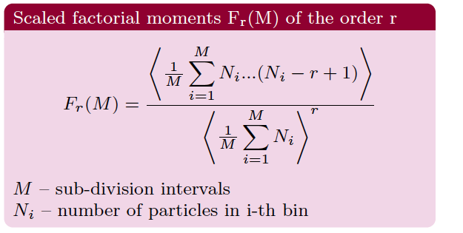
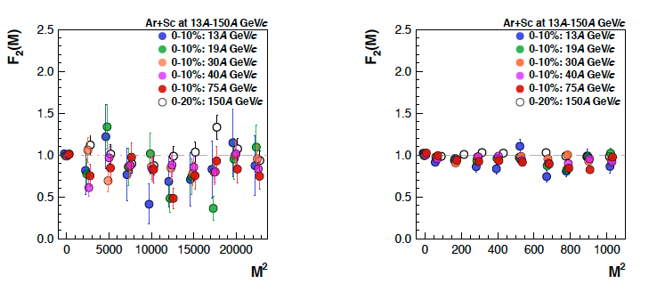
NA61/SHINE extensive search of CEP: √ s_{NN}~6-10 GeV NA61/SHINE strong interaction program, extensive studies:
Multiplicity fluctuations--no collision energy dependence has been observed in Ar+Sc data [1]
Net-charge fluctuations—no significant non-monotonic signals[2]
Bose-Einstein (HBT) correlations –no indication for critical behavior was observed so far[3]
Intermittency analysis of scaled factorial moments [4] --no indication for power-law increase with cumulative pT binning [5]
[1] NA61/SHINE, PoS CPOD2017 (2018) 012; Andronov, Kuich, Gazdzicki, Universe 9 (2023) 2, 106
[2] NA61/SHINE, PoS(PANIC2021)238 NA61/SHINE, Status Report 2022
[3] S´andor L¨ok¨os, Probing the QCD phase diagram with HBT femtoscopy, arXiv:2206.13952v2 [hep-ex] 13 Oct 2022, Acta Phys. Pol. B Proc. Suppl. 15, 3-A30 (2022)
[4] N. Antoniu et al., Phys.Rev.Lett.97 (2006) 032002
[5] NA61/SHINE, EPJC 83 (2023) 881; NA61/SHINE, EPJC 84 (2024) 7, 741

Slide 5
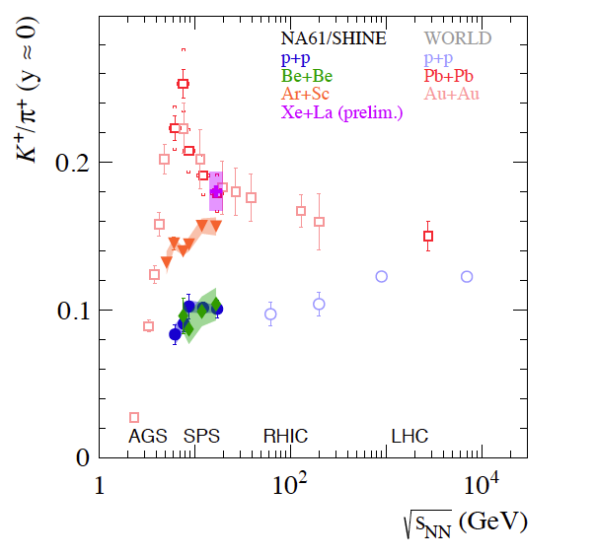
Some selected results from NA61/SHINE and RHIC BES: “horn”plots
NA61/SHINE
Energy dependence of Λ , ̄Λ, Ξ⁻ , and Ξ⁺ midrapidity yield ratio to that of pions (1.5 ( π⁺ + π⁻ )) in central Au+Au collisions from STAR BES, compared with the existing data from various other experiments (see in [2]).
Two explanations:
NA61/SHINE: Studying the properties of the onset of deconfinement[1].
Statistical hadron gas model (SHM) [3]:
is close to data[2] reflecting the evolution of the fireball composition at freeze-out as a function of energy. (Includes the threshold for strangeness production, determined in the model by the steep encrease of the temperature)
Energy dependence of the K⁺/π⁺ ratio
at mid-rapidity for central (10%)
Xe+La, Ar+Sc, Be+Be, Pb+Pb,
and Au+Au collisions [1]
[1] http://cds.cern.ch/record/2878507/files/SPSC-SR-336.pdf
[2] Chen, JH., Dong, X., He, XH. et al., “Properties of the QCD matter: review of selected results from the relativistic heavy ion collider beam energy scan (RHIC BES) program”. NUCL SCI TECH 35, 214 (2024). https://doi.org/10.1007/s41365-024-01591-2
[3] A. Andronic, P. Braun-Muniziger, Krzysztov Redlich & J. Stachel , Nature 561, 312 (2018); arXiv:1710.09425
Notes:
NA61/SHINE: The results on the energy dependence of the K+/π+ ratio (horn plot) from the 10% most
central Ar+Sc collisions are shown in Fig. 15 together with measurements in inelastic p+p,
central Be+Be, central Pb+Pb and central Au+Au collisions. A clear distinction between the
two data subsets is visible – p+p and Be+Be results show similar values and collision energy
dependence, while the heavy systems of Pb+Pb, Au+Au, and Ar+Sc show much higher
K+/π+ ratios.
STAR BES: hadron-string dynamics (HSD)) and statisti-
cal hadron gas model (SHM) [55, 76, 77]. The STAR BES
data are in good agreement with the trend displayed by the
existing experimental data. The hadronic models (UrQMD
1.3 and HSD) seem to reproduce the Λ∕𝜋 data, indicating
that hadronic rescatterings might play an important role in
hyperon production in heavy ion collisions
The steep variation of the K+/π+ and K−/π− ratios at the lowest
energies reflects the threshold for strangeness production, determined in the model by the steep
increase of the temperature.
On
the other hand, the SHM model predictions agree well with
data across the entire energy range from AGS to top RHIC.
The SHM model used here is based on a grand canonical
ensemble and assumes chemical equilibrium.

Slide 6
Some selected results from the energy scan (RHIC BES) program
A summary of the chemical freeze-out temperature Tch(B) distribution. Data points are from the 0–5% central Au+Au collisions at STAR BES (see referrnces in [1]).
Strong competition with HADES, NA61/SHINE,
STAR BES, and future JPARK-HI and CBM!
[1] Chen, JH., Dong, X., He, XH. et al. Properties of the QCD matter: review of selected results from the relativistic heavy ion collider beam energy scan (RHIC BES) program. NUCL SCI TECH 35, 214 (2024).
https://doi.org/10.1007/s41365-024-01591-2

Slide 7
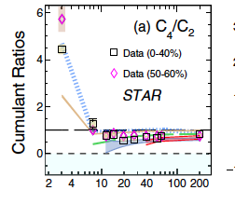
Some selected results from the energy scan (RHIC BES) program: a Hot topic!
Proton and net-proton High-Order Cumulants
DEFINITIONS of central moments and cumulants [1]
the proton multiplicity in a given event | N
the average over all events | <….>
Mean∶ | M = <N> =C₁,
Deviation, | δN =N − <N>
Variance | σ2 =<(δN)²>=C₂,
skewness | S =<(δN)³>/σ³ = =C₃/C₂^{3/2},
kurtosis | k=<(δN)⁴>/σ⁴ − 3 = =C₄/C₂²
Collision energy dependence of the ratios of cumulants C4/C2, for net proton (red circles) from 0%–40% and 50-60% Au + Au collisions at RHIC ( [2]).
.
Fluctuation of conserved quantities
were predicted to be sensitive near CEP
to the correlation length [3]
Can we do better with MPD@NICA?
[1] Xiaofeng Luo, Nu Xu, NUCL SCI TECH (2017) 28:112
DOI 10.1007/s41365-017-0257-0;
[2] B.E.Aboona et al. *STAR Collaboration), “Beam Energy Dependence of Fifth- and Sixth-Order Net-Proton Number Fluctuations in Au+Au Collisions at RHIC”, Phys. Rev. Lett. 130, 082301,(2023) https://doi.org/10.1103/PhysRevLett.130.082301
[3] C. Athanasiou, K. Rajagopal, M. Stephanov, Phys. Rev. Lett. 102, 032301 (2009).doi:10.1103/PhysRevD.82.074008
Notes:
S.Ejiri, : We discuss the properties of hadronic fluctuations, i.e. fluctuations of net quark and isospin numbers as well as electric charge, in the vicinity of the QCD transition in isospin-symmetric matter at vanishing quark chemical potential. We analyse second- and fourth-order cumulants of these fluctuations and argue that the ratio of quartic and quadratic cumulants reflects the relevant degrees of freedom that carry the quark number, isospin or charge, respectively. In the hadronic phase we find that an enhancement of charge fluctuations arises from contributions of doubly charged hadrons to the thermodynamics. The rapid suppression of fluctuations seen in the high-temperature phase suggests that in the QGP, net quark number and electric charge are predominantly carried by quasi-particles, with the quantum numbers of quarks
S. Ejiri, F. Karsch, and K. Redlich, Phys. Lett. B 633, 275 (2006).
In physics, the susceptibility of a material or substance describes its response to an applied field. More general, a susceptibility is a quantification for the change of an extensive property under variation of an intensive property

Slide 8
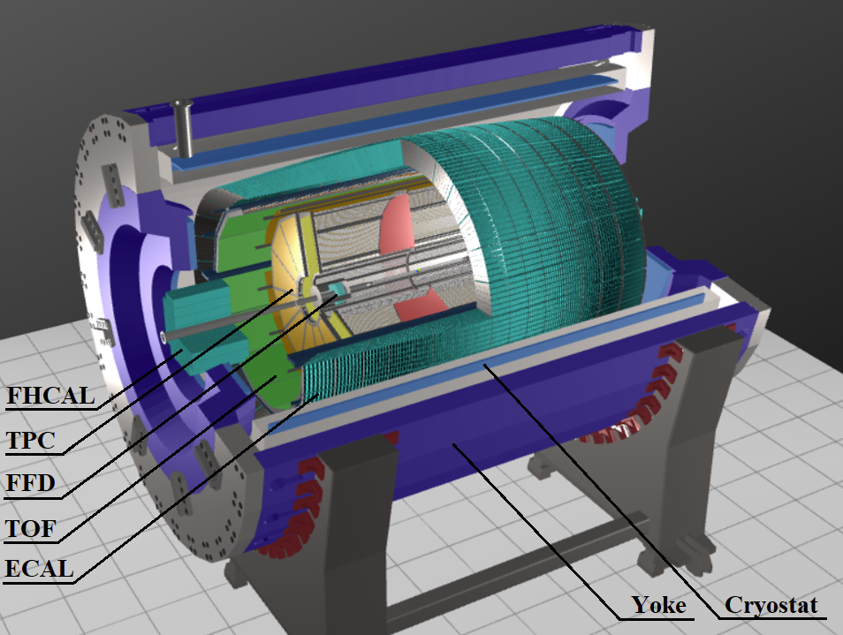
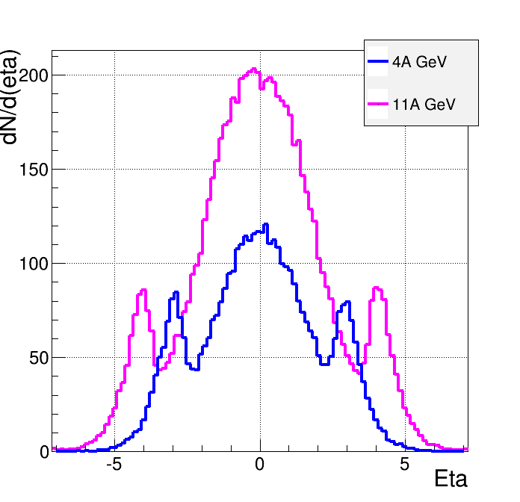
Multi-Purpose Detector (MPD) at the 1st stage of operation[1]
Strong competition with HADES, NA61/SHINE, STAR BES, and CBM!
Model simulations
URQMD
charged
b<11 fm
dN/dη
TPC
ECal
CPC
TOF
FFD
[1] MPD Collaboration, ”MPD physics performance studies
in Bi+Bi collisions at √1sNN = 9.2 GeV”, to be published
FHCal
MPD -- a 4π spectrometer for detecting charged hadrons, electrons
and photons in A+A collisions at high luminosity. FXT and colliding modes
Wide rapidity coverage, excellent PID capabilities
Tracking at midrapidity (TPC)
ToF, FFD, ECal and FHCal
Beams expected at Stage-1:
Xe+Xe/Bi+Bi at √s_{NN=}9.02 GeV
Or in the fixed target mode:
Xe/Bi +W at √s_{NN=}3.0 GeV
η
Notes:
The MPD will be put in operation at two stages. At the first one the barrel part will be equipped with major tracking detector TPC, TOF end ECAL. FHC and FD will be operational as well.
At the second stage the detector will be supplemented with IT and end cap subdetectors.

Slide 9
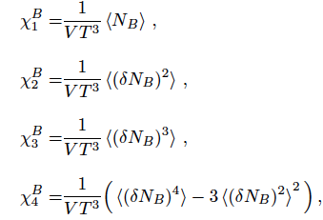
Some selected results from the energy scan (RHIC BES) program: a Hot topic!
Proton and net-proton High-Order Cumulants
DEFINITIONS of central moments and cumulants [1]
the proton multiplicity in a given event | N
the average over all events | <….>
Mean∶ | M = <N> =C₁,
Deviation, | δN =N − <N>
Variance | σ2 =<(δN)²>=C₂,
skewness | S =<(δN)³>/σ³ = =C₃/C₂^{3/2},
kurtosis | k=<(δN)⁴>/σ⁴ − 3 = =C₄/C₂²
baryon number N_{B} distribution can be measured via the net proton distribution
〈· · ·〉 -- the ensemble average
δN_{B} =N_{B} −〈N_{B} 〉
Ratios of the cumulants are used
to reduce volume dependence:
C₂/C₁=σ²/M, C₃/C₂.=Sσ, and C₄/C₂ =κσ².
Susceptibility ratios:
σ²/M =χ₂/χ₁, Sσ = χ₃/χ₂, κσ² = χ₄/χ₂
Cons to use δN =N − <N>:
Volume dependence of baryon number susceptibilities
δN =N − <N>brings an added weight to outliers that are far from the mean.
The 2nd,3rd or the 3rd power of δN can skew the data.
Corrections procedures [1-3] for the Bin width effect–are they feasible
when V is also a strongly fluctuating quantity from event-to-event?
More precise selection of central event class is needed in the MPD analysis!
The system-size scan is missing at RHIC – it is a competitive advantage for MPD!
[1] -Xiaofeng Luo (STAR Collab.) , Probing the QCD Critical Point with Higher Moments of Net-proton Multiplicity Distributions, arXiv:1106.2926v1,J. Phys.: Conf. Ser. 316, 012003 (2011),
DOI:https://doi.org/10.1088/1742-6596/316/1/012003; Skokov, 1205.4756v2.pdf arXiv:1205.4756:;
[2] S. Ejiri, F. Karsch, and K. Redlich, Hadronic fluctuations at the QCD phase transition,Phys. Lett. B 633, 275 (2006).
[3] W. J. Fu, X. Luo, J. M. Pawlowski, F. Rennecke, R. Wen, and S. Yin, Hyper-order baryon number fluctuations at finite temperature and density , Phys. Rev. D 104, 094047 (2021).
Notes:
S.Ejiri, : We discuss the properties of hadronic fluctuations, i.e. fluctuations of net quark and isospin numbers as well as electric charge, in the vicinity of the QCD transition in isospin-symmetric matter at vanishing quark chemical potential. We analyse second- and fourth-order cumulants of these fluctuations and argue that the ratio of quartic and quadratic cumulants reflects the relevant degrees of freedom that carry the quark number, isospin or charge, respectively. In the hadronic phase we find that an enhancement of charge fluctuations arises from contributions of doubly charged hadrons to the thermodynamics. The rapid suppression of fluctuations seen in the high-temperature phase suggests that in the QGP, net quark number and electric charge are predominantly carried by quasi-particles, with the quantum numbers of quarks
S. Ejiri, F. Karsch, and K. Redlich, Phys. Lett. B 633, 275 (2006).
In physics, the susceptibility of a material or substance describes its response to an applied field. More general, a susceptibility is a quantification for the change of an extensive property under variation of an intensive property

Slide 10
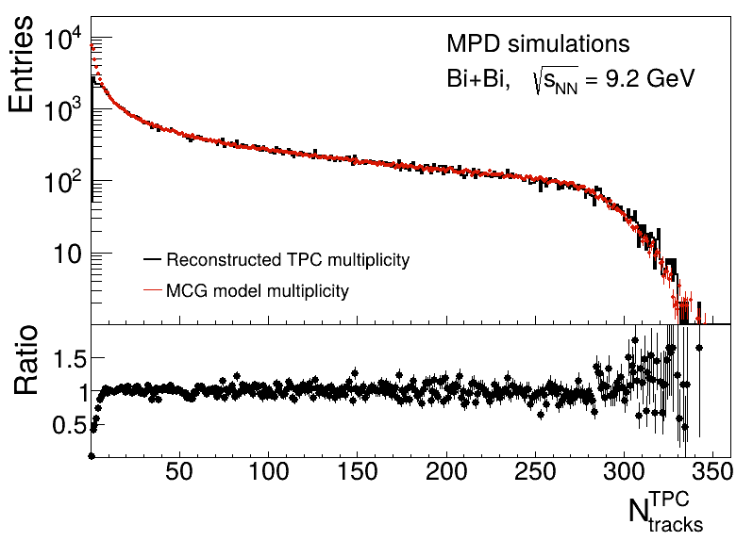
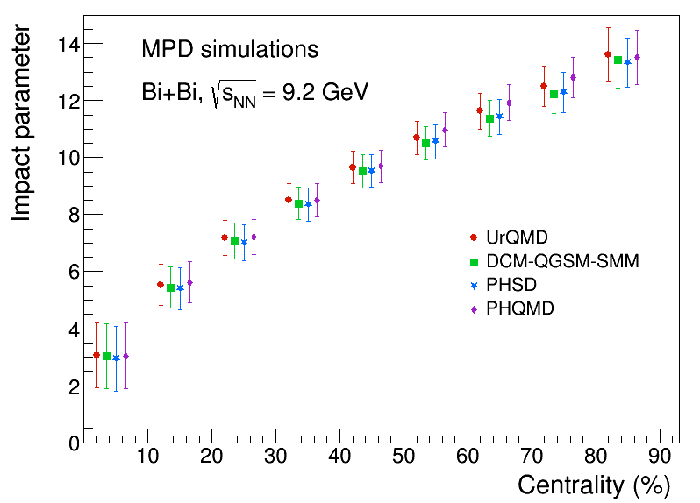
MPD physics performance study: centrality
The value of the impact parameter for 10% centrality intervals estimated for Bi+Bi collisions at √ s_{NN} = 9.2 GeV, modeled with the UrQMD, PHSD, DCM-QGSM-SMM, and PHQMD event generators [1]
The reconstructed TPC (black) and MCG modeled (red) multiplicity distributions for Bi+Bi collisions
at √s_{NN} = 9.2 GeV [1]
Why the geometrical term “centrality” is so important?
--- We need the accurate knowledge of the energy density in the interaction region in any given event selected
The width of the class of centrality of A+A collisions is directly related to the unavoidable volume fluctuations [2]
[1] MPD Collaboration^ ”MPD physics performance studies in Bi+Bi collisions at √1sNN = 9.2 GeV”, to be published
[2] T. A. Drozhzhova,V. N. Kovalenko,A. Yu. Seryakov,G. A. Feofilov, Physics of Atomic Nuclei, 2016, V 79, Issue 5, pp 737–748

Slide 11
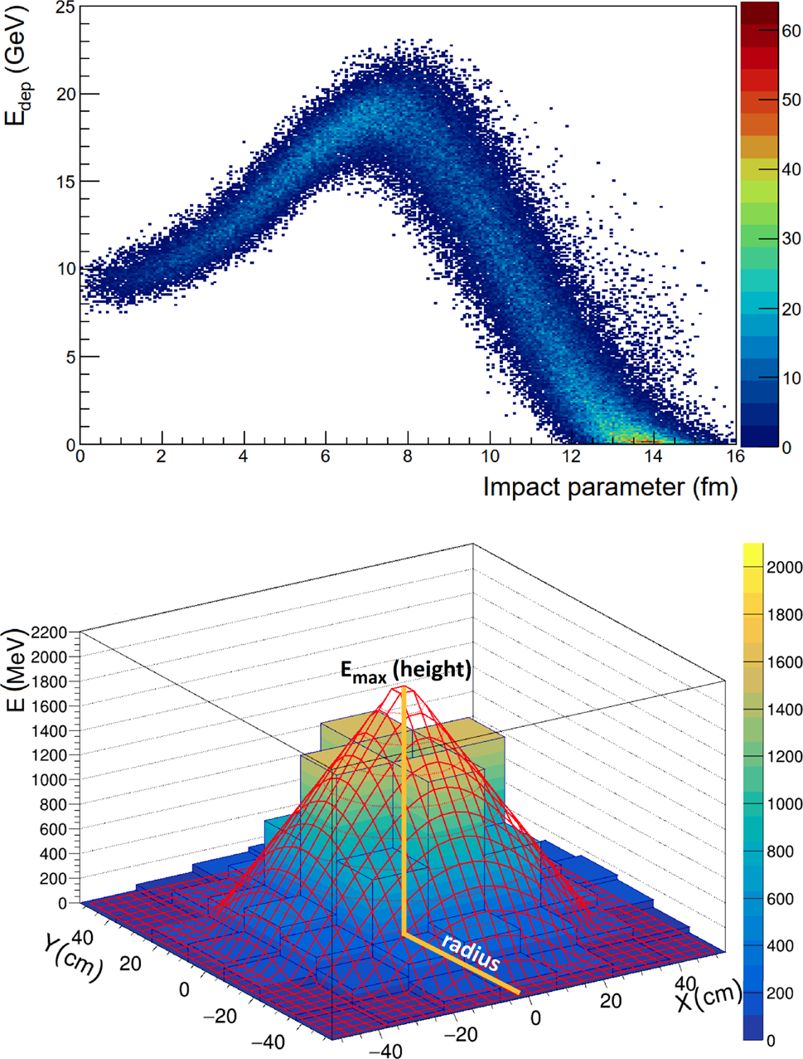
MPD physics performance study: centrality using Hadron Calorimeter to measure the energy of spectator fragments [1]
(Top) Dependence of the energy deposition in the FHCal on the
MC-generated impact parameter for events, simulated with the DCMQGSM
ragmentation model. [1]
(Bottom) The two-dimensional linear fit (line mesh) of example single-event energy distribution in the FHCal
modules (histogram) [1]
The comparison of results for
Au+Au and Bi+Bi collisions at
√ sNN = 7.7 GeV for UrQMD events[1]
[1] The MPD Collaboration, Status and initial physics performance studies of the MPD
experiment at NICA, Eur. Phys. J. A (2022) 58:140, https://doi.org/10.1140/epja/s10050-022-00750-6

Slide 12
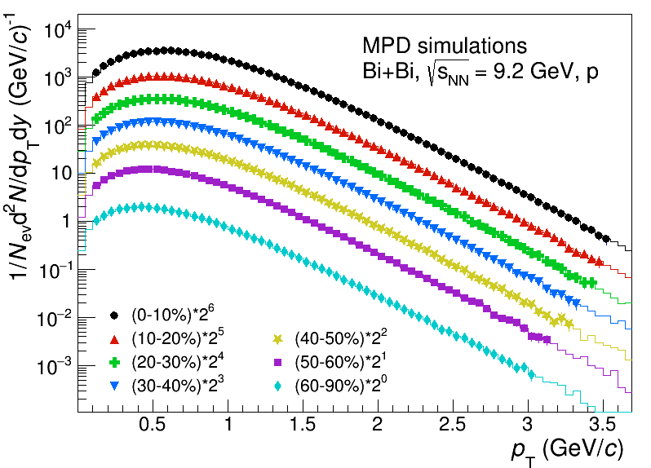
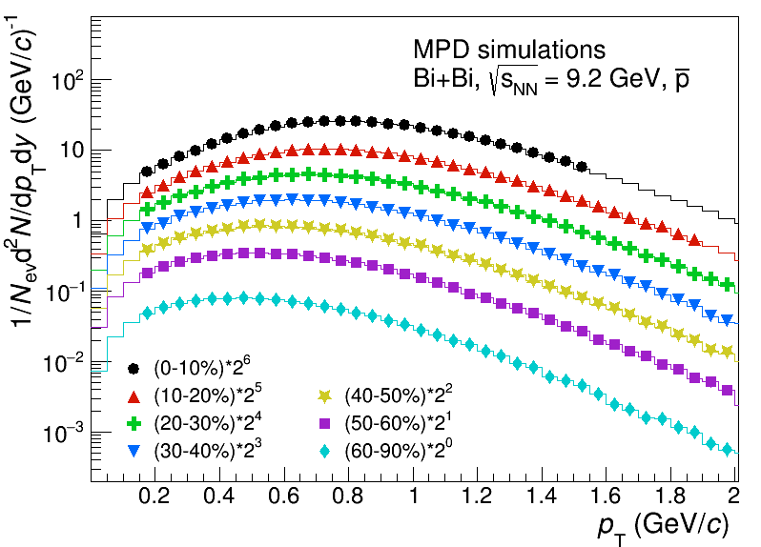
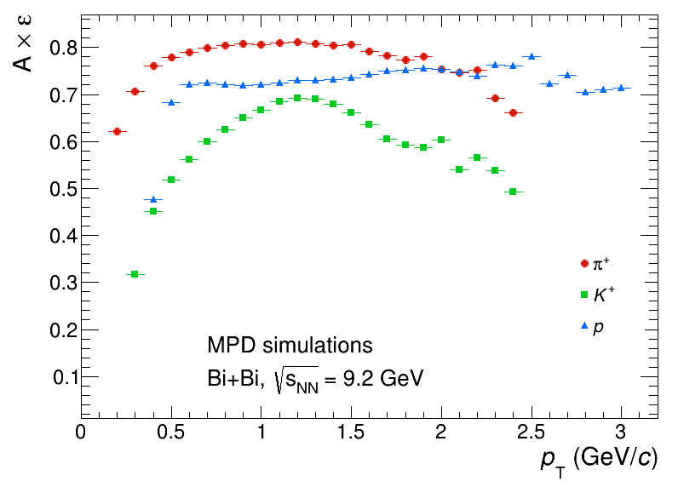
MPD physics performance study: reconstruction of protons and anti-protons
The reconstructed (markers) and generated (histograms) transverse momentum spectra for p and anti-p for midcentral (|y| < 0.5) Bi+Bi collisions at √s_{NN} = 9.2 GeV in different centrality intervals.
.
The overall efficiency for positively
charged hadrons as a function of p_{T} [1]
Different techniques are available for PID hadron measurements
Spectra were obtained (limited in pT) to have a purity of > 95%
Measurements with contamination corrections span over a wider pT range
Important to study the proton and net-proton High-Order Cumulants !
[1] MPD Collaboration, ”MPD physics performance studies in Bi+Bi collisions at √1sNN = 9.2 GeV”, to be published

Slide 13
MPD physics performance study: direct photons in MPD at NICA
Experimental measurements of direct photons in A+A collisions at LHC (2.76-5 TeV), at RHIC (52-200 GeV and WA98 (17.2 GeV) at SPS . No measurements at NICA energies
Reconstruction of the direct photons in MPD at NICA[1]: either in electromagnetic calorimeter (ECAL) or by Photon Conversion Method (PCM)
Prompt and thermal photons[2]
Measurements will provide constraints on proton and nuclear PDFs, signal about QGP formation through thermal photon excess, possible hints for CEP in the QCD phase diagram
Thermal direct photons excess at the top NICA energy (√sNN = 11 GeV) is expected on the level of 5% in 0-10% centrality [2]
Unique measurements at NICA energy range
Inclusive photon reconstruction efficiency in the ECAL and PCM method
as a function of photon pT (Left) and of rapidity (Right), (see in [1]).
[1] MPD Collaboration^ ”MPD physics performance studies in Bi+Bi collisions at √1sNN = 9.2 GeV”, to be published
[2] D. Blau and D. Peresunko, Direct Photon Production in Heavy-Ion Collisions: Theory and Experiment, Particles 6 (2023) 173, 10.3390/particles6010009
Notes:
Direct photons can be emitted either in hard processes involving partons of incoming nucleons (prompt direct photons) or as the thermal emission of hot quark or hadron matter (thermal direct photons).
Reconstruction of the direct photons in MPD at NICA[1]:
--- either in electromagnetic calorimeter (ECAL) or converted in the material of inner detectors and reconstructed as a pair of e+e− tracks in the tracking system. --Photon Conversion Method (PCM).
Photons in theMPD can be reconstructed in two ways, ei1432
ther in electromagnetic calorimeter (ECAL) or converted in
1433 the material of inner detectors and reconstructed as a pair of
1434 e+e− tracks in the tracking system.

Slide 14
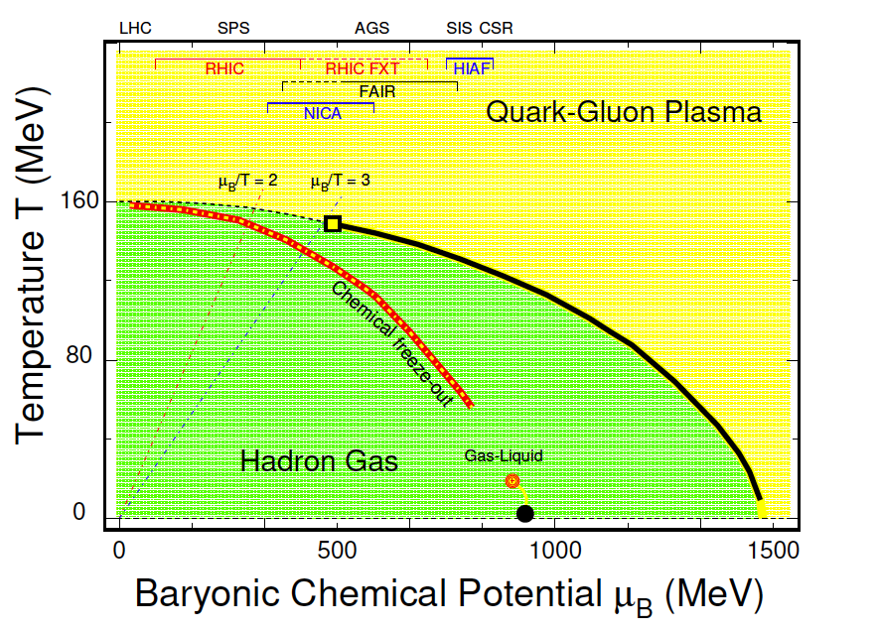
MPD physics performance study: short-lived resonances at NICA
To study properties of the hadronic phase (between the chemical and kinetic freeze-out)
Short-lived resonances are sensitive to the properties of the medium produced in heavy-ion collisions (including the lifetime)
FIGURE 18. The invariant mass distributions for K+K− (left) and π°Λ (right) pairs accumulated for the same and the mixed events in Bi+Bi collision at √sNN = 9.2 GeV.
[ ]
Notes:
Measurements of resonance properties in heavy-ion collisions
at √sNN = 7.7−5020 GeV revealed that production of resonances with lifetimes τ < 20 fm/c is suppressed in ce tral collisions, while production of longer-lived resonances like ϕ (1020) remains almost unchanged

Slide 15
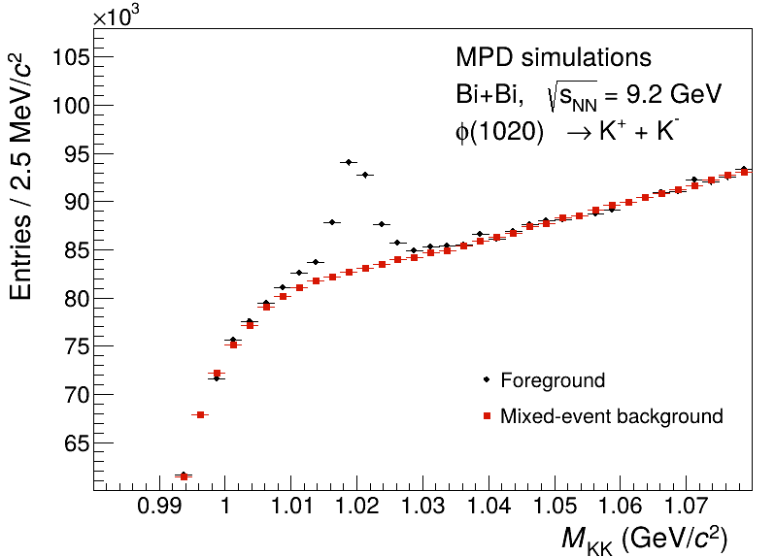
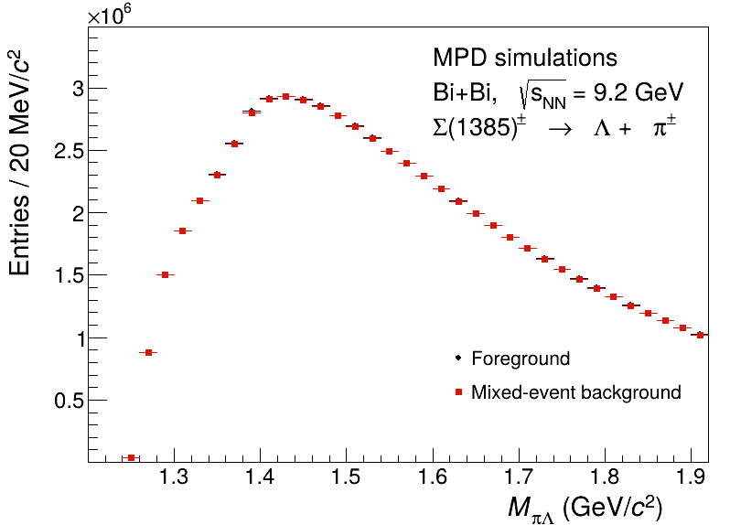
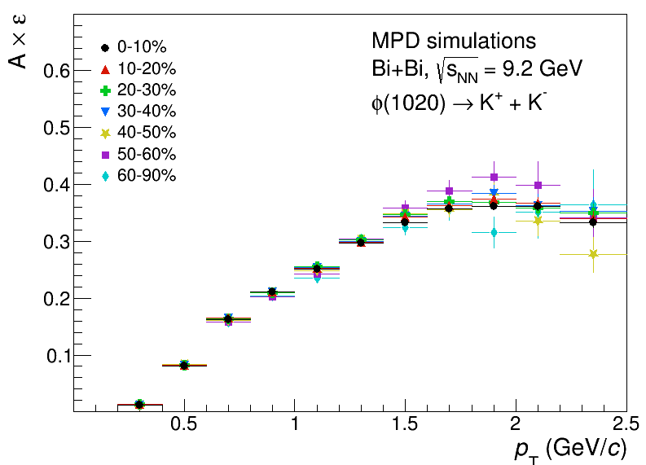
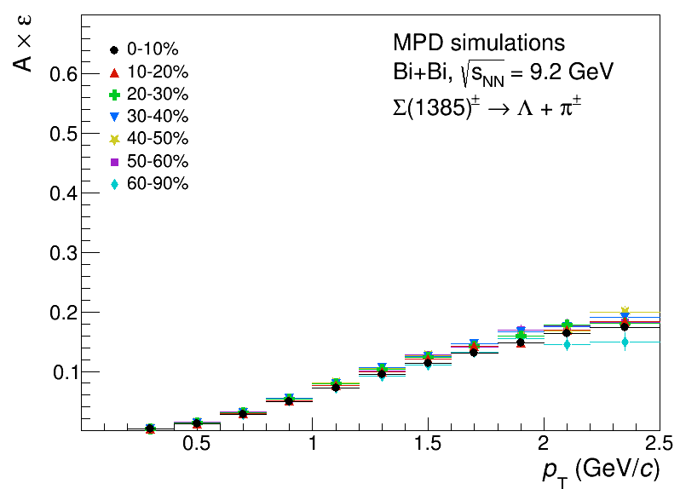
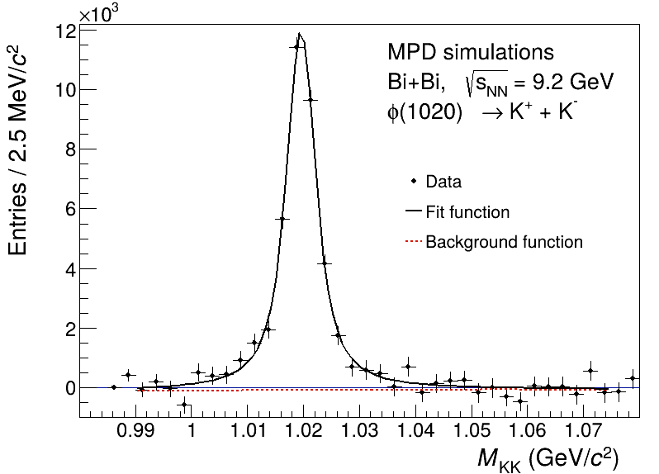
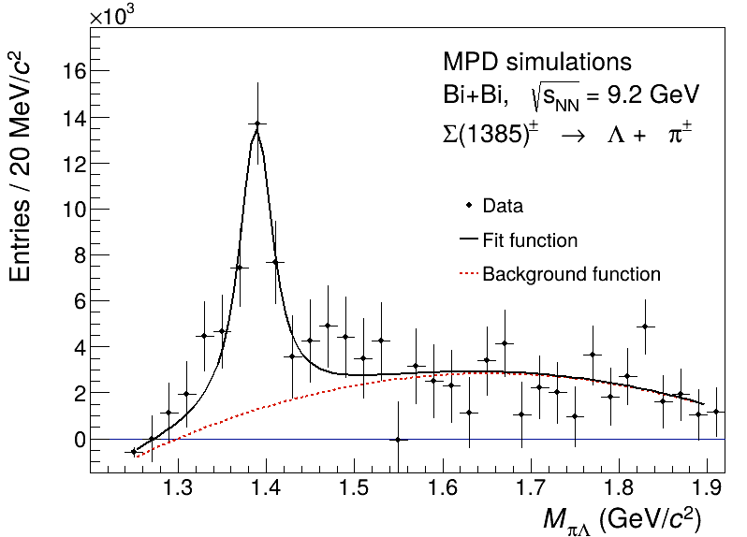
MPD physics performance study: short-lived resonances at NICA --example
The invariant mass distributions for K+K− (left) and π°Λ (right) pairs accumulated
for the same and the mixed events in Bi+Bi collision at √sNN = 9.2 GeV. [1]
Reconstruction efficiencies evaluated for ϕ(1020) and Σ(1385) resonances as a function of transverse momentum
in different centrality Bi+Bi collisions at √sNN = 9.2 GeV [1]
The bottom panels show the distributions after subtraction of the mixed-event background [1].
/
[1] MPD Collaboration, ”MPD physics performance studies in Bi+Bi collisions at √1sNN = 9.2 GeV”, to be published
Notes:
Measurements of resonance properties in heavy-ion collisions
at √sNN = 7.7−5020 GeV revealed that production of resonances with lifetimes τ < 20 fm/c is suppressed in ce tral collisions, while production of longer-lived resonances like ϕ (1020) remains almost unchanged

Slide 16
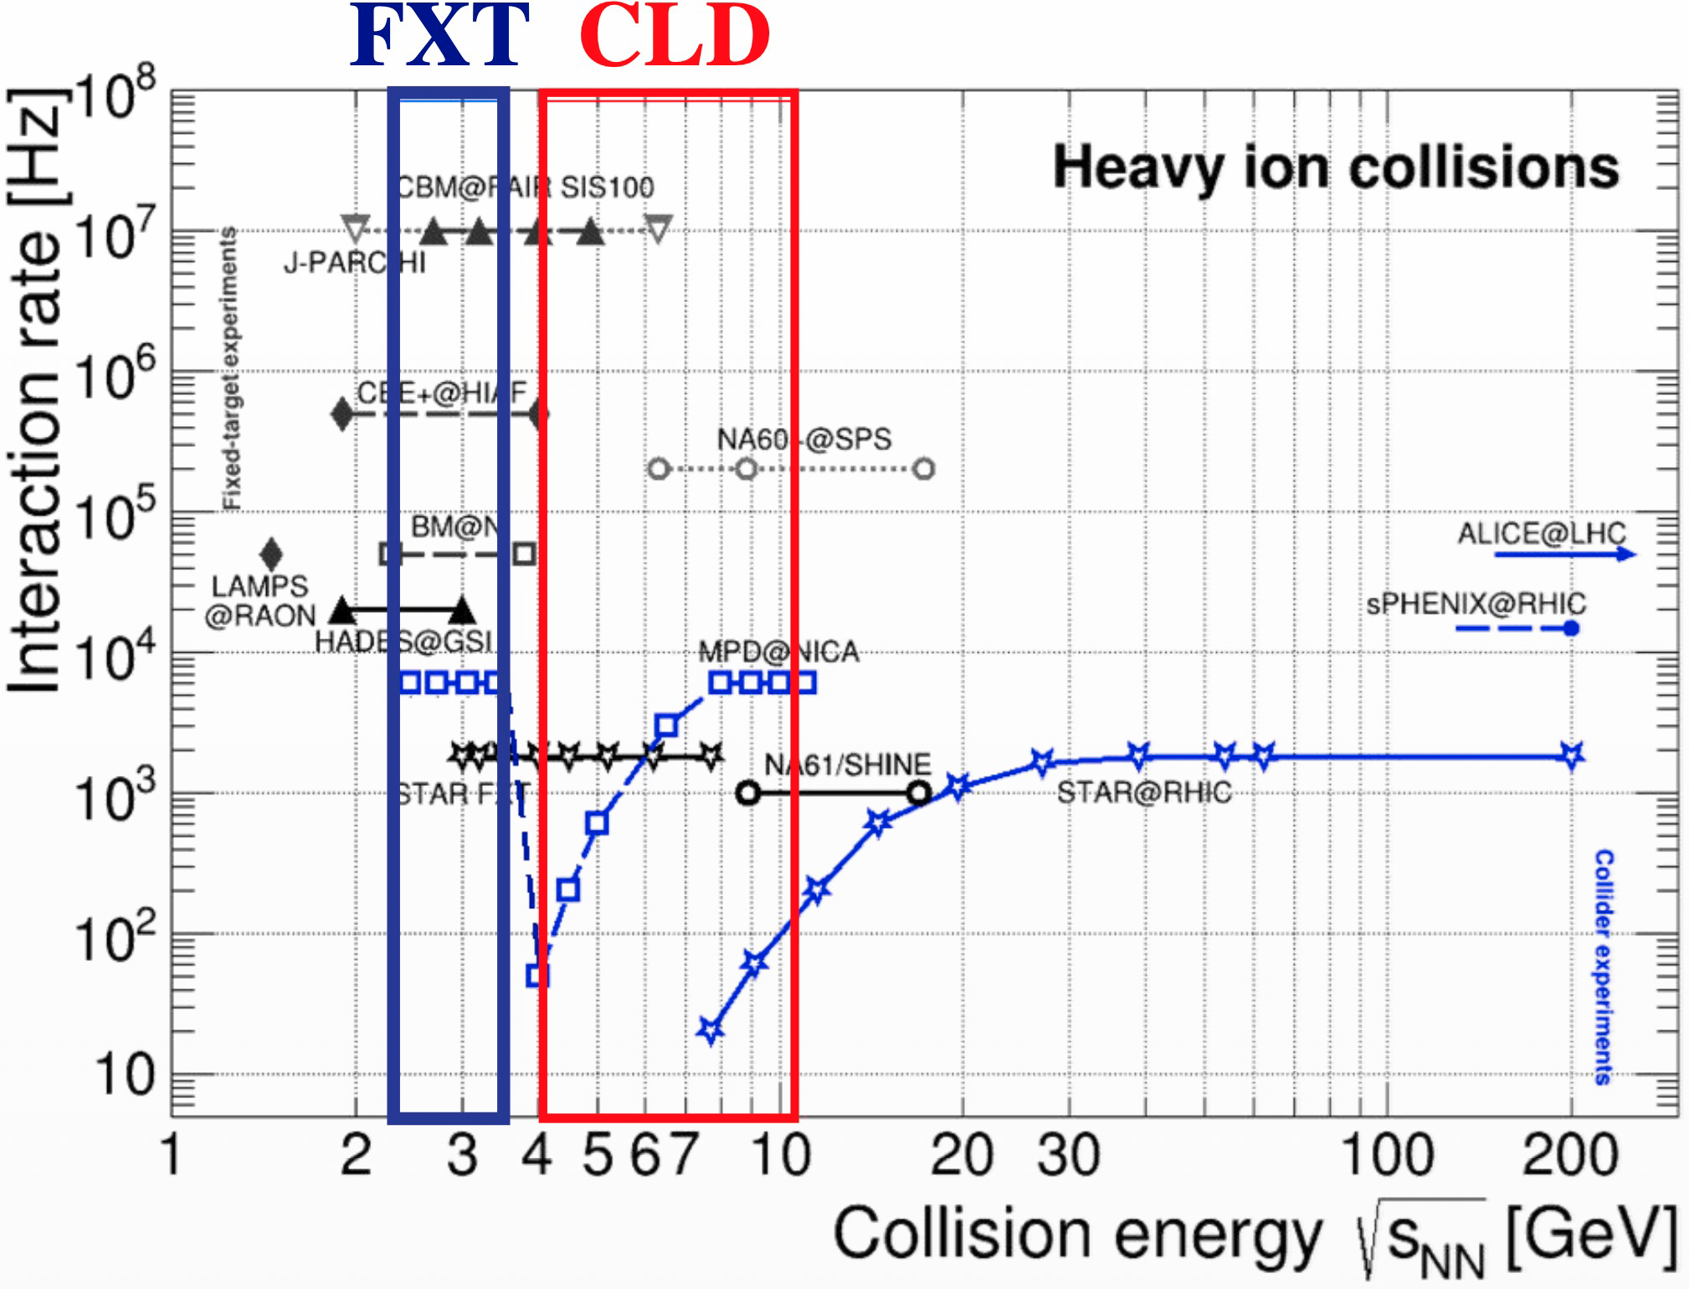
Summary
MPD at NICA is in final state of preparation towards first physics studies planned with the MPD experiment at NICA in Bi+Bi collisions at √ s_{NN} = 9.2 GeV
Two different operation options are being considered: collider and fixed-target modes.
Beams expected at Stage-1: Xe+Xe/Bi+Bi at √s_{NN=}9.02 GeV, or Xe/Bi +W at √s_{NN=}3.0 GeV-- in the fixed target mode.
Methods and techniques are in preparations for analysis of the first MPD data
Strong competition with HADES, NA61/SHINE, STAR BES, and CBM!
With closing of HI program at RHIC , delay of CBM plans and some uncertainties for NA61 -- NICA should become a flagship facility in the field, resolve remaining mysteries left after analysis of existing data ta RHIC

Slide 17
Back-up slides

Slide 18
Layout of this talk
Introduction. From LHC and RHIC to lower energies. QCD phase diagram and CEP
Some selected results in CEP search by NA61/SHINE at SPS and BES at RHIC
Can we do better with MPD experiment at NICA? Few examples of physics
feasibility studies in Bi+Bi collisions at √ sNN = 9.2 GeV.
MPD setup
Proton and net-proton High-Order Cumulants
Centrality
Reconstruction of protons and anti-protons
Direct photons
Short-lived resonances
Summary

Slide 19
MC Glauber calculations Pb+Pb 2.76 TeV [4]
For the class of selected events, the mean volume V and temperature T are supposed to be the same [1] – as obtained after the procedure of averaging over the class bin width and corrections applied [2]
But narrow class in multiplicity, e.g. of 1% width,
does not mean narrow distribution neither in b [3] nor in Npart[4]
This will skew distribution of N_{B}
[1] W. J. Fu, X. Luo, J. M. Pawlowski, F. Rennecke, R. Wen, and S. Yin, Hyper-order baryon number fluctuations at finite temperature and density Phys. Rev. D 104, 094047 (2021).
[2] Bin width effect -Xiaofeng Luo (STAR Collab.) , Probing the QCD Critical Point with Higher Moments of Net-proton Multiplicity Distributions, arXiv:1106.2926v1,J. Phys.: Conf. Ser. 316, 012003 (2011), DOI: https://doi.org/10.1088/1742-6596/316/1/012003
[3] see Fig.44 in the paoer:The MPD Collaboration, Status and initial physics performance studies of the MPD
experiment at NICA, Eur. Phys. J. A (2022) 58:140, https://doi.org/10.1140/epja/s10050-022-00750-6
[4] T. A. Drozhzhova,V. N. Kovalenko,A. Yu. Seryakov,G. A. Feofilov, Physics of Atomic Nuclei, September 2016, Volume 79, Issue 5, pp 737–748

Slide 20
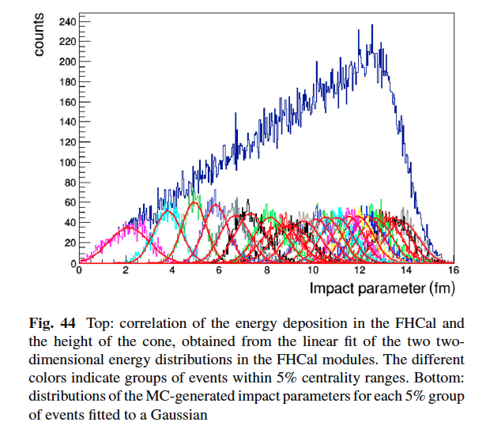
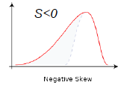
Cons of using
=c₂
i
Cons:
Added weight to outliers:
Outliers are the numbers far from the mean.
Squaring these numbers gives them more weight,
which can skew the data
---”Therefore, we conclude that fluctuations of conserved charges in heavy ion collisions can provide robust probes of the chiral phase boundary if a good control of volume fluctuations can be achieved.!”[1]
[1] V.Skokov,arXiv:1205.4756;
[2] Xiaofeng Luo, Ji Xu, Bedangadas Mohanty, Nu Xu, arXiv:1302.2332
.

Slide 21
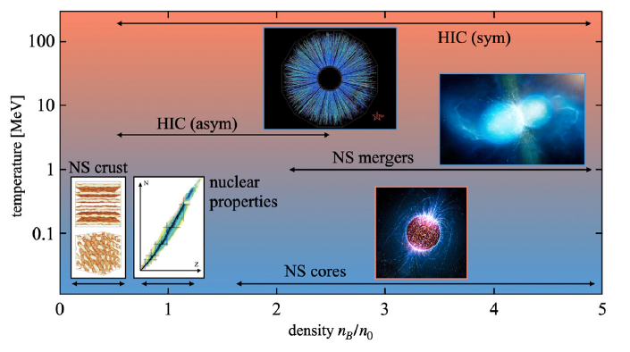
Introduction: Heavy-ion collisions and nuclear matter EOS [1]
Astronomical observations are sensitive to EoS of nuclear matter [1].
HI experiment: control the properties of matter produced by varying the beam energy, collision geometry, and also the isotopic composition of the target and projectile
To probe the nuclear matter under new conditions of wide ranges of baryon density
)
[1] A.Sorensen et al., “Dense nuclear matter equation of state from heavy-ion collisions”, Progress in Particle and Nuclear Physics. Volume 134, January 2024, 104080
Notes:
relevant progress in the description of the EoS,
both for the isospin-symmetric matter and
and for the isospin-asymmetric matter,
the so called symmetry energy

Slide 22
Can we do better with MPD experiment at NICA? Few examples of physics feasibility studies in Bi+Bi collisions at √ sNN = 9.2 GeV. MPD goals of physics research[1]: (1) QCD Phase diagram and search for CEP and (2) Equation of state at high baryon densities
Section 5 in [1]: Physics feasibility studies
5.1 Centrality determination
5.2 Bulk properties: hadron spectra, yields and ratios
5.3 Hyperon reconstruction
5.3.1 Λ, and Ξ⁻ reconstruction
5.3.2 Ξ⁺ and Ω∓ reconstruction
5.4 Reconstruction of resonances
5.5 Electromagnetic probes
5.6 Anisotropic flow
5.7 Event-by-event net-proton and net-kaon studies
[1] The MPD Collaboration, Status and initial physics performance studies of the MPD
experiment at NICA, Eur. Phys. J. A (2022) 58:140, https://doi.org/10.1140/epja/s10050-022-00750-6

Slide 23
.
.

Slide 24
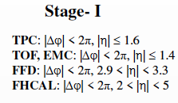
klk
.

